Slide 1
Git for Azure DevOps Developers

Slide 2
Welcome!
Introductions
Quick Agenda Review
Class Logistics:
Hours: 8:30-4:30 AST
Lunch & Breaks
Teaming for Success / How to Communicate
All questions encouraged
Realtime feedback is great
Chat / raise hand features
Class Materials
Will be emailed to you directly for local use.
Class Surveys

Slide 3
Table of Contents
1. Getting Started with Collaboration
2. Understanding the GitHub Flow
3. Branching with Git
4. Local Git Configuration
5. Working Locally with Git
6. Collaborating on Your Code
7. Merging Pull Requests
8. Viewing Local Project History
9. Streaming Your Workflow with Aliases
10. Workflow Review Project:
11. Resolving Merge Conflicts
12. Working with Multiple Conflicts

Slide 4
Table of Contents
13. Searching for Events in Your Code
14. Reverting Commits
15. Helpful Git Commands
16. Viewing Local Changes
17. Creating a New Local Repository
18. Fixing Commit Mistakes
19. Rewriting History with Git Reset
20. Getting it Back
21. Merge Strategies: Rebase
23. Complex Workflows

Slide 5
1. Getting Started with Collaboration

Slide 6
What is Git?
Git is a free and open source distributed code management and Version control system that is distributed under the GNU General Public License version 2.
In addition to software version control, Git is used for other applications including configuration management and content management.
Notes:
Git is a DevOps tool used for source code management. It is a free and open-source version control system used to handle small to very large projects efficiently. Git is used to tracking changes in the source code, enabling multiple developers to work together on non-linear development.
Distributed version control systems such as Git give each developer his or her own copy of the project's history, a clone of a repository. This is what makes Git fast: nearly all operations are performed locally, and are flexible: you can set up repositories in many ways. Repositories meant for developing also provide a separate working area (or a worktree) with project files for each developer. The branching model used by Git enables cheap local branching and flexible branch publishing, allowing you to use branches for context switching and for sandboxing different works in progress (making possible, among other things, a very flexible topic branch workflow).
The fact that the whole history is accessible allows for long-term undo, rewinding back to last working version, and so on. Tracking ownership of changes automatically makes it possible to find out who was responsible for any given area of code, and when each change was done. You can compare different revisions, go back to the revision a user is sending a bug report against, and even automatically find out which revision introduced a regression bug. The fact that Git is tracking changes to the tips of branches with reflog allows for easy undo and recovery.
A unique feature of Git is that it enables explicit access to the staging area for creating commits (new revisions of a project). This brings additional flexibility to managing your working area and deciding on the shape of a future commit.
All this flexibility and power comes at a cost. It is not easy to master using Git, even though it is quite easy to learn its basic use. This course will help you attain this expertise, but let's start with a reminder about basics with Git.
* Demostrate git, give git cheat sheet, talk about different was to work with git (git tortoise for windows, git bash, where can you download git)

Slide 7

What is GitHub?
People use GitHub to build some of the most advanced technologies in the world.
Whether you’re visualizing data or building a new game, there’s a whole community and set of tools on GitHub that can help you do it even better.
GitHub is a collaboration platform that uses Git for versioning. GitHub is a popular place to share and contribute to open-source software.
Notes:
GitHub is a web-based platform designed to facilitate software development and version control using Git, a distributed version control system. It provides a collaborative environment where developers and teams can work together on code, track changes, manage projects, and share work publicly or privately. GitHub is widely used in the software development industry, open-source projects, and even non-coding tasks requiring version control.
Key Features of GitHub
Git Repository Hosting:
GitHub hosts Git repositories, which contain the files, folders, and history of a project's development.
Developers can clone repositories, work on code locally, and push changes back to GitHub.
Version Control:
GitHub allows tracking changes in code over time.
Developers can view commit histories, compare versions, and revert to previous states if needed.
Collaboration:
GitHub enables teams to collaborate on code with features like pull requests, code reviews, and comments.
Branching and merging allow developers to work on separate features or fixes without affecting the main codebase.
Issue Tracking:
GitHub provides an integrated issue tracker for reporting and discussing bugs, feature requests, and tasks.
Labels, milestones, and assignees help organize and prioritize work.
Project Management:
Built-in tools like Projects (Kanban boards) and Actions (automation workflows) streamline project management directly within the repository.
Continuous Integration/Continuous Deployment (CI/CD):
GitHub Actions allow developers to automate workflows for building, testing, and deploying code.
Open Source Hosting:
GitHub is a popular platform for open-source projects, providing visibility and collaboration opportunities.
Projects can be hosted publicly, allowing others to contribute, fork, and use the code.
Community and Social Features:
Users can star, fork, and follow repositories.
GitHub's social coding environment fosters networking and community building.
Documentation and Wikis:
GitHub supports Markdown for writing README files, documentation, and project details.
Wikis provide a structured way to document projects in detail.
Code Security and Analysis:
Features like Dependabot, secret scanning, and code scanning help identify vulnerabilities and secure projects.
GitHub Pages:
Allows hosting of static websites directly from a repository.
Integration with Other Tools:
GitHub integrates with numerous third-party tools and services, such as Slack, Trello, and IDEs.
How GitHub Works
Repository (Repo):
A repository is a project's central location. It contains all project files, commit history, and branches.
Repositories can be public (visible to everyone) or private (restricted to specific users or teams).
Branches:
Branches allow developers to work on different parts of a project independently.
The main branch (usually main or master) is the default branch where the stable version of the project resides.
Commits:
A commit is a snapshot of changes made to the codebase.
Each commit has a unique hash, message, and metadata.
Pull Requests:
A pull request (PR) is a request to merge changes from one branch into another.
Developers use PRs for code reviews and discussions before merging changes.
Forking and Cloning:
Forking: Creating a personal copy of someone else's repository.
Cloning: Downloading a local copy of a repository to work on it offline.
Collaboration via Git:
Developers push changes to GitHub repositories and pull updates from them to stay in sync with teammates.
Real-World Use Cases for GitHub
Software Development:
Managing code for applications, libraries, and tools in both public and private repositories.
Open Source Contributions:
Collaborating on popular open-source projects like Linux, TensorFlow, or React.
Documentation:
Hosting project documentation and wikis for easier sharing and collaboration.
Learning and Sharing:
Using GitHub to host tutorials, coding exercises, and personal projects.
Project Management:
Utilizing GitHub's built-in issue tracker, project boards, and GitHub Actions to manage workflows
GitHub for Individuals and Organizations
Individual Developers:
Showcase personal projects and portfolios.
Collaborate on open-source projects.
Organizations:
Manage codebases for commercial applications.
Collaborate across teams with advanced access controls and integrations.
Key Terms
Git: A distributed version control system for tracking changes in source code.
Repository: A storage location for code and its version history.
Pull Request: A method to propose changes to a codebase.
Issue: A way to track tasks, enhancements, and bugs.
GitHub Pages: A feature for hosting static websites from repositories.
Actions: Automation workflows for CI/CD.
Why GitHub?
Ease of Use:
Intuitive UI for managing repositories and collaborating on code.
Community:
Millions of developers and organizations use GitHub, making it a hub for coding collaboration.
Free and Paid Plans:
Offers free repositories for individuals and teams, with paid plans for additional features.
GitHub is not just a platform for hosting code; it's a collaborative ecosystem that supports every stage of the software development lifecycle.
4o

Slide 8
Exploring a GitHub Repository
A repository is the most basic element of GitHub, They're easiest to imagine as a project's folder.
A repository contains all of the project files (including documentation), and stores each file's revision history.
Repositories can have multiple collaborators and can be either public or private.
Notes:
A repository is a project containing files and folders. A repository tracks versions of files and folders.
A branch is a parallel version of your repository. By default, your repository has one branch named main and it is considered to be the definitive branch. You can create additional branches off of main in your repository. You can use branches to have different versions of a project at one time.
A repository (often abbreviated as "repo") in GitHub is a storage space where you can manage the codebase and related files for a project. It acts as a version-controlled workspace, allowing developers to collaborate, track changes, and organize their work. A repository is at the core of Git and GitHub's functionality.
Key Features of a Repository
Code Storage:
A repository stores your project's files, including source code, configuration files, and documentation.
Version Control:
Every change to the files in a repository is tracked as a commit. This allows you to see the history of changes, revert to earlier versions, and collaborate efficiently.
Branches:
A repository can contain multiple branches, enabling developers to work on features, fixes, or experiments in isolation before merging them into the main branch.
Collaboration:
Repositories support collaboration by allowing multiple users to contribute, review, and manage code changes through pull requests and code reviews.
Issue Tracking:
GitHub repositories include tools for reporting and tracking bugs, feature requests, and other project-related tasks.
Documentation:
Repositories often include documentation, such as README files or wikis, to describe the project and guide contributors.
Integration:
Repositories can integrate with tools like CI/CD pipelines, project management tools, and automation workflows.

Slide 9
Comparison of Git vs GitHub
Aspect | Git | GitHub
Definition | A distributed version control system. | A web-based platform for hosting Git repositories.
Functionality | Tracks changes, manages versions, and branches. | Adds collaboration, hosting, and community features.
Installation | Installed on a local machine. | Accessed via a web browser (no installation needed).
Collaboration | Supports local collaboration through Git. | Enables online collaboration with teams.
Platform | Command-line based tool. | GUI-based online tool (with CLI integration).
Storage | Local repository on your computer. | Remote repositories stored in the cloud.
Usage | For version control of code locally or remotely. | To share and collaborate on Git repositories.
Integration | Works with any hosting platform (e.g., GitHub, GitLab). | Tightly integrated with Git, provides additional services.
Access Control | Local file permissions. | Role-based permissions for collaborators.
Community | No social features. | Social features like stars, forks, and followers.
Notes:
The difference between Git and GitHub lies in their purpose and functionality, although they complement each other.
How Git and GitHub Work Together
Git is the tool you use locally to manage and track changes in your project.
GitHub is the platform where you push your local Git repository to share it with others, collaborate, and manage your project online.
Key Takeaways
Git is essential for version control and is used locally.
GitHub is a platform that enhances Git's functionality by providing hosting, collaboration, and additional features.
You can use Git without GitHub (e.g., with GitLab, Bitbucket, or locally).
You cannot use GitHub without Git, as it relies on Git for version control.
Together, Git and GitHub form a powerful system for managing and collaborating on software projects.

Slide 10
2. Understanding Git Flow

Slide 11
The Essential Git Workflow
Git flow is a lightweight, branch-based workflow.
The Git flow is useful for everyone, not just developers.
For example, at Git, we use Git flow for our site policy, documentation, and roadmap.
Notes:
Git Flow is a structured branching model designed for managing development and release processes in complex projects with well-defined release cycles. It was introduced by Vincent Driessen in 2010 and is widely used in large projects where multiple release branches are needed.
Key characteristics:
Main branches:
Main (or master): Holds the production-ready code.
Develop: Used as the main branch for development, integrating changes before they are ready to go into production.
Supporting branches:
Feature branches: Created off the develop branch, where new features are developed. They are merged back into develop after completion.
Release branches: Created from develop when it’s time for a release. Allows for final testing and bug fixes before merging into main and tagging the release.
Hotfix branches: Created from main to quickly address urgent issues in production and then merged back into both main and develop.
Use case: Suitable for projects with structured, scheduled releases and long-lived development processes (e.g., enterprise software development). Git Flow's structure adds complexity but helps manage parallel development, testing, and release processes.

Slide 12
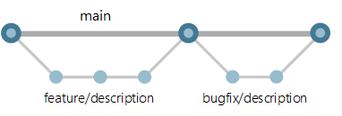
Git Flow in Azure DevOps
Using Git Flow with Azure DevOps involves implementing the structured Git Flow branching model within the Azure DevOps environment. This combination is beneficial for managing complex projects, ensuring stable release cycles, and enabling collaboration among development teams.
Notes:
Git Flow in Azure DevOps is a structured branching model designed to manage the development lifecycle of projects, ensuring stability, parallel development, and effective collaboration. It combines Git Flow’s principles with Azure DevOps' tools, such as Azure Repos, Pipelines, Boards, and Pull Requests, to streamline source code management and delivery.
Here’s a detailed breakdown of how Git Flow is applied when using Azure DevOps:
1. Key Branches in Git Flow with Azure DevOps
Main (Production) Branch:
Represents the stable, production-ready code.
Only release and hotfix branches are merged into main.
Protected branch with policies requiring pull requests, successful builds, and approvals.
Develop Branch:
Represents the latest working code that integrates completed features.
Features and release branches are merged into develop.
Used for continuous integration (CI) pipelines to test all changes before they’re released.
Feature Branches:
Created from develop for new features or enhancements.
Merged back into develop after development and testing via pull requests.
Release Branches:
Created from develop when preparing for a release.
Used for final testing, bug fixing, and versioning before merging into both main and develop.
Hotfix Branches:
Created from main to address critical issues in production.
Merged back into both main and develop to ensure fixes are included in ongoing development.

Slide 13
Git Flow in Azure DevOps
Workflow Steps in Azure DevOps
Feature Development:
Create feature branches from develop.
Complete work and merge back through pull requests.
Release Preparation:
Create a release branch from develop for testing.
Finalize and merge into both main and develop.
Hotfixes:
Create a hotfix branch from main for urgent production fixes.
Merge back into both main and develop after testing.
Notes:
Main Steps in the Git Flow Process with Azure DevOps
Step 1: Setting Up the Repository and Branches
Main Branch: Set up the main branch as the stable branch in Azure DevOps, representing production-ready code.
Develop Branch: Create a develop branch from main. This branch will be used as the primary branch for integrating completed features.
Step 2: Creating Feature Branches
Create a Feature Branch: For each new feature, create a separate branch off of the develop branch, naming it after the feature or task (e.g., feature/login-authentication).
In Azure DevOps, use the Branches section to create a new branch from develop.
Develop the Feature: Make changes within the feature branch and commit as needed.
Pull Requests: When the feature is ready, submit a pull request in Azure DevOps to merge the feature branch into develop. Use reviewers and code policies to ensure quality.
Merge and Delete: Once reviewed and approved, merge the feature branch into develop and delete the feature branch to keep the repository clean.
Step 3: Creating Release Branches
Prepare for a Release: When it’s time for a release, create a release branch from develop (e.g., release/v1.0).
This branch is used for final testing, bug fixes, and preparation for deployment.
Apply Final Adjustments: Test the code and apply final adjustments, such as version number updates.
Review and Approve: Use pull requests in Azure DevOps for any changes made in the release branch, allowing team members to review adjustments.
Merge into Main and Develop: After final approval, merge the release branch into both main and develop:
Main: To deploy the new release.
Develop: To keep develop updated with the latest release state.
Tag the Release: Tag the commit on main to mark the release version (e.g., v1.0). Azure DevOps can use this tag for deployments and tracking.
Step 4: Hotfix Branches
Create a Hotfix Branch: If an urgent issue is found in production, create a hotfix branch from main (e.g., hotfix/critical-fix).
Apply and Test Fixes: Make the necessary changes and test them thoroughly.
Merge into Main and Develop: Once reviewed, merge the hotfix branch into both main and develop to ensure that the hotfix is reflected in the ongoing development.
Tag and Deploy: Tag the commit on main to record the hotfix version and deploy the changes

Slide 14
Git Flow in Azure DevOps
Branch Policies in Azure DevOps
Pull Requests: Require for all merges to main and develop.
Code Reviewers: Assign mandatory reviewers for quality control.
Build Validation: Set up automated builds before merging.
Status Checks: Enforce linting and testing.
Notes:
Setting up Branch Policies in Azure DevOps
To enforce Git Flow practices, Azure DevOps allows you to configure branch policies for main and develop, such as:
Require Pull Requests: Enforce pull requests for merging changes into main and develop.
Code Reviewers: Specify mandatory code reviewers for pull requests to ensure quality control.
Build Validation: Require successful builds before changes can be merged to main or develop.
Status Checks: Configure status checks, such as linting and testing, to run before allowing merges.

Slide 15
Git Flow in Azure DevOps
CI/CD Pipelines in Azure DevOps
Continuous Integration: Automatically build and test develop and feature branches.
Continuous Deployment: Deploy from main to production.
Release Pipelines: Deploy release branches to staging environments.
Notes:
Managing the Workflow with Azure DevOps Pipelines (automation)
Continuous Integration (CI): Set up Azure Pipelines for continuous integration to automatically build and test changes in develop and feature branches.
Continuous Deployment (CD): Configure Azure Pipelines for continuous deployment to production when new commits are pushed to main, allowing for smooth, automated releases.
Release Pipelines: Define release pipelines for more complex deployment strategies. For instance, you can set up pipelines to deploy the release branch to a staging environment and deploy main to production.

Slide 16
Git Flow in Azure DevOps
Benefits of Git Flow with Azure DevOps
Structured Branch Management: Clear workflows for feature, release, and hotfix branches.
Quality Assurance: Ensures code review, testing, and build validation.
Scalability: Supports parallel development by multiple team members.
Automated Deployment: Integrated CI/CD pipelines for efficient releases.
Notes:
Visualizing and Monitoring Git Flow in Azure DevOps
Azure DevOps provides visualizations for your branches and pull requests, making it easy to track:
Active Branches: View all active branches, including feature, release, and hotfix branches.
Pull Request Status: Check the status of pull requests and whether they meet branch policies.
Tag History: See tagged commits, which represent specific releases and hotfixes.
Benefits of Using Git Flow in Azure DevOps
Structure and Consistency: Clearly defined branches make it easy to track the lifecycle of each feature, release, and hotfix.
Quality Control: Azure DevOps' branch policies and pull requests help ensure that only reviewed and tested code is integrated into production.
Scalability: Git Flow with Azure DevOps supports multiple developers working on parallel features, releases, and hotfixes.
Automated CI/CD: By integrating Git Flow with Azure DevOps Pipelines, teams can streamline continuous integration and delivery processes.
In summary, using Git Flow in Azure DevOps combines the structured, organized workflow of Git Flow with Azure DevOps' collaborative and CI/CD features, enabling reliable development and streamlined releases for complex projects.

Slide 17
4. Local Git Configuration

Slide 18
Working locally in Git
Working locally with Git involves setting up and managing a
Git repository on your computer to handle version control for
your projects. This process allows you to develop, test, and
commit changes offline, syncing with remote repositories
only when needed.
Notes:
Setting Up Git Locally
Install Git
Download and install Git for your operating system:
Git for Windows
Git for macOS
Git for Linux
Initial Git Configuration
After installation, configure Git with your username and email to associate commits with your identity:
git config --global user.name "Your Name"
git config --global user.email "your.email@example.com"
Optionally, configure a default editor (e.g., VS Code):
bash
Copy code
git config --global core.editor "code --wait"

Slide 19
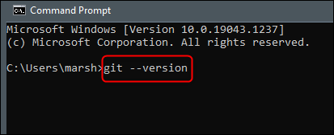
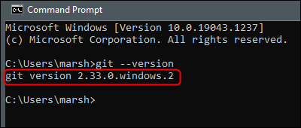
Checking your Git version
Once open, run this command:
git --version
Notes:
The command to check which version of Git you’re using is the same on both Windows and Mac. To check your Git version, open Command Prompt (Windows), Terminal (Mac), or the Linux terminal.

Slide 20
Git Configuration Levels
In Git different layers that can be configured. The layers are:
SYSTEM: This layer is system-wide and found in /etc/gitconfig
GLOBAL: This layer is global for the user and found in ~/.gitconfig
LOCAL: This layer is local to the current repository and found in .git/config

Slide 21
Viewing your configurations
You can use:
git config –list
or look at your ~/.gitconfig file. The local configuration will be in your repository's .git/config file.
Use:
git config --list --show-origin
to see where that setting is defined (global, user, repo, etc...)

Slide 22
Configuring your username and email
# Create a project specific config, you have to execute this under the project's directory.
$ git config user.name "John Doe"
$ git config --global user.name "John Doe"
$ git config --global user.email johndoe@example.com

Slide 23
Working Locally

Slide 24
Git Fundamentals - Working Locally
In this lesson, we will dive deep into some of the fundamentals of Git.
It’s essential to understand well how Git thinks about files.
Its way of tracking the history of commits, and all the basic commands that we need to master, in order to become proficient.
Notes:
I slightly changed my approach in explaining how Git works; instead of explaining with words and figures, this time
I want to show you how Git works internally with only the help of the shell, allowing you to follow all the steps on your computer and hoping that these will be clear enough for you to understand.

Slide 25
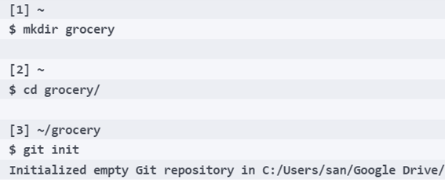
Git objects
Let's create a new repository to refresh our memory and then start learning a little bit more about Git.
In this example, we use Git to track our shopping list before going to the grocery; so, create a new grocery folder, and then initialize a new Git repository:

Slide 26
Git objects
As we have already seen before, the result of the git init command is the creation of a .git folder, where Git stores all the files it needs to manage our repository:
[4] ~/grocery (master)
$ ll
total 8
drwxr-xr-x 1 san 1049089 0 Aug 17 11:11 ./
drwxr-xr-x 1 san 1049089 0 Aug 17 11:11 ../
drwxr-xr-x 1 san 1049089 0 Aug 17 11:11 .git/
Notes:
So, we can move this grocery folder wherever we want, and no data will be lost. Another important thing to highlight is that we don't need any server: we can create a repository locally and work with it whenever we want, even with no LAN or internet connection. We only need them if we want to share our repository with someone else, directly or using a central server. In fact, during this example, we won't use any remote server, as it is not necessary.

Slide 27
Git objects
Go on and create a new README.md file to remember the purpose of this repository:
[5] ~/grocery (master)
$ echo "My shopping list repository" > README.md
Then add a banana to the shopping list:
[6] ~/grocery (master)
$ echo "banana" > shoppingList.txt

Slide 28
Git objects
At this point, as you already know, before doing a commit, we have to add files to the staging area; add both the files using the shortcut git add :
[7] ~/grocery (master)
$ git add .
With this trick (the dot after the git add command), you can add all the new or modified files in one shot.
Notes:
First of all, take a look at the second line, where Git says something like root commit; this means this is the first commit of your repository, and this is like a root in a tree (or a root on a disk partition; maybe you nerds will understand this better). Later we will come back to this concept.
Then, Git shows a message that says: "You didn't set a global username and email; I used ones I found configured in your system, but if you don't like it, you can go back and remake your commit with another pair of data".
I prefer not to set up a global username and password in Git, as I usually work on different repositories using different usernames and emails; if I don't pay attention, I end up doing a job commit with my hobby profile or vice versa, and this is annoying. So, I prefer setting up usernames and emails per repository; in Git, you can set up your config variables at three levels: repository (with the --local option, the default one), user (with the --global option), and system-wide (with the --system option). Later we will learn something more about configuration, but this is what you need for now to go on with.

Slide 29
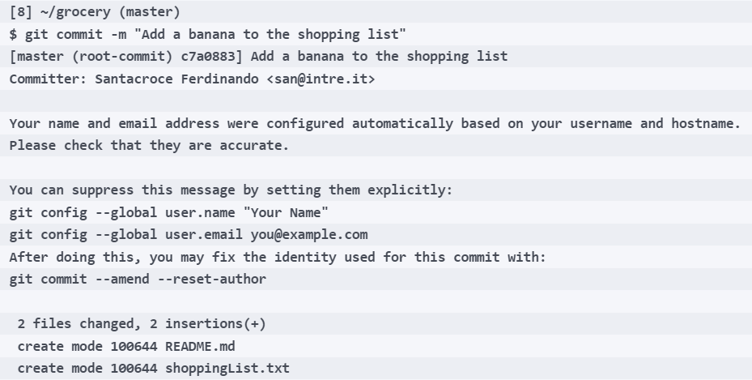
Git objects
So, let's change these settings and amend our commit:
Notes:
Amending a commit is a way to redo the last commit and fix up some little mistakes, such as adding a forgotten file, changing the message or the author
As I didn't specify the config level, these parameters will be set at repository level (the same as --local); from now on, all the commits I will do in this repository will be signed by "Ferdinando Santacroce", with the ferdinando.santacroce@gmail.com email (now you know how to get in touch with me, just in case).
Now it's time to type this command, git commit --amend --reset-author. When amending a commit this way, Git opens the default editor to let you change even the commit message, if you like; as we have seen in lesson 1, Getting Started with Git, in Windows the default editor is Vim.

Slide 30
Git objects
For the purpose of this exercise, please leave the message as it is, press Esc, and then input the :wq (or :x) command and press Enter to save and exit:
[9] ~/grocery (master)
$ git config user.name "Ferdinando Santacroce"
[10] ~/grocery (master)
$ git config user.email ferdinando.santacroce@gmail.com
Notes:
Okay, now I have a commit with the right author and email.

Slide 31
Git objects
Now it's time to start investigating commits.
To verify the commit we have just created, we can use the git log command:
[12] ~/grocery (master)
$ git log
commit a57d783905e6a35032d9b0583f052fb42d5a1308
Author: Ferdinando Santacroce <ferdinando.santacroce@gmail.com>
Date: Thu Aug 17 13:51:33 2017 +0200
Add a banana to the shopping list
Notes:
As you can see, git log shows the commit we did in this repository; git log shows all the commits, in reverse chronological order; we have only a commit for now, but next we will see this behavior in action.
The hash
It is now time to analyze the information provided. The first line contains the commit's SHA-1 (https://en.wikipedia.org/wiki/SHA-1), an alphanumeric sequence of 40 characters representing a hexadecimal number. This code, or hash, as it is usually called, uniquely identifies the commit within the repository, and it's thanks to it that from now on we can refer to it doing some actions.
The author and the commit creation date
We already talked about authors just a couple of paragraphs before; the author is who performed the commit, and the date is the full date when the commit was generated. Since that instance, this commit is part of the repository.

Slide 32
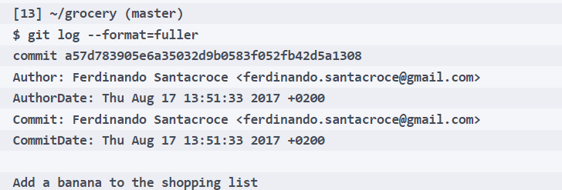
Git objects
Just under the author and date, after a blank line, we can see the message we attached to the commit we made; even the message is part of the commit itself but there's something more under the hood; let's try to use the git log command with the --format=fuller option:
Notes:
The committer and the committing date
Other than the author, a commit preserves even the committer, and the committing date; what's the difference compared to author and author date? First of all, don't worry too much about this: 99% of commits in your repository will have the same values for the author and committer, and the same dates.
In some situations, such as the cherry-pick, you carry an existing commit on top of another branch, making a brand-new commit that applies the same changes of the previous. In this case, the author and author date will remain the same, while the committer and the committing date will be related to the person who performed this operation and the date they did it. Later we will get in touch with this useful Git command.

Slide 33
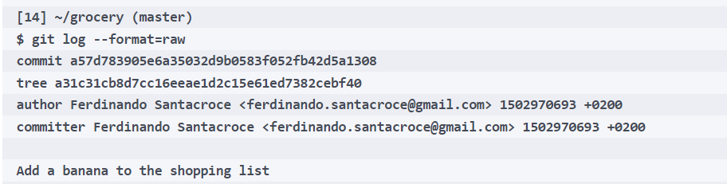
Git objects
We analyzed a commit, and the information supplied by a simple git log; but we are not yet satisfied, so go deeper and see what's inside.
Using the git log command again, we can enable x-ray vision using the --format=raw option:
Notes:
Going deeper
This time the output format is different; we can see the author and committer, as we saw before, but in a more compact form; then there is the commit message, but something new appears: it's a tree. Please be patient, we will talk about trees in a couple of paragraphs.
What I want to show now is another command, this time a little bit more obscure; it's git cat-file -p.
Let's try this command. To make it work, we need to specify the object we want to investigate; we can use the hash of the object, our first commit in this case. You don't need to specify the entire hash, but the first five-six characters are enough for small repositories. Git is smart enough to understand what's the object even with less than the 40 characters; the minimum is four characters, and the number increases as the total amount of Git objects in the repository increases. Just to give you an idea, the Linux kernel is currently 15 million lines of code, with millions of tracked files and folders; in that Git repository[1], you need to specify 12 characters to get the right object.
When in need, I usually try typing only the first five characters; if they are not sufficient to make Git aware of the object I need, it will warn me to input a character or two more.

Slide 34
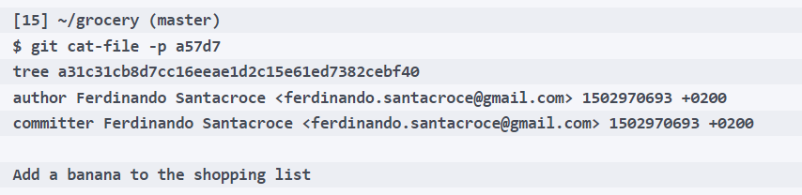
Git objects
Back on topic; type the command, specifying the first characters of the commit's hash (a57d7 in my case):
Notes:
Okay, as you can see, the output is the same of git log --format=raw.
This is not unusual in Git: there are different commands and options that end up doing the same thing; this is a common feature of Git, and it's due to its organic growth across the years. Git changed (and changes) continuously, so the developers have to guarantee some backward compatibility when introducing new commands; this is one of the side effects.
I introduced this command only to have the chance of introducing another peculiarity of Git, the separation between porcelain commands and plumbing commands.

Slide 35
Git objects
Porcelain commands and plumbing commands
Git, as we know, has a myriad of commands, some of which are practically never used by the average user; as by example, the previous git cat-file.
These commands are called plumbing commands, while those we have already learned about, such as git add, git commit, and so on, are among the so-called porcelain commands.
Notes:
The metaphor originates directly from the fervent imagination of Linus Torvalds, the dad of Git, and has to do with plumbers. They, as is well known, also take care of the maintenance of the toilets; here Linus refers to the toilet bowl. The bowl is a porcelain artifact, which makes us sit comfortably; using then a series of pipes and devices, it allows us a correct discharge of what you know down into the sewerage system.
Linus has used this refined metaphor to divide the Git commands into two families, the highest-level ones, comfortable for a user interested in the most common operations (porcelain) and those used internally by the same (but usable at the discretion of the more experienced users) to perform lower-level operations (plumbing).
We can, therefore, consider porcelain commands as interface commands to the user, while the plumbing works at a low level. This also means that porcelain commands stay more stable over time (usage patterns and options vary with more caution and delayed time), as they are used directly, but are also implemented in numerous graphic tools, editors, and so on, while plumbing generally evolves with less restrictions.
There is no precise subdivision between these two categories of commands, as the border is often quite lively; we will still use them, in order to better understand the internal functioning of Git.
Let's go back to the topic now; we were talking about Git objects.
Git uses four different types of objects, and commit is one of these. Then there are tree, blob, and annotated tag. Let's leave the annotated tags aside for a moment (whoever already uses a versioning system knows what tags are) and focus on blobs and trees.

Slide 36
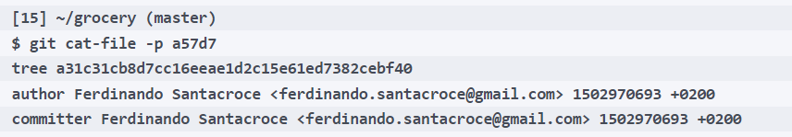
Git objects
Here, for convenience, there is the output of the git cat-file -p command typed before:
Notes:
As we can understand now, this plumbing command lets you peek into the Git objects; with the -p option (which means pretty-print here), we ask Git to show an easier way to read what the contents of the object are.
At this point, it's time to learn what a tree is in Git; in fact, in the command output, we can see this line: tree a31c31cb8d7cc16eeae1d2c15e61ed7382cebf40.
What does it mean? Let's see it together.

Slide 37
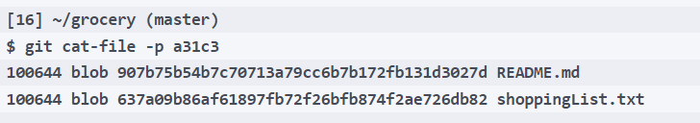
Trees
The tree is a container for blobs and other trees.
The easiest way to understand how it works is to think about folders in your operating system, which also collect files and other subfolders inside them.
Let's try to see what this additional Git object holds, using again the git cat-file -p command:
Notes:
This tree, which we said is something that Git uses to identify a folder, also contains some additional objects, called blobs.

Slide 38
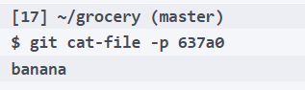
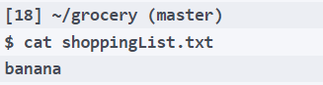
Blobs
Wow! Its content is exactly the content of our shoppingFile.txt file.
To confirm, we can use the cat command, which on *nix systems allows you to see the contents of a file:
As you can see, the result is the same.
Notes:
As you can see, at the right of the previous command output, we have README.md and shoppinglist.txt, which makes us guess that Git blobs represent the files. As before, we can verify its contents; let's see what's inside 637a0:

Slide 39
Blobs
Blobs are binary files, nothing more and nothing less.
These byte sequences, which cannot be interpreted with the naked eye, retain inside information belonging to any file, whether binary or textual, images, source code, archives, and so on.
Everything is compressed and transformed into a blob before archiving it into a Git repository.
Notes:
As already mentioned previously, each file is marked with a hash; this hash uniquely identifies the file within our repository, and it is thanks to this ID that Git can then retrieve it when needed, and detect any changes when the same file is altered (files with different content will have different hashes).
We said SHA-1 hashes are unique; but what does it mean?

Slide 40
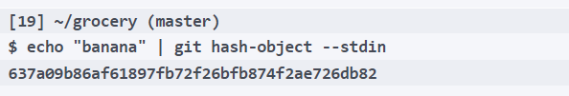
Blobs
Let's try to understand it better with an example.
Open a shell and try to play a bit with another plumbing command, git hash-object:
Notes:
The git hash-object command is the plumbing command to calculate the hash of any object; in this example, we used the --stdin option to pass as a command argument the result of the preceding command, echo "banana"; in a few words, we calculated the hash of the string "banana", and it came out 637a09b86af61897fb72f26bfb874f2ae726db82.
And on your computer, did you try it? What is the result?
A bit of suspense... That's incredible, it's the same!
You can try to rerun the command as many times as you want, the resulting hash will always be the same (if not, it can be due to different line endings in your operating system or shell).
This makes us understand something very important: an object, whatever it is, will always have the same hash in any repository, in any computer, on the face of the Earth.
The experienced and the smart ones probably had "smelt a rat" for some time now, but I hope that in the rest of the readers I have pulled up the same amazement that caught me when I did this for the first time. This behavior has some interesting implications, as we will see soon.
Last, but not least, I want to highlight how Git calculates the hash on the content of the file, not in the file itself; in fact, the 637a09b86af61897fb72f26bfb874f2ae726db82 hash calculated using git hash-object is the same as the blob we inspect previously using git cat-file -p. This teaches us an important lesson: if you have two different files with the same content, even if they have different names and paths, in Git you will end up having only one blob.

Slide 41
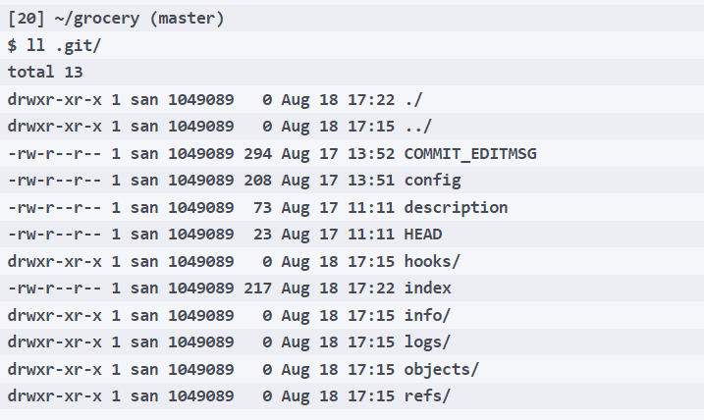
Even deeper - the Git storage object model
Do you remember the .git folder? Let's put our nose inside it:
Notes:
Okay, now we know there are different Git objects, and we can inspect inside them using some plumbing commands. But how and where does Git store them?

Slide 42
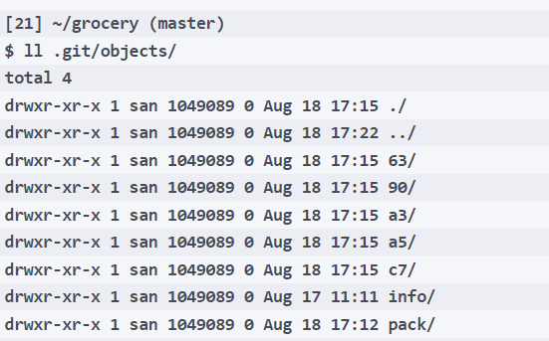
Even deeper - the Git storage object model
Within it, there is an objects subfolder; let's take a look:

Slide 43
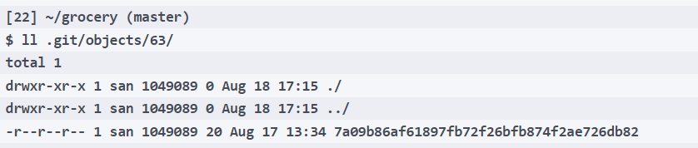
Even deeper - the Git storage object model
Other than info and pack folders, which are not interesting for us right now, as you can see there are some other folders with a strange two-character name; let's go inside the 63 folder:
Notes:
Hmmm...
Look at the file within it, and think: 63 + 7a09b86af61897fb72f26bfb874f2ae726db82 is actually the hash of our shoppingList.txt blob!
Git is amazingly smart and simple: to be quicker while searching through the filesystem, Git creates a set of folders where the name is two characters long, and those two characters represent the first two characters of a hash code; inside those folders, Git writes all the objects using as a name the other 38 characters of the hash, regardless of the kind of Git object.
So, the a31c31cb8d7cc16eeae1d2c15e61ed7382cebf40 tree is stored in the a3 folder, and the a57d783905e6a35032d9b0583f052fb42d5a1308 commit in the a5 one.
Isn't that the most clever and simple thing you have ever seen?
Now, if you try to inspect those files with a common cat command, you will be deluded: those files are plain text files, but Git compresses them using the zlib library to reserve space on your disk. This is why we use the git cat-file -p command, which decompresses them on the fly for us.
This highlights once again the simplicity of Git: no metadata, no internal databases, or useless complexity, but simple files and folders are enough to make it possible to manage any repository.
At this point, we know how Git stores objects, and where they are archived; we also know that there is no database, no central repository or stuff like that, so how is Git able to reconstruct the history of our repository? How can it define which commit precedes or follows another one?

Slide 44
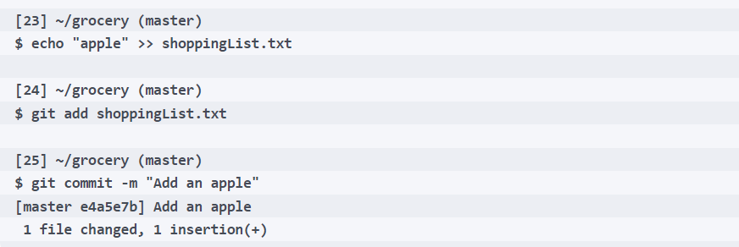
Even deeper - the Git storage object model
To become aware of this, we need a new commit. So, let's now proceed modifying the shoppingList.txt file:

Slide 45
Even deeper - the Git storage object model
Use the git log command to check the new commit; the --oneline option allows us to see the log in a more compact way:
[26] ~/grocery (master)
$ git log --oneline
e4a5e7b Add an apple
a57d783 Add a banana to the shopping list

Slide 46
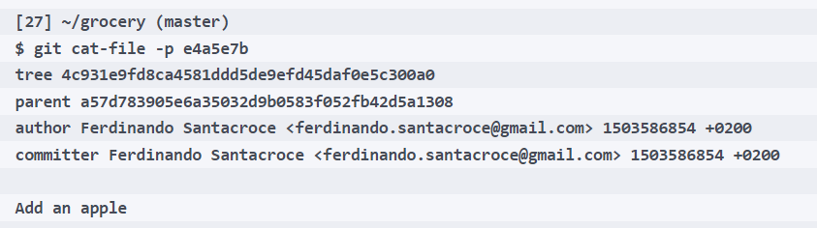
Even deeper - the Git storage object model
Okay, we have a new commit, with its hash.
Time to see what's inside it:
Notes:
There's something new!
I'm talking about the parent a57d783905e6a35032d9b0583f052fb42d5a1308 row; did you see? A parent of a commit is simply the commit that precedes it. In fact, the a57d783 hash is actually the hash of the first commit we made. So, every commit has a parent, and following these relations between commits, we can always navigate from a random one down to the first one, the already mentioned root commit.
If you remember, the first commit did not have a parent, and this is the main (and only) difference between all commits and the first one. Git, while navigating and reconstructing our repository, simply knows it is done when it finds a commit without a parent.

Slide 47
Git doesn't use deltas
In Git even if you change only a char in a big text file, it always stores a new version of the file.
Git doesn't do deltas (at least not in this case), and every commit is actually a snapshot of the entire repository.
At this point, people usually exclaim:
"Gosh, Git waste a large amount of disk space in vain!"
Well, this is simply untrue.
Notes:
Now it's time to investigate another well-known difference between Git and other versioning systems. Take Subversion as an example: when you do a new commit, Subversion creates a new numbered revision that only contains deltas between the previous one; this is a smart way to archive changes to files, especially among big text files, because if only a line of text changes, the size of the new commit will be much smaller.

Slide 48
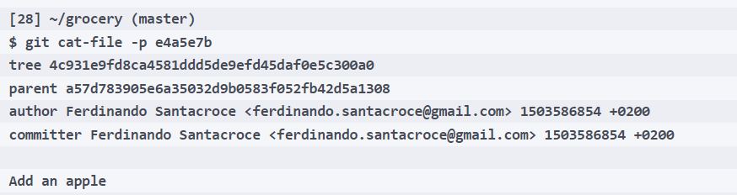
Git doesn't use deltas
Furthermore, Git has a clever way to deal with files; let's take a look again at the last commit:
Notes:
In a common source code repository, with a certain amount of commit, Git usually won't need more space than other versioning systems. As an example, when Mozilla went from Subversion to Git, the exact same repository went from 12GB to 420MB disk space required; look at this comparison page to learn more: https://git.wiki.kernel.org/index.php/GitSvnComparsion

Slide 49
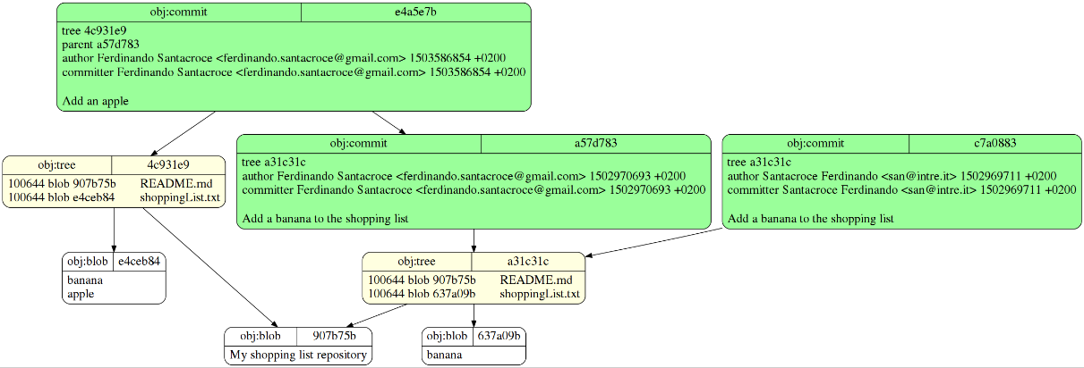
Wrapping up
Notes:
It's time to summarize all the concepts illustrated since now.
An image, as they say, is worth a thousand words, so here you can find a picture representing the actual state of our repository, thanks to the git-draw tool (https://github.com/sensorflo/git-draw):
This image illustrates the structure of Git objects (commits, trees, and blobs) and how they relate to each other in a Git repository. Here's a breakdown of the components in the diagram:
1. Commit Objects (Green Boxes)
Each green box represents a commit object in Git. A commit stores:
Tree Hash: Points to the root of the directory structure (tree object).
Parent Commit: References the preceding commit(s) in the history (except for the first commit, which has no parent).
Author/Committer Information: Includes the name, email, and timestamp of the author and committer.
Commit Message: Describes the changes made in this commit (e.g., "Add an apple" or "Add a banana to the shopping list").
2. Tree Objects (Yellow Boxes)
Each yellow box represents a tree object, which organizes the directory structure at the time of the commit. A tree object stores:
File Metadata: Includes file permissions and types.
Blobs or Subtrees: Points to blob objects (file contents) or other tree objects (subdirectories).
File/Directory Names: Stores the names of files and directories.
In this diagram:
The README.md and shoppingList.txt files are part of the tree objects.
3. Blob Objects (White Boxes)
Each white box represents a blob object, which stores the actual content of a file. Blob objects are content-addressable, meaning their SHA-1 hash is derived from the file's content. This ensures:
Identical file contents are stored only once, even if used in multiple commits or directories.
For example:
The blob e4ceb84 contains the content "banana\napple".
The blob 637a09b contains the content "banana".
4. Relationships Between Objects
The diagram illustrates how Git stores a snapshot of the repository by linking objects together:
Commit Object:
Points to a tree object that represents the state of the repository at the time of the commit.
References the previous commit (parent) to establish a chain of commits.
Tree Object:
Contains pointers to blob objects (file contents) and other tree objects (subdirectories).
Represents the directory structure for a specific commit.
Blob Object:
Contains the actual file content.
Does not store file names or permissions (these are stored in the tree object).
5. Example Explanation
Commit e4a5e7b ("Add an apple"):
Points to tree 4c931e9, which contains two blobs:
Blob 907b75b (content of README.md).
Blob e4ceb84 (content of shoppingList.txt, which now contains "banana\napple").
Has a parent commit a57d783.
Commit a57d783 ("Add a banana to the shopping list"):
Points to tree a31c31c, which also contains two blobs:
Blob 907b75b (content of README.md, unchanged).
Blob 637a09b (content of shoppingList.txt, which contains "banana").
Has a parent commit c7a0883.
Commit c7a0883:
Represents an earlier state of the repository.
Key Takeaways
Git tracks changes by storing snapshots of the repository using commit, tree, and blob objects.
Commits link to trees to represent the directory structure.
Trees link to blobs, which store file contents.
This efficient design avoids duplicating unchanged data and allows Git to recreate the repository's state for any commit.

Slide 50
Wrapping up
In this graphic representation of previous slide, you will find a detailed diagram that represents the current structure of the newly created repository.
You can see trees (yellow), blobs (white), commits (green), and all relationships between them, represented by oriented arrows.
Notes:
Note how the direction of the arrow joining the commit comes from the second commit and goes to the first, or from descendant to its ancestor; it may seem a detail, but it is important that graphic representations such as these are properly indicated in order to correctly highlight the relationship that binds the commits between them (it is always the child who depends on the parent).
I just want to highlight some other things; such as:
The two different trees refer to the same README.md blob
There are two different blobs for the shoppingList.txt files, one containing only the banana text line and one containing banana and apple
The second commit refers to the first
The first commit has no parent
There are three commits!
What the heck?!
Okay, don't panic. Look at the commit at the right of the picture, and read author and email: that was the first commit we did using the wrong user and email; after that, we amended the commit, changing the author, remember?
Well, but why is it already there? And why do we see it in this picture, but we don't see it in git log?
It's about reachability of the commit, a topic that we will talk about in the following sections.

Slide 51
Wrapping up
Commit
|
└── Tree (root directory)
├── Blob (file1.txt content)
├── Blob (file2.txt content)
└── Tree (subdir)
└── Blob (file3.txt content)
Notes:
This represents the hierarchical structure of Git objects and how they are organized within a commit. It outlines how Git tracks changes and stores data in a repository.
1. Commit
Commit Object:
A commit represents a snapshot of the repository at a specific point in time.
It stores:
A reference to a tree object (representing the directory structure).
Metadata (e.g., author, committer, timestamp, and commit message).
A reference to its parent commit(s) (except for the first commit, which has no parent).
In this diagram, the commit links to a Tree object representing the root directory.
2. Tree (Root Directory)
Tree Object:
Represents a directory in the repository.
Stores:
Metadata about files and directories (e.g., names, permissions).
References to blob objects (for files) and other tree objects (for subdirectories).
In this example:
The root tree contains:
Two blobs (file1.txt and file2.txt) representing file contents.
Another tree (subdirectory) called subdir.
3. Blob
Blob Object:
Represents the actual content of a file.
It does not store metadata like file name or permissions (these are stored in the tree object).
Blobs are uniquely identified by a SHA-1 hash derived from their content.
In this example:
file1.txt and file2.txt are blobs directly under the root tree.
file3.txt is a blob within the subdir tree.
4. Subdirectory Tree
A tree object can reference other trees to represent subdirectories.
The subdir tree contains a blob for file3.txt.
Why Are Trees and Blobs Important?
Efficiency: Git stores only the unique content in blobs, avoiding duplication of unchanged data across commits.
Versioning: Trees and blobs enable Git to represent the complete state of the repository at any given point.
Snapshot Model: Git tracks the project as snapshots (trees) rather than deltas (changes).
In summary, blobs store file contents, while trees provide structure, linking blobs and other trees to represent the repository's hierarchy.

Slide 52
Git Aliases

Slide 53
Git aliases
Shortcuts to common commands
One thing you may find useful is to shorten common commands such as git checkout and so on; therefore, useful aliases can include the following:
[1] ~/grocery (master)
$ git config --global alias.co checkout
[2] ~/grocery (master)
$ git config --global alias.br branch
[3] ~/grocery (master)
$ git config --global alias.ci commit
[4] ~/grocery (master)
$ git config --global alias.st status
Notes:
We already mentioned Git aliases and their purpose; in this section, I will suggest only a few more, to help make things easier.

Slide 54
Git aliases
Another common practice is to shorten a command, adding one or more options you use all the time; for example, set a git cm <commit message> command shortcut to the alias git commit -m <commit message>:
[5] ~/grocery (master)
$ git config --global alias.cm "commit -m"
[6] ~/grocery (master)
$ git cm "My commit message"
On branch master
nothing to commit, working tree clean
Notes:
Creating commands
Another common way to customize your Git experience is to create commands you think should exist.

Slide 55
Git aliases
The classic example is the git unstage alias:
[1] ~/grocery (master)
$ git config --global alias.unstage 'reset HEAD --’
With this alias, you can remove a file from the index in a more meaningful way, compared to the equivalent git reset HEAD -- <file> syntax:
[2] ~/grocery (master)
$ git unstage myFile.txt
Notes:
git unstage

Slide 56
Git aliases
Now behaves the same as:
[3] ~/grocery (master)
$ git reset HEAD -- myFile.txt
git undo
Want a fast way to revert the last ongoing commit? Create a git undo alias:
[1] ~/grocery (master)
$ git config --global alias.undo 'reset --soft HEAD~1'
Notes:
You can obviously use --hard instead of --soft, or go with the default --mixed option.

Slide 57
Git aliases
git last
A git last alias is useful to read about your last commit:
[1] ~/grocery (master)
$ git config --global alias.last 'log -1 HEAD'
[2] ~/grocery (master)
$ git last
commit b25ffa60f44f6fc50e81181cab87ed3dbf3b172c
Author: Ernesto Lee <socrates73@gmail.com>
Date: Thu Jul 27 15:12:48 2017 +0200Add an apricot

Slide 58
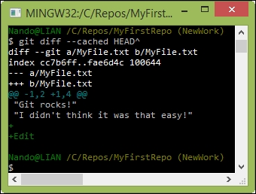
Git aliases
git difflast
With the git difflast alias, you can see a diff against your last commit:
$ git config --global alias.difflast 'diff --cached HEAD^'
Notes:
[2] ~/grocery (master)
$ git difflast
diff --git a/shoppingList.txt b/shoppingList.txt
index d362b98..08e7361 100644
--- a/shoppingList.txt
+++ b/shoppingList.txt
@@ -4,3 +4,4 @@ orange
peach
grape
blackberry
+apricot

Slide 59
Getting ready
In this example, we will use the jgit repository, Navigating Git, with the master branch pointing at b14a93971837610156e815ae2eee3baaa5b7a44b. Navigating Git, or clone the repository again, as follows:
$ git clone https://git.eclipse.org/r/jgit/jgit
$ cd jgit
$ git checkout master && git reset --hard b14a939

Slide 60
How to do it...
$ git config --global alias.co checkout
$ git config --global alias.br branch
$ git config --global alias.ci commit
$ git config --global alias.st status
Now, try to run git st in the jgit repository as follows:
$ git st
# On branch master
nothing to commit, working directory clean
Notes:
First, we'll create a few simple aliases, then a couple of more special ones, and finally a couple of aliases using external commands. Instead of writing git checkout every time we need to switch branches, we can create an alias of that command and call it git co. We can do the same for git branch, git commit, and git status as follows:

Slide 61
How to do it...
The alias method is also good to create the Git commands you think are missing in Git.
One of the common Git aliases is unstage, which is used to move a file out of the staging area, as shown in the following command:
$ git config --global alias.unstage 'reset HEAD --'

Slide 62

How to do it...
Try to edit the README.md file in the root of the jgit repository and add it in the root.
Now, git status/git st should display something like the following:
$ git st
# On branch master
# Changes to be committed:
# (use "git reset HEAD <file>..." to unstage)
#
# modified: README.md

Slide 63
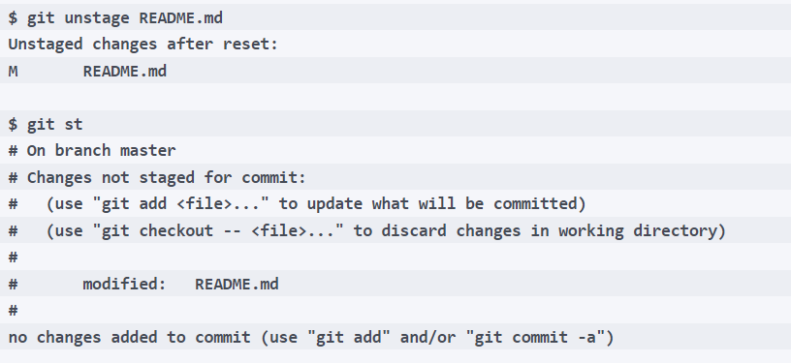
How to do it...
Notes:
Let's try to unstage README.md and then look at git st as follows:

Slide 64
How to do it...
Let's say you want the number of lines added and deleted for each file in the commit displayed along with some common commit data.
For this, we can create the following alias so we don't have to type everything each time:
$ git config --global alias.ll "log --pretty=format:\"%C(yellow)%h%Cred%d %Creset%s %Cgreen(%cr) %C(bold blue)<%an>%Creset\" --numstat"
Notes:
A common use case for aliases is to format the history of Git in specific ways.

Slide 65
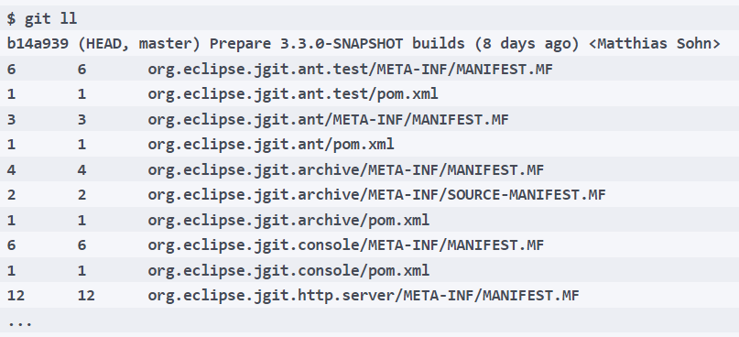
How to do it...
Notes:
Now, we can execute git ll in the terminal and get a nice stat output, as shown in the following command:
It is also possible to use an external command instead of a Git command. So, small shell scripts and so on can be embedded. To create an alias with an external command, the alias must start with an exclamation mark !.

Slide 66
Git aliases
Advanced aliases with external commands
If you want the alias to run external shell commands, instead of a Git sub-command, you have to prefix the alias with a !:
$ git config --global alias.echo !echo
Suppose you are annoyed by the canonical git add <file> plus git commit <file> sequence of commands, and you want to do it in a single shot; you can call the git command twice in sequence by creating this alias:
$ git config --global alias.cm '!git add -A && git commit -m'
Notes:
With this alias you commit a file, adding it before if necessary.
Have you noted that I set the cm alias again? If you set an already configured alias, the previous alias will be overwritten.
There are also aliases that define and use complex functions or scripts, but I'll leave it to the curiosity of the reader to explore these aliases. If you are looking for inspiration, take a look at this GitHub repository at https://github.com/GitAlias/gitalias.

Slide 67
Git aliases
Removing an alias
Removing an alias is quite easy; you have to use the --unset option, specifying the alias to remove.
For example, if you want to remove the cm alias, you have to run:
$ git config --global --unset alias.cm
Notes:
Note that you have to specify the configuration level with the appropriate option; in this case, we are removing the alias from the user (--global) level.

Slide 68
Git aliases
Aliasing the git command itself
I've already said I'm a bad typist; if you are too, you can alias the git command itself (using the default alias command in Bash):
$ alias gti='git'
Notes:
In this manner, you will save some other keyboard strokes. Note that this is not a Git alias, but a Bash shell alias.

Slide 69
3. Branching with Git

Slide 70
Git branching
Branches are not just exclusive to Git. However, in this course we focus on Git due to the many advantages this model of branching offers.
Consequently, before we delve into the various branching strategies out there, including Git branching strategies.
Put simply, Git and other version control tools allow developers to track, manage and organize their code.
Notes:
We will take a look at how Git actually handles branches and why it’s a standout among other VCS tools.
Git branches allow developers to diverge from the main branch by creating separate branches to isolate code changes. The default branch in Git is the master branch.
The biggest advantage of a Git branch is that it’s ‘lightweight’, meaning that data consists of a series of snapshots so with every commit you make, Git takes a picture of what your files look like at that moment and stores a reference to that snapshot. This means that these branches aren’t just copies of the file system but simply a pointer to the latest commit.
Meanwhile, other VCS tools store information as a list of file-based changes which may slow things down and use up significant space.
In Git, a branch is essentially a reference or a pointer to the latest commit in a given context; it’s not a container for commits. As you create new commits in the new branch, Git creates new pointers to track the changes. Git branches, then, can be seen as a pointer to a snapshot of your changes.

Slide 71
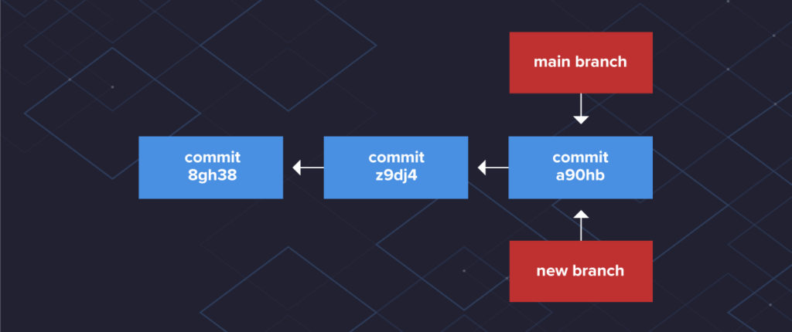
Git Branching
Notes:
There is nothing special about the main branch. It is the first branch made when you initialize a Git repository using the git initcommand.
When you create a commit, Git identifies that snapshot of files with a unique SHA-1 hash. When you initially create a branch, Git creates a new pointer to the same commit the main branch is currently on. The diagram below shows both branches have the same snapshot of code at this point.

Slide 72
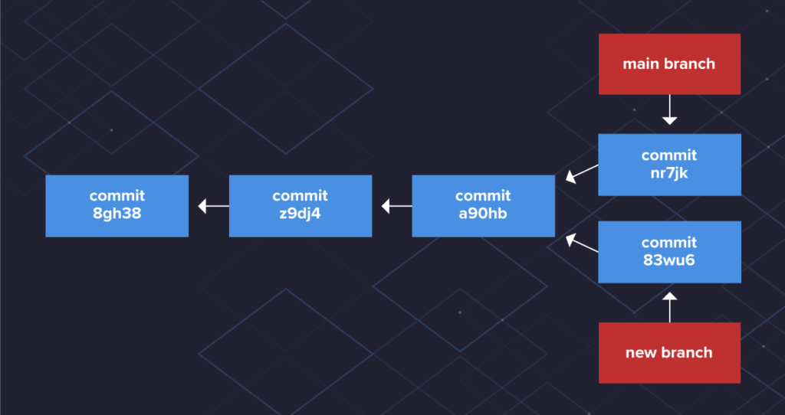
Git Branching
Notes:
As you create commits in the new branch, Git creates new pointers to track the changes. The latest commits are now ahead of the main branch commits. As you continue to make commits, each branch keeps track of its version of files.

Slide 73
Git Branching
Notes:
Git knows which branch you have checked out by using a special pointer called HEAD. When you create a new branch, Git doesn’t immediately change the HEAD pointer to the new branch. You’ll see HEAD in the tutorial when you create branches and view the commit log.
This branching function is what makes Git really powerful. Multiple people create separate branches to work on their code and merge their changes into the main branch. Branches are meant to be temporary and should be deleted when work is completed.

Slide 74
Branch Naming Strategies
Branch names can be anything you’d like.
Your organization or project may have standards outlined for branch naming.
For example, naming the branch based on the person responsible for working on the branch and a description or work item:
username/description
username/workitem
Notes:
Your organization or project may have standards outlined for branch naming.
Another branching strategy is having branches dedicated to the different development cycles, like feature or hotfix. As work items come up, you create a branch for that item from its respective branch. Yes, you can create branches from branches!

Slide 75
Branch Naming Strategies
You can name a branch to indicate the branch’s function, like a feature, bug fix, or hotfix:
bugfix/description
feature/feature-name
hotfix/description

Slide 76
COMPLETE
Activity: Creating a Branch with Git

Slide 77
Branching with Git

Slide 78
Create a branch
Create a branch in your repository, A short, descriptive branch name enables your collaborators to see ongoing work at a glance.
For example, increase-test-timeout or add-code-of-conduct
By creating a branch, you create a space to work without affecting the default branch, Additionally, you give collaborators a chance to review your work.

Slide 79
Make changes
On your branch, make any desired changes to the repository.
Your branch is a safe place to make changes, If you make a mistake, you can revert your changes or push additional changes to fix the mistake.
Your changes will not end up on the default branch until you merge your branch.
Commit and push your changes to your branch.
Give each commit a descriptive message to help you and future contributors understand what changes the commit contains.
Notes:
For example, fix typo or increase rate limit.
Ideally, each commit contains an isolated, complete change. This makes it easy to revert your changes if you decide to take a different approach. For example, if you want to rename a variable and add some tests, put the variable rename in one commit and the tests in another commit. Later, if you want to keep the tests but revert the variable rename, you can revert the specific commit that contained the variable rename. If you put the variable rename and tests in the same commit or spread the variable rename across multiple commits, you would spend more effort reverting your changes.
By committing and pushing your changes, you back up your work to remote storage. This means that you can access your work from any device. It also means that your collaborators can see your work, answer questions, and make suggestions or contributions.
Continue to make, commit, and push changes to your branch until you are ready to ask for feedback.

Slide 80
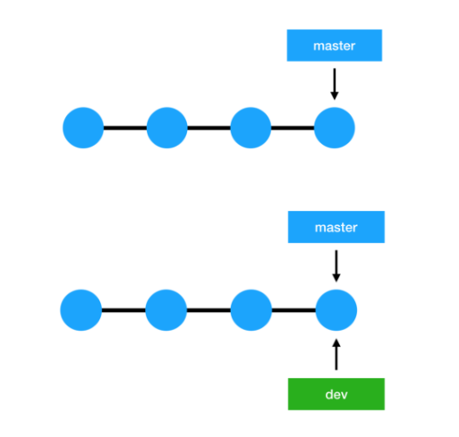
Introduction
Notes:
The images below illustrate this concept, where the top image shows the master branch and a pointer pointing to the last commit and the image right below it shows what happens when you create a new branch called ‘dev’- a new pointer now points to the latest commit.
To sum up, the Git branching model is lightweight compared to other version control systems; this is why it’s so easy and cheap to create branches in Git, as the whole code doesn’t need to be copied to the branch creating a large amount of duplicate files, as opposed to other VCS tools.

Slide 81
Introduction
If you are developing a small application in a big corporation as a developer.
Or you are trying to wrap your head around an open source project from GitHub, you have already been using branches with Git.
Notes:
Most of the time, you may just be working on a local develop or master branch and didn't care so much about other branches.

Slide 82
Managing your local branches
Suppose you are just having your local Git repository, and you have no intentions at the moment to share the code with others.
However, you can easily share this knowledge while working with a repository with one or more remotes.
Notes:
Local branches with no remotes work exactly in this fashion, As you can see in the examples, we are cloning a repository, thus we have a remote.
Let's start by creating a few local branches.

Slide 83
Getting ready
Use the following command to clone the jgit repository to match:
$ git clone https://git.eclipse.org/r/jgit/jgit
$ cd jgit

Slide 84
How to do it…
Whenever you start working on a bug fix or a new feature in your project, you should create a branch.
You can do so using the following code:
$ git branch newBugFix
$ git branch
* master
newBugFix
Notes:
Perform the following steps to manage your local branches:

Slide 85
How to do it…
The newBugFix branch points to the current HEAD I was on at the time of the creation.
You can see the HEAD with git log -1:
$ git log -1 newBugFix --format=format:%H
25fe20b2dbb20cac8aa43c5ad64494ef8ea64ffc
If you want to add a description to the branch, you can do it with the --edit-description option for the git branch command:
$ git branch --edit-description newBugFix
Notes:
Perform the following steps to manage your local branches:

Slide 86
How to do it…
The previous command will open an editor where you can type in a description:
Refactoring the Hydro controller
The hydro controller code is currently horrible needs to be refactored.
Close the editor and the message will be saved.

Slide 87
How it works…
Git stores the information in the local git config file; this also means that you cannot push this information to a remote repository.
To retrieve the description for the branch, you can use the --get flag for the git config command:
$ git config --get branch.newBugFix.description
Refactoring the Hydro controller
The hydro controller code is currently horrible needs to be refactored.

Slide 88
How it works…
The branch information is stored as a file in .git/refs/heads/newBugFix:
$ cat .git/refs/heads/newBugFix
25fe20b2dbb20cac8aa43c5ad64494ef8ea64ffc
Note that it is the same commit hash we retrieved with the git log command

Slide 89
Git references
It's all about labels
In Git, a branch is nothing more than a label, a mobile label placed on a commit.
In fact, every leaf on a Git branch has to be labeled with a meaningful name to allow us to reach it and then move around, go back, merge, rebase, or discard some commits when needed.
Notes:
In the previous section, we have seen that a Git repository can be imagined as a tree that, starting from a root (the root-commit), grows upward through one or more branches.
These branches are generally distinguished by a name. In this Git is no exception; if you remember, the experiments conducted so far led us to commit to the master branch of our test repository. Master is precisely the name of the default branch of a Git repository, somewhat like trunk is for Subversion.
But Subversion analogies end here: we will now see how Git handles branches, and for Subversion users it will be a little surprising.

Slide 90
Git references
Let's start exploring this topic by checking the current status of our grocery repository; we do it using the well-known git log command, this time adding some new options:
[1] ~/grocery (master)
$ git log --oneline --graph --decorate
* e4a5e7b (HEAD -> master) Add an apple
* a57d783 Add a banana to the shopping list
Notes:
Let's look at those options in detail:
--graph: In this case it just adds an asterisk to the left, before the commit hash, but when you have more branches, this option will draw them for us giving a simple but effective graphical representation of the repository
--decorate: This option prints out the labels attached to any commits that are shown; in this case, it prints (HEAD ->master) on the e4a5e7b commit
--oneline: This is easy to understand: it reports every commit using one line, shortening things when necessary

Slide 91
Git references
We'll now do a new commit and see what happens:
[2] ~/grocery (master)
$ echo "orange" >> shoppingList.txt
[3] ~/grocery (master)
$ git commit -am "Add an orange"
[master 0e8b5cf] Add an orange
1 file changed, 1 insertion(+)
Notes:
Have you noticed? After adding an orange to the shopingList.txt, I made a commit without first making git add; the trick is in the -a (--add) option added to the git commit command, which means add to this commit all the modified files that I have already committed at least one time before. In our case, this option allowed us to go faster and skip the git add command.
Anyway, use it carefully, especially while learning and using Git at the beginning: you easily end up doing commit with more files than you want.

Slide 92

Git references
Okay, go on now and take a look at the current repository situation:
[4] ~/grocery (master)
$ git log --oneline --graph --decorate
* 0e8b5cf (HEAD -> master) Add an orange
* e4a5e7b Add an apple
* a57d783 Add a banana to the shopping list
Notes:
Interesting! Both HEAD and master have now moved on the last commit, the third one; what does it mean?
Branches are movable labels
We have seen in the previous sections how the commits are linked to each other by a parent-and-son relationship: each commit contains a reference to the previous commit.
This means that, for example, to navigate within a repository I cannot start from the first commit and try to go to the next, because a commit has no reference to who comes next, but to who comes first. By staying in our arboreal metaphor, this means that our tree is only navigable from leaves, from the extreme top of a branch, and then down to root-commit.
So, branches are nothing but labels that are on the tip commit, the last one. This commit, our leaf, must always be identified by a label so that its ancestors commits can be reached while browsing within a repository. Otherwise, we should remember for every branch of our repository the hash code of the tip commit, and you can imagine how easy it would be for humans.

Slide 93
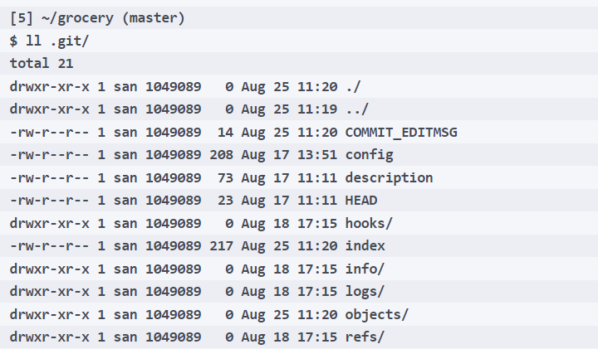
Git references
But how will Git handle this feature? Let's go back to putting the nose again in the .git folder:
Notes:
How references work
So, every time we make a commit to a branch, the reference that identifies that branch will move accordingly to always stay associated with the tip commit.

Slide 94
Git references
There's a refs folder: let's take a look inside:
[6] ~/grocery (master)
$ ll .git/refs/
total 4
drwxr-xr-x 1 san 1049089 0 Aug 18 17:15 ./
drwxr-xr-x 1 san 1049089 0 Aug 25 11:20 ../
drwxr-xr-x 1 san 1049089 0 Aug 25 11:20 heads/
drwxr-xr-x 1 san 1049089 0 Aug 17 11:11 tags/

Slide 95
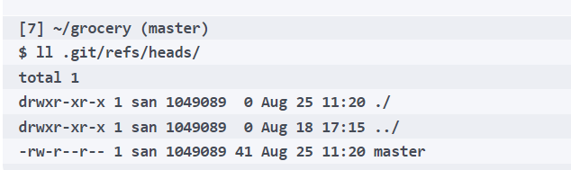
Git references
Now go to heads:
There's a master file inside! Let's see what's the content:
[8] ~/grocery (master)
$ cat .git/refs/heads/master
0e8b5cf1c1b44110dd36dea5ce0ae29ce22ad4b8
Notes:
As you could imagine, Git manages all this articulated reference system... with a trivial text file! It contains the hash of the last commit made on the branch; in fact, if you look at the previous git log output, you can see the hash of the last commit is 0e8b5cf.
Nowadays it has been time since the first time, but I continue to be amazed by how essential and effective the internal structure of Git is.

Slide 96
Git references
Creating a new branch
Now that we have warmed up, the fun begins.
Let's see what happens when you ask Git to create a new branch.
Since we are going to serve a delicious fruit salad, it's time to set a branch apart for a berries-flavored variant recipe:
[9] ~/grocery (master)
$ git branch berries
Notes:
That's all! To create a new branch, all you need to do is call the git branch followed by the name of the branch you'd like to use. And this is super-fast; always working locally, Git does this kind of work in a blink of an eye.
To be true, there are some (complicated) rules to be respected and things to know about the possible name of a branch (all you need to know is here: https://git-scm.com/docs/git-check-ref-format), but for now it is not relevant.

Slide 97
Git references
So, git log again:
[10] ~/grocery (master)
$ git log --oneline --graph --decorate
* 0e8b5cf (HEAD -> master, berries) Add an orange
* e4a5e7b Add an apple
* a57d783 Add a banana to the shopping list
Notes:
Wonderful! Now Git tells us there's a new branch, berries, and it refers to the same commit as a master branch.

Slide 98
Git references
Anyway, at the moment we continue to be located in the master branch; in fact, as you can see in the shell output prompt, it continues to appear (master) between the round parenthesis:
[10] ~/grocery (master)
How can I switch branch? By using the git checkout command:
[11] ~/grocery (master)
$ git checkout berries
Switched to branch 'berries'

Slide 99
Git references
Do a git log to see:
[12] ~/grocery (berries)
$ git log --oneline --graph --decorate
* 0e8b5cf (HEAD -> berries, master) Add an orange
* e4a5e7b Add an apple
* a57d783 Add a banana to the shopping list
Notes:
Mmm, interesting! Now there's a (berries) sign into the shell prompt, and more, something happened to that HEAD thing: now the arrows points to berries, not more to master. What does it mean?

Slide 100
Git references
HEAD, or you are here
During previous exercises we continued to see that HEAD thing while using git log, and now it's time to investigate a little bit.
First of all, what is HEAD? As branches are, HEAD is a reference.
It represents a pointer to the place on where we are right now, nothing more, nothing less.
In practice instead, it is just another plain text file:
[13] ~/grocery (berries)
$ cat .git/HEAD
ref: refs/heads/berries
Notes:
The difference between the HEAD file and branches text file is that the HEAD file usually refers to a branch, and not directly to a commit as branches do. The ref: part is the convention Git uses internally to declare a pointer to another branch, while refs/heads/berries is of course the relative path to the berries branch text file.
So, having checked out the berries branch, in fact we moved that pointer from the master branch to the berries one; from now on, every commit we do will be part of the berries branch. Let's give it a try.

Slide 101
Git references
Add a blackberry to the shopping list:
[14] ~/grocery (berries)
$ echo "blackberry" >> shoppingList.txt
Then perform a commit:
[15] ~/grocery (berries)
$ git commit -am "Add a blackberry"
[berries ef6c382] Add a blackberry
1 file changed, 1 insertion(+)

Slide 102
Git references
Take a look on what happened with the usual git log command:
[16] ~/grocery (berries)
$ git log --oneline --graph --decorate
* ef6c382 (HEAD -> berries) Add a blackberry
* 0e8b5cf (master) Add an orange
* e4a5e7b Add an apple
* a57d783 Add a banana to the shopping list
Okay, so now our shoppingList.txt file appears to contain these text lines:
[17] ~/grocery (berries)
$ cat shoppingList.txt
banana
apple
orange
blackberry
Notes:
Nice! Something happened here:
The berries branch moved to the last commit we performed, confirming what we said before: a branch is just a label that follows you while doing new commits, getting stuck to the last one
The HEAD pointer moved too, following the branch it is actually pointing to, the berries one
The master branch remains where it was, stuck to the penultimate commit, the last one we did before switching to the berries branch

Slide 103
Git references
Check out the master branch:
[18] ~/grocery (berries)
$ git checkout master
Switched to branch 'master'
Look at the shoppingFile.txt content:
[19] ~/grocery (master)
$ cat shoppingList.txt
banana
apple
orange
Notes:
What happens if we move back to the master branch? Let's see.

Slide 104
Git references
We actually moved back to where we were before adding the blackberry; as it is being added in the berries branch, here in the master branch it does not exist: sounds good, doesn't it?
Even the HEAD file has been updated accordingly:
[20] ~/grocery (master)
$ cat .git/HEAD
ref: refs/heads/master
Notes:
But at this point someone could raise their hand and say:
"That's weird! In Subversion, we usually have different folders for each different branch; here Git seems to always overwrite the content of the same folder, isn't it?"
.
Of course, it is. This is how Git works. When you switch a branch, Git goes to the commit the branch is pointing to, and following the parent relationship and analyzing trees and blobs, rebuilds the content on the working directory accordingly, getting hold of that files and folders (that is the same Subversion can do with the switch branch feature, actually).
This is a big difference between Git and Subversion (and other similar versioning systems); people used to Subversion often argue that in this manner you cannot easily compare branches file by file, or open in your favorite IDE two different versions of your in-development software. Yes, this is true, in Git you cannot do the same, but there are some tricks to work around this issue (if it is an issue for you).
Another important thing to say is that in Git you cannot check out only a folder of the repository, as you can do in Subversion; when you check out a branch, you get all its content.

Slide 105
Git references
Go back to the repository now; let's do the usual git log:
[21] ~/grocery (master)
$ git log --oneline --graph --decorate
* 0e8b5cf (HEAD -> master) Add an orange
* e4a5e7b Add an apple
* a57d783 Add a banana to the shopping list

Slide 106
Git references
Uh-oh: where is the berries branch? Don't worry: git log usually displays only the branch you are on, and the commit that belongs to it.
To see all branches, you only need to add the --all option:
[22] ~/grocery (master)
$ git log --oneline --graph --decorate --all
* ef6c382 (berries) Add a blackberry
* 0e8b5cf (HEAD -> master) Add an orange
* e4a5e7b Add an apple
* a57d783 Add a banana to the shopping list
Notes:
Okay, let's see: we are on the master branch, as the shell prompts and as HEAD remembers us, with that arrow that points to master; then there is a berries branch, with a commit more than master.
Reachability and undoing commits
Now let's imagine this scenario: we have a new commit on the berries branch, but we realized it is a wrong one, so we want the berries branch to go back where master is. We actually want to discard the last commit on the berries branch.

Slide 107
Git references
First, check out the berries branch:
[23] ~/grocery (master)
$ git checkout -
Switched to branch 'berries'
Now a new command, git reset (please don't care about the --hard option for now):
[24] ~/grocery (berries)
$ git reset --hard master
HEAD is now at 0e8b5cf Add an orange
Notes:
New trick: using the dash (-), you actually are saying to Git: "Move me to the branch I was before switching"; and Git obeys, moving us to the berries branch.

Slide 108
Git references
The git reset actually moves a branch from the current position to a new one; here we said Git to move the current berries branch to where master is, and the result is that now we have all the two branches pointing to the same commit:
[25] ~/grocery (berries)
$ git log --oneline --graph --decorate --all
* 0e8b5cf (HEAD -> berries, master) Add an orange
* e4a5e7b Add an apple
* a57d783 Add a banana to the shopping list

Slide 109
Git references
You can double-check this looking at refs files; this is the berries one:
[26] ~/grocery (berries)
$ cat .git/refs/heads/berries
0e8b5cf1c1b44110dd36dea5ce0ae29ce22ad4b8
And this is the master one:
[27] ~/grocery (berries)
$ cat .git/refs/heads/master
0e8b5cf1c1b44110dd36dea5ce0ae29ce22ad4b8
Notes:
Same hash, same commit.
A side effect of this operation is losing the last commit we did in berries, as we already said: but why? And how?
This is due to the reachability of commits. A commit is not more reachable when no branches points to it directly, nor it figures as a parent of another commit in a branch. Our blackberry commit was the last commit on the berries branch, so moving the berries branch away from it, made it unreachable, and it disappears from our repository.
But are you sure it is gone? Want to make a bet?

Slide 110
Git references
Let's try another trick: we can use git reset to move the actual branch directly to a commit.
And to make things more interesting, let's try to point the blackberry commit (if you scroll your shell window backwards, you can see its hash, which for me is ef6c382) so, git reset to the ef6c382 commit:
[28] ~/grocery (berries)
$ git reset --hard ef6c382
HEAD is now at ef6c382 Add a blackberry

Slide 111
Git references
And then do the usual git log:
[29] ~/grocery (berries)
$ git log --oneline --graph --decorate --all
* ef6c382 (HEAD -> berries) Add a blackberry
* 0e8b5cf (master) Add an orange
* e4a5e7b Add an apple
* a57d783 Add a banana to the shopping list
Notes:
That's magic! We actually recovered the lost commit!
Okay, jokes aside, there's no magic in Git; it simply won't delete unreachable commits, at least not immediately. It makes some housekeeping automatically at a given time, as it has some powerful garbage collection features (look at the git gc command help page if you are curious; I want you to remember that any Git command, followed by the --help option, will open for you the internal man page for it).
So, we have seen what reachability of commits means, and then learnt how to undo a commit using the git reset command, that is a thing to know to take advantage of Git features while working on a repository.
But let's continue experimenting with branches.

Slide 112
Git references
Assume you want to add a watermelon to the shopping list, but later you realize you added it to the wrong berries branch; so, add "watermelon" to the shoppingList.txt file:
[30] ~/grocery (berries)
$ echo "watermelon" >> shoppingList.txt
Then do the commit:
[31] ~/grocery (berries)
$ git commit -am "Add a watermelon"
[berries a8c6219] Add a watermelon
1 file changed, 1 insertion(+)

Slide 113
Git references
And do a git log to check the result:
[32] ~/grocery (berries)
$ git log --oneline --graph --decorate --all
* a8c6219 (HEAD -> berries) Add a watermelon
* ef6c382 Add a blackberry
* 0e8b5cf (master) Add an orange
* e4a5e7b Add an apple
* a57d783 Add a banana to the shopping list

Slide 114
Git references
Now our aim here is: have a new melons branch, which the watermelon commit have to belong to, then set the house in order and move the berries branch back to the blackberry commit.
To keep the watermelon commit, first create a melon branch that points to it with the well-known git branch command:
[33] ~/grocery (berries)
$ git branch melons

Slide 115
Git references
Let's check:
[34] ~/grocery (berries)
$ git log --oneline --graph --decorate --all
* a8c6219 (HEAD -> berries, melons) Add a watermelon
* ef6c382 Add a blackberry
* 0e8b5cf (master) Add an orange
* e4a5e7b Add an apple
* a57d783 Add a banana to the shopping list
Notes:
Okay, so now we have both berries and melons branches pointing to the watermelon commit.
Now we can move the berries branch back to the previous commit; let's get advantage of the opportunity to learn something new.
In Git, you often have the need to point to a preceding commit, like in this case, the one before; for this scope, we can use HEAD reference, followed by one of two different special characters, the tilde~ and the caret^. A caret basically means a back step, while two carets means two steps back, and so on. As you probably don't want to type dozens of carets, when you need to step back a lot, you can use tilde: similarly, ~1 means a back step, while ~25 means 25 steps back, and so on.
There's more to know about this mechanism, but it is enough for now; for all the details check http://www.paulboxley.com/blog/2011/06/git-caret-and-tilde.

Slide 116
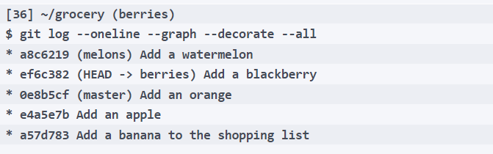
Git references
So, let's step back our berries branch using caret; do a git reset --hard HEAD^:
[35] ~/grocery (berries)
$ git reset --hard HEAD^
HEAD is now at ef6c382 Add a blackberry
Let's see the result:
Notes:
Well done! We successfully recovered the mistake, and learnt how to use the HEAD reference and git reset command to move branches from here to there.

Slide 117
Git references
Just to remark concepts, let's take a look at the shoppingList.txt file here in the berries branch:
[37] ~/grocery (berries)
$ cat shoppingList.txt
banana
apple
orange
blackberry
Okay, here we have blackberry, other than the other previously added fruits.
Switch to master and check again; check out the master branch:
[38] ~/grocery (berries)
$ git checkout master
Switched to branch 'master'

Slide 118
Git references
Then cat the file:
[39] ~/grocery (master)
$ cat shoppingList.txt
banana
apple
orange
Okay, no blackberry here, but only fruits added before the berries branch creation and now a last check on the melons branch; check out the branch:
[40] ~/grocery (master)
$ git checkout melons
Switched to branch 'melons'

Slide 119
Git references
And cat the shoppingList.txt file:
[41] ~/grocery (melons)
$ cat shoppingList.txt
banana
apple
orange
blackberry
watermelon
Notes:
Fantastic! Here there is the watermelon, other than fruits previously added while in the berries and master branches.
Quick tip: while writing the branch name, use Tab to autocomplete: Git will write the complete branch name for you.

Slide 120
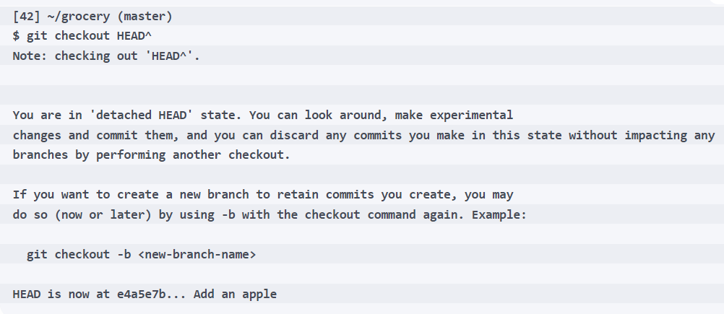
Git references
For the sake of the explanation, go back to the master branch and see what happens when we check out the previous commit, moving HEAD backward; perform a git checkout HEAD^:
Notes:
Detached HEAD
Now it's time to explore another important concept about Git and its references, the detached HEAD state.
Wow, a lot of new things to see here. But don't be scared, it's not that complicated: let's take some baby steps into the long message Git showed us.
First, think about it: Git is very kind and often tells us loads of useful information in its output messages. Don't under evaluate this behavior: especially at the beginning, reading Git messages allows you to learn a lot, so read them carefully.

Slide 121
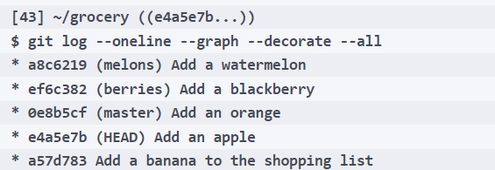
Git references
Here, Git says we are in a detached HEAD state. Being in this state basically means that HEAD does not reference a branch, but directly a commit, the e4a5e7b one in this case; do a git log and see:

Slide 122
Git references
First of all, in the shell prompt you can see that between rounds, that now are doubled, there is not a branch name, but the first seven characters of the commit, ((e4a5e7b...)).
Then, HEAD is now stuck to that commit, while branches, especially the master one, remains at their own place.
As a result, the HEAD file now contains the hash of that commit, not a ref to a branch as before:
[44] ~/grocery ((e4a5e7b...))
$ cat .git/HEAD
e4a5e7b3c64bee8b60e23760626e2278aa322f05
Notes:
Going on, Git says that in this state we can look around, make experiments, doing new commits if we like, and then discard them simply by checking out an existing branch, or save them if you like creating a new branch. Can you say why this is true?
Due to reachability of commits, of course. If we do some commits, then move HEAD to an existing branch, those commits become unreachable. They stay in a reachable state until HEAD is on top of the last of them, but when you move HEAD with a git checkout, they are gone. At the same time, if you create a new branch before moving HEAD, there will be a label, a pointer Git can use to reach those commits, so they are safe.
Want to try?

Slide 123
Git references
Okay, let's have some fun; modify the shoppingList.txt file, adding a bug:
[45] ~/grocery ((e4a5e7b...))
$ echo "bug" > shoppingList.txt
Then commit this voluntary mistake:
[46] ~/grocery ((e4a5e7b...))
$ git commit -am "Bug eats all the fruits!"
[detached HEAD 07b1858] Bug eats all the fruits!
1 file changed, 1 insertion(+), 2 deletions(-)

Slide 124
Git references
Let's cat the file:
[47] ~/grocery ((07b1858...))
$ cat shoppingList.txt
bug
Ouch, we actually erased all your shopping list files!
What happened in the repository then?
Notes:
Nice! We have a new commit, the bug one, and we can see as HEAD followed us, so now it points to it. Then, the console drew two different paths, because starting from apple commit, we traced two routes: one that goes to the master branch (then to berries and melons), and one that goes to the bug commit we just made.
[48] ~/grocery ((07b1858...))
$ git log --oneline --graph --decorate --all
* 07b1858 (HEAD) Bug eats all the fruits!
| * a8c6219 (melons) Add a watermelon
| * ef6c382 (berries) Add a blackberry
| * 0e8b5cf (master) Add an orange
|/
* e4a5e7b Add an apple
* a57d783 Add a banana to the shopping list

Slide 125
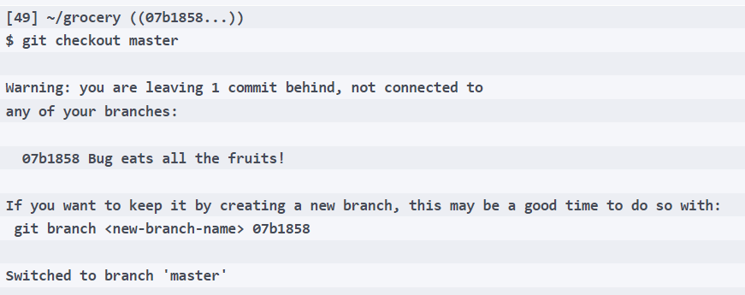
Git references
Okay, so if we now check out master again, what happens? Give it a try:
Notes:
Okay, we have already seen this message: Git is aware that we are leaving a commit behind; but in this case, it's not a problem for us, indeed it's actually what we really want.

Slide 126
Git references
Let's check the situation:
[50] ~/grocery (master)
$ git log --oneline --graph --decorate --all
* a8c6219 (melons) Add a watermelon
* ef6c382 (berries) Add a blackberry
* 0e8b5cf (HEAD -> master) Add an orange
* e4a5e7b Add an apple
* a57d783 Add a banana to the shopping list
Notes:
Yay! The bug commit is gone, so nothing is compromised. In the previous message, Git was kind enough to remind us how to recover that commit, just in case; the trick is to directly create a branch that points to that commit, and Git pinned us even the complete command.

Slide 127
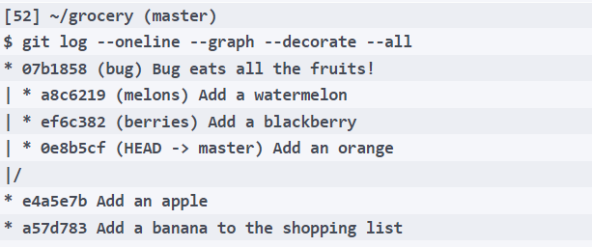
Git references
Let's try it, creating a bug branch:
[51] ~/grocery (master)
$ git branch bug 07b1858
Let's see what happened:
Notes:
Wow, that's amazingly simple! The commit is here again, and now we have even a branch to check out if we like.
The reflogs
Okay, but what if we ignore the Git message the first time, then time goes and at the end, we can't remember the hash of the commit we want to retrieve?
Git never forgets you. It has another powerful tool in its wrench box, and that is called the reference log, or reflog for short. Basically, the reflog (or better the reflogs, as there is one for every reference) records what happens in the repository while you commit, reset, check out, and so on. To be more precise, every reflog records all the times that tips of the branches and other references (such as HEAD) where updated.

Slide 128
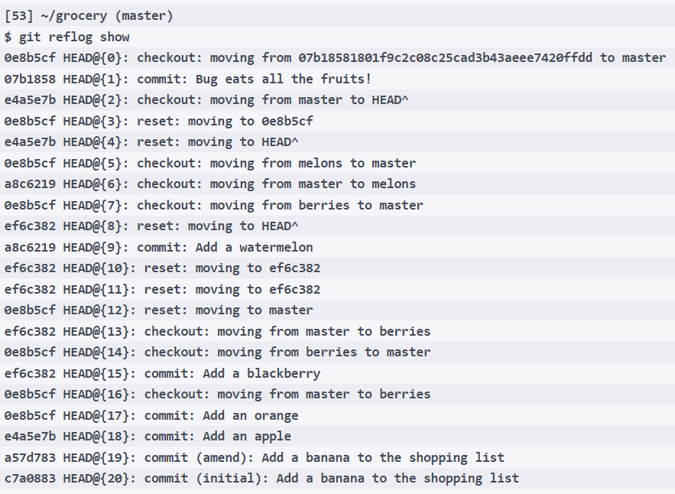
Git references
We can take a look at it with a convenient Git command, git reflog show:

Slide 129
Git references
Actually, here there are all the movements the HEAD reference made in my repository since the beginning, in reverse order, as you may have already noticed.
In fact, the last one (HEAD@{0}) says:
checkout: moving from 07b18581801f9c2c08c25cad3b43aeee7420ffdd to master
Notes:
Actually, this is the very last thing we did, apart from the creation on the bug branch. As we never moved into it, the HEAD reflog doesn't log anything about bug branch creation.
The reflog is a quite complex topic to be discussed in depth, so here we only learn how to open and read it, and how to interpret information from it.
The only things I want you to know are that this log will be cleared at some point; the default retention is 90 days. Then, there is a reflog for every reference; what we are seeing now is the HEAD reflog (HEAD@ is a hint about this), but if you type git reflog show berries you will see the movements berries branch did in the past:

Slide 130
Git references
[54] ~/grocery (master)
$ git reflog berries
ef6c382 berries@{0}: reset: moving to HEAD^
a8c6219 berries@{1}: commit: Add a watermelon
ef6c382 berries@{2}: reset: moving to ef6c382
0e8b5cf berries@{3}: reset: moving to master
ef6c382 berries@{4}: commit: Add a blackberry
0e8b5cf berries@{5}: branch: Created from master
Notes:
To go back to our problem, if we want to check out a currently unreachable commit, we can go to the HEAD reflog and look for a line where we did the commit (in this example, I would look for a commit: logline, searching the one where the commit message says something that helps me to remind, something like bug in this case).
Well done, that's enough for now; later we will use reflog again.

Slide 131
Git references
Creating a tag is simple: you only need the git tag command, followed by a tag name; we can create one in the tip commit of bug branch to give it a try; check out the bug branch:
[1] ~/grocery (master)
$ git checkout bug
Switched to branch 'bug'
Then use the git tag command followed by the funny bugTag name:
[2] ~/grocery (bug)
$ git tag bugTag
Notes:
Tags are fixed labels
Tags are labels you can pin to a commit, but unlike branches, they will stay there.

Slide 132
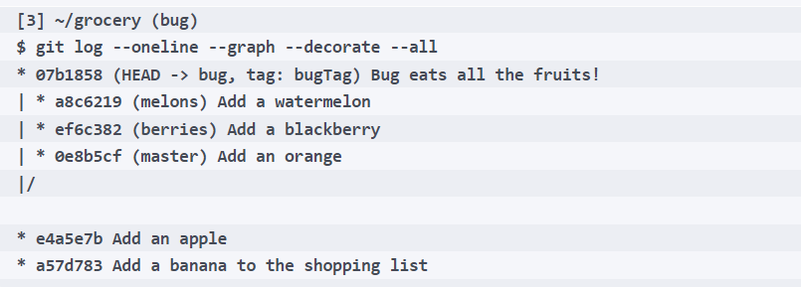
Git references
Let's see what git log says:
Notes:
As you can see in the log, now on the tip of the bug branch there is even a tag named bugTag.

Slide 133
Git references
If you do a commit in this branch, you will see the bugTag will remain at its place; add a new line to the same old shopping list file:
[4] ~/grocery (bug)
$ echo "another bug" >> shoppingList.txt
Perform a commit:
[5] ~/grocery (bug)
$ git commit -am "Another bug!"
[bug 5d605c6] Another bug!
1 file changed, 1 insertion(+)

Slide 134
Git references
Then look at the current situation:
[6] ~/grocery (bug)
$ git log --oneline --graph --decorate --all
* 5d605c6 (HEAD -> bug) Another bug!
* 07b1858 (tag: bugTag) Bug eats all the fruits!
| * a8c6219 (melons) Add a watermelon
| * ef6c382 (berries) Add a blackberry
| * 0e8b5cf (master) Add an orange
|/
* e4a5e7b Add an apple
* a57d783 Add a banana to the shopping list
Notes:
That's exactly what we predict.
Tags are useful to give a particular meaning to some particular commits; for instance, as a developer, you maybe want to tag every release of your software: in that case, this is all you need to know to do that job.

Slide 135
Git references
Even tags are references, and they are stored, as branches, as simple text files in the tags subfolder within the .git folder; take a look under the .git/refs/tags folder, you will see a bugTag file; look at the content:
[7] ~/grocery (bug)
$ cat .git/refs/tags/bugTag
07b18581801f9c2c08c25cad3b43aeee7420ffdd
Notes:
As you maybe have already predicted, it contains the hash of the commit it refers to.
To delete a tag, you have to simply append the -d option: git tag -d <tag name>.
As you can't move a tag, if you need to move it you have to delete the previous tag and then create a new one with the same name that points to the commit you want; you can create a tag that points a commit wherever you want, appending the hash of the commit as an argument, for example, git tag myTag 07b1858.

Slide 136
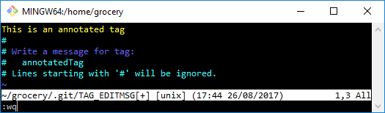
Git references
To create one, simply append -a to the command; let's create another one to give this a try:
[8] ~/grocery (bug)
$ git tag -a annotatedTag 07b1858
At this point Git opens the default editor, to allow you to write the tag message, as in the following screenshot:
Notes:
Annotated tags
Git has two kinds of tags; this is because in some situations you may want to add a message to the tag, or because you like to have the author stick to it.
We already have seen the first type, the simpler one; tags containing this extra information load belong to the second type, the annotated tag.
An annotated tag is both a reference and a git object such as commits, trees, and blobs.

Slide 137
Git references
Save and exit, and then see the log:
[9] ~/grocery (bug)
$ git log --oneline --graph --decorate --all
* 5d605c6 (HEAD -> bug) Another bug!
* 07b1858 (tag: bugTag, tag: annotatedTag) Bug eats all the fruits!
| * a8c6219 (melons) Add a watermelon
| * ef6c382 (berries) Add a blackberry
| * 0e8b5cf (master) Add an orange
|/
* e4a5e7b Add an apple
* a57d783 Add a banana to the shopping list
Notes:
Okay, there are two tags now on the same commit.

Slide 138
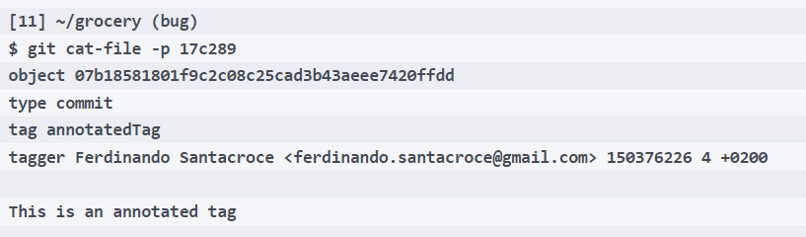
Git references
A new ref has been created:
[10] ~/grocery (bug)
$ cat .git/refs/tags/annotatedTag
17c289ddf23798de6eee8fe6c2e908cf0c3a6747
But even a new object: try to cat-file the hash you see in the reference:
Notes:
This is how an annotated tag looks like.
Obviously, the git tag command has many other options, but I only highlighted the ones I think are worth knowing at the moment.
If you want to look at all the options of a command, remember you can always do a git <command> --help to see the complete guide.
Time to spend some words on the staging area, as we have only scratched the surface.

Slide 139
Merging in Git

Slide 140
Merging branches
In Git, merging two (or more!) branches is the act of making their personal history meet each other. When they meet, two things can happen:
Files in their tip commit are different, so some conflict will rise
Files do not conflict
Commits of the target branch are directly behind commits of the branch we are merging, so a fast-forward will happen
Notes:
Yes, I know, probably there's a thought on your mind since we start playing with branches: why he doesn't talk about merging?.
Now the moment has arrived.
In the first two cases, Git will guide us assembling a new commit, a so-called merge commit; in the fast-forward case instead, no new commit is needed: Git will simply move the target branch label to the tip commit of the branch we are merging.

Slide 141
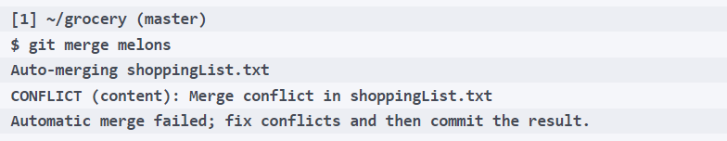
Merging branches
Let's give it a try.
We can try to merge the melons branch into the master one; to do so, you have to check out the target branch, master in this case, and then fire a git merge <branch name> command; as I'm already on the master branch, I go straight with the merge command:
Notes:
Uh-oh, conflicts here. Git always tries to auto-merge a file (it uses complex algorithms to reduce your manual work on files), but if you're in doubt, pretend you fix the issues by hand.

Slide 142
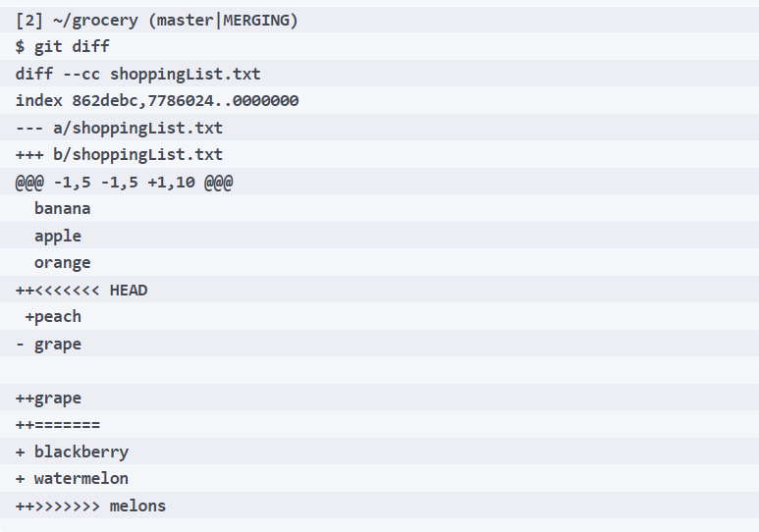
Merging branches
See the conflict with git diff:
Notes:
Okay, it's clear that the fourth and fifth line of our shoppingList.txt diverged in the two branches: in master, they are occupied respectively by peach and grape, in the melons branch the place is taken by blackberry and watermelon.
Note the shell prompt: it has that MERGING word after the branch name to remind us that we are in the middle of a merge. Instead, don't mind the - grape ++grape part: it is a due line ending mismatch between my Windows computer and the GNU/Linux Git subsystem.
To resolve the merge, you have to edit the file accordingly, and then add and commit it; let's go.

Slide 143
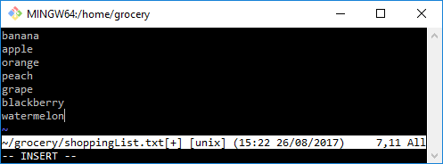
Merging branches
I will edit the file enqueuing blackberry and watermelon after peach and grape, as per the following screenshot:

Slide 144
Merging branches
After saving the file, add it to the staging area and then commit:
[3] ~/grocery (master|MERGING)
$ git add shoppingList.txt
[4] ~/grocery (master|MERGING)
$ git commit -m "Merged melons branch into master"
[master e18a921] Merged melons branch into master
Notes:
The commit is done, and the merge is finished. Perfect!

Slide 145
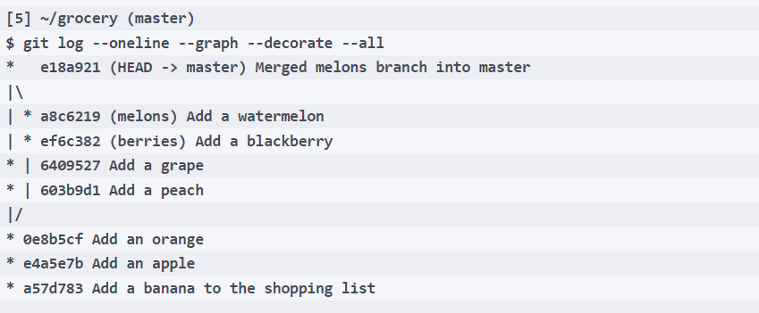
Merging branches
Now take a look at the log:
Notes:
Wow, that's cool!
Look at the green path, the one on the right: this is now the new history of the master branch. It starts from the beginning, the banana commit, goes to apple, orange, and then to peach, grape, blackberry, and the watermelon commit.
The tip commit on the master branch is the merge commit, the result of the merge. Can you tell how Git is able to draw this graph?

Slide 146
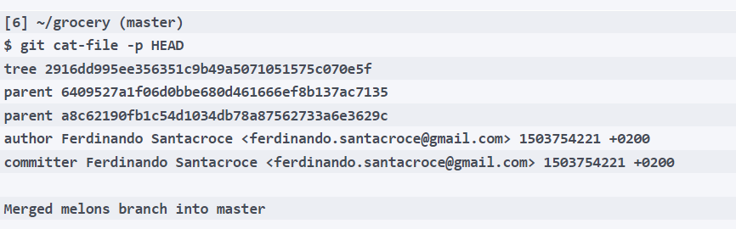
Merging branches
Suggestion: look at the merge commit with git cat-file -p:
Notes:
A-ha! This commit has two parents! In fact, this is the result of the merge of two previous commits, and this is how Git handles merges. Storing the two parents inside the commit, Git can keep track of the merge, and use the information to draw the graph and let you remember, even after years, when and how you merged two branches.

Slide 147
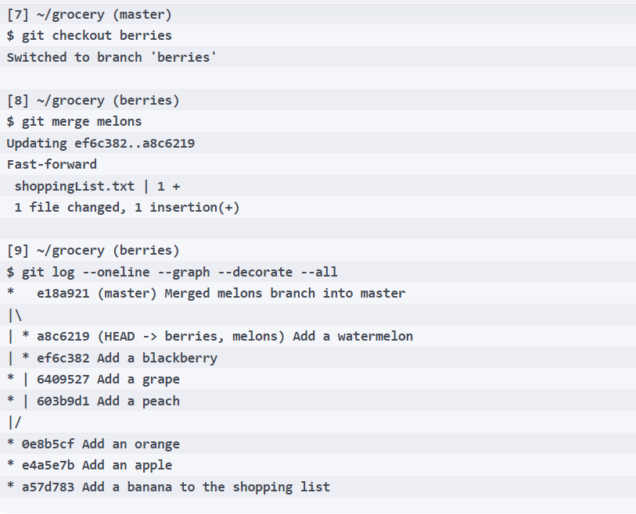
Merging branches
Fast forwarding
A merge not always generates a new commit; to test this case, try to merge the melons branch into a berries one:
Notes:
As melons contained only a commit more than the berries branch, and as it changes between the two are not in conflict, doing a merge here is just a matter of a second: Git only needs to move the berries label to the same tip commit of the melons branch.
This is called fast-forwarding.
This time there's no merge commit, as it is not necessary; someone will argue that in this manner you lose the information that tells you when two branches have been merged. If you want to force Git always create a new merge commit, you can use the --no-ff (no fast-forward) option.
Wanna try? Okay, good chance to make another exercise.

Slide 148
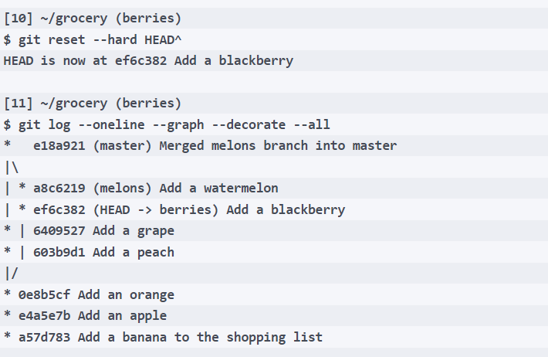
Merging branches
Move back the berries branch where it was using git reset:

Slide 149

Merging branches
We have just undone a merge, did you realize it?
Okay, now do the merge again with the --no-ff option:
[12] ~/grocery (berries)
$ git merge --no-ff melons

Slide 150
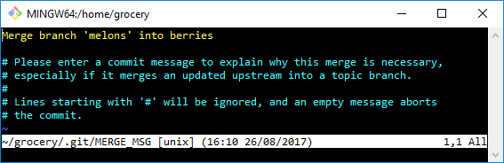
Merging branches
Git will now open your default editor to allow you to specify a commit message, as shown in the following screenshot:
Notes:
As you can see, when Git can automatically merge the changes, it does; it then asks you for a commit message, suggesting a default one.

Slide 151
Merging branches
Accept the default message, save and exit:
[13] ~/grocery (berries)
Merge made by the 'recursive' strategy.--all
shoppingList.txt | 1 +
1 file changed, 1 insertion(+)
Notes:
Merge done.
Git tells us what merging strategy is adopted for the automatic merge, and then what changed in terms of files and changes to them (insertions or deletions).

Slide 152
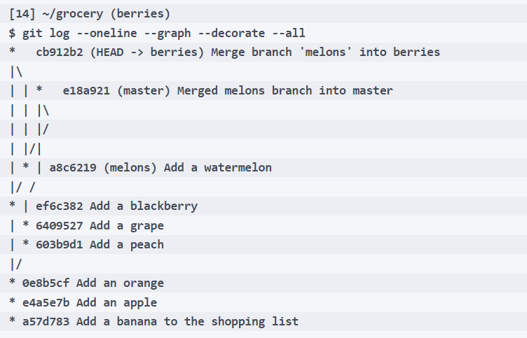
Merging branches
Now a git log:
Notes:
Okay, now the graph highlights the merge between the two branches. As you can see, the graph is a little bit more complicated now, and this is why doing a fast-forward merge is normally preferable: it ends with a more compact and simple repository structure.

Slide 153
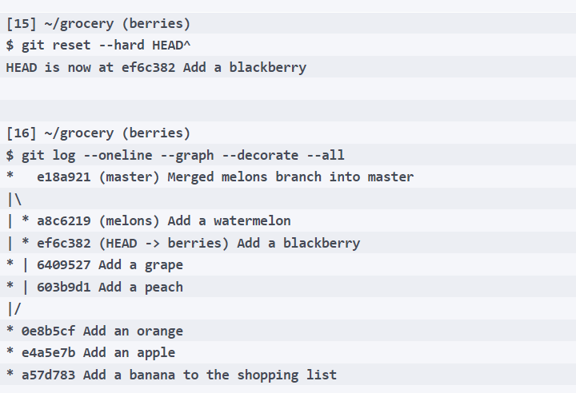
Merging branches
We are done with these experiments; anyway, I want to undo this merge, because I want to keep the repository as simple as possible to allow you to better understand the exercise we do together; go with a git reset --hard HEAD^:

Slide 154
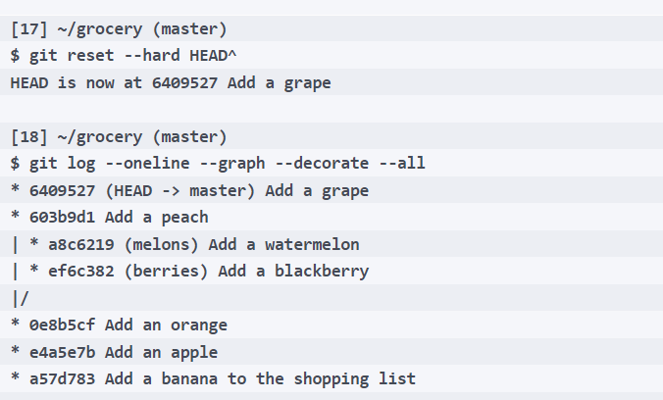
Merging branches
Okay, now undo even the past merge we did on the master branch:
Notes:
I'm sure you get the point now: undoing a merge in Git is easy. I wanted to show you this more and more because sometimes merging branches is scaring; after doing it, sometimes you realize you messed up your project, and you go out of mind. Instead, don't worry about it: recovering from this situation is simple.

Slide 155
6. Collaborating on Your Code

Slide 156
Git Fundamentals - Working Remotely
In this lesson, we finally start to work in a distributed manner, using remote servers as a contact point for different developers. These are the main topics we will focus on:
Dealing with remotes
Cloning a remote repository
Working with online hosting services, such as Azure DevOps and GitHub
Notes:
In the previous lesson, we learned a lot about Git; we learned how it works internally and how to manage a local repository, but now it's time to learn how to share our goodies.

Slide 157
Working with remotes
Git is a tool for versioning files, as you know, but it has been built with collaboration in mind.
In 2005, Linus Torvalds had the need for a light and efficient tool to share the Linux kernel code, allowing him and hundreds of other people to work on it without going crazy.
Notes:
Basically, a Git remote is another "place" that has the same repository you have on your computer. As shown in the following image, you can think of it as different copies of the same repository that can exchange data between themselves:
The pragmatism that guided its development gave us a very robust layer for sharing data among computers, without the need of a central server.

Slide 158
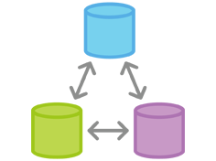
Working with remotes
Notes:
So, a remote Git repository is just a remote copy of the same Git repository we created locally; if you have access to that remote via common protocols such as SSH, the custom git:// protocol, or other protocols, you can keep in sync your modification with it.
Even another folder in your computer can act as a remote: for Git, the filesystem is a communication protocol like any other, and you are allowed to use it if you like.
This is what we will do to grasp the basic concepts about remotes.

Slide 159
Working with remotes
Clone a local repository
Create a new folder on your disk to clone our grocery repository:
[1] ~
$ mkdir grocery-cloned
Then clone the grocery repository using the git clone command:
Notes:
Done.
The dot . argument at the end of the command means clone the repository in the current folder, while the ~/grocery argument is actually the path where Git has to look for the repository.

Slide 160
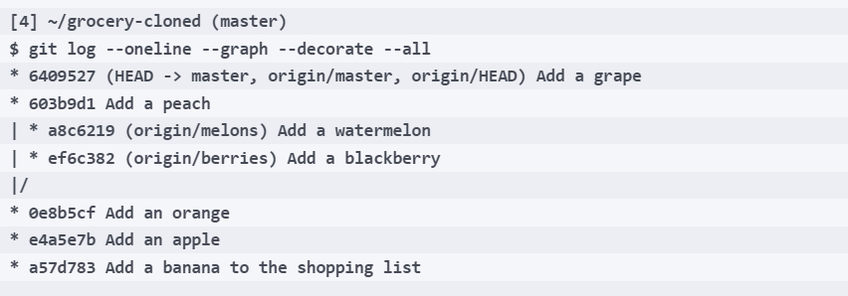
Working with remotes
Now, go directly to the point with a git log command:
Notes:
As you can see, other than the green master branch label, we have some red origin/<branch> labels on our log output.
The origin
What is the origin?
Git uses origin as the default name of a remote. Like with master for branches, origin is just a convention: you can call remotes whatever you want.
The interesting thing to note here is that Git, thanks to the --all option in the git log command, shows us that there are some more branches in the remote repository, but as you can see, they do not appear in the locally cloned one. In the cloned repository, there is only master.

Slide 161
Working with remotes
But don't worry: a local branch in which to work locally can be created by simply checking it out:
[5] ~/grocery-cloned (master)
$ git checkout berries
Branch berries set up to track remote branch berries from origin.
Switched to a new branch 'berries'
Notes:
Look at the message, Git says that a local branch has been set up to track the remote one; this means that, from now on, Git will actively track differences between the local branch and the remote one, notifying you of differences while giving you output messages (for example, while using the git status command).
Having said that, if you do a commit in this branch, you can send it to the remote and it will be part of the remote origin/berries.
This seems obvious, but, in Git, you can pair branches as you want; for example, you can track a remote origin/foo branch by a local bar branch, if you like. Alternatively, you can have local branches that simply don't exist on the remote. Later, we will look at how to work with remote branches.

Slide 162

Working with remotes
Now, look at the log again:
Notes:
Now a green berries label appears, just near the red origin/berries one; this makes us aware that the local berries branch and remote origin/berries branch point to the same commit.
What happens if I do a new commit?

Slide 163

Working with remotes
Let's try:
Notes:
Your name and email address were configured automatically based on your username and hostname. Please check that they are accurate.

Slide 164
Working with remotes
You can suppress this message by setting them explicitly:
git config --global user.name "Your Name"
git config --global user.email you@example.com
After doing this, you may fix the identity used for this commit with the following code:
git commit --amend --reset-author
1 file changed, 1 insertion(+)
Notes:
As in the previous lesson, Git warns me about author and email; this time I will go with the suggested ones.

Slide 165

Working with remotes
OK, let's see what happened:
Notes:
Nice! The local berries branch moved forward, while origin/berries is still in the same place.
Sharing local commits with git push
As you may already know, Git works locally; there's no need for a remote server.
So, when you do a commit, it is available only locally; if you want to share it with a remote counterpart, you have to send it in some manner.
In Git, this is called push.

Slide 166

Working with remotes
Now, we will try to push the modifications in the berries branch to the origin; the command is git push, followed by the name of the remote and the target branch:
Notes:
Wow! There is a lot of things in this output message. Basically, Git informed us about the operations it does before and during the sending of commits to the remote.
Note that, as Git will send only the objects it knows are not present in the remote to the remote (three, in this case: a commit, a tree, and a blob), it will not send unreachable commits, nor other related unreachable objects (such as trees, blobs, or annotated that tighten only with unreachable commits).
Finally, Git tells us where it is sending objects, the destination, which in this case is just another folder on my computer: To C:/Users/san/Google Drive/fenago/PortableGit/home/grocery. It then tells the commit hash remote where the origin/berries originally was and the hash of the new tip commit, that is the same as the one in the local berries branch, ef6c382..ab9f231. Lastly, it gives the name of the two branches, the local and the remote branches, berries -> berries.

Slide 167

Working with remotes
Now, we obviously want to see if, in the remote repository, there is a new commit in the berries branch; so, open the grocery folder in a new console and do git log:
Notes:
Yes, wonderful!
Just a little warning: usually, a remote repository copy is managed as a bare repository; in lesson 4, Git Fundamentals - Niche Concepts, Configurations, and Commands, we will spend some words on it. As you normally won't work directly on it, a bare repository contains only the .git folder; it doesn't have a checked out working tree nor a HEAD reference. Instead, we use a normal repository as a remote. This is not a problem; you have just to remember one thing: you cannot push changes to the actual checked out remote branch.
In fact, in that grocery repository, we are actually on the master branch, and in the grocery-cloned repository, we push the berries branch. The reason for this is quite simple to understand: by pushing to a remote checked out branch, you will affect the work in progress on that repository, maybe destroying ongoing changes, and this is not fair.

Slide 168
Working with remotes
Getting remote commits with git pull
Now, it's time to experiment the inverse: retrieving updates from the remote repository and applying them to our local copy.
So, make a new commit in the grocery repository, and then, we will download it into the grocery-cloned one:
[13] ~/grocery (master)
$ printf "\r\n" >> shoppingList.txt

Slide 169
Working with remotes
I firstly need to create a new line, because due to the previous grape rebase, we ended having the shoppinList.txt file with no new line at the end, as echo “ " >> <file> usually does:
[14] ~/grocery (master)
$ echo "apricot" >> shoppingList.txt
[15] ~/grocery (master)
$ git commit -am "Add an apricot"
[master 741ed56] Add an apricot
1 file changed, 2 insertions(+), 1 deletion(-)
Notes:
OK, now back to the grocery-cloned repository.
We can retrieve objects from a remote with git pull.
In truth, git pull is a super command; in fact, it is basically the sum of two other Git commands, git fetch and git merge. While obtaining objects from a remote, Git won't force you to merge them into a local branch; this can seem a little bit confusing at first, as in other versioning systems, such as Subversion, this is the default behavior.
Instead, Git is more conservative: it could happen that someone pushed a commit or more on top of a branch, but you realized those commits are not good for you, or simply they are just wrong. So, using git fetch, you can get and inspect them before applying them on your local branch with a git merge.

Slide 170
Working with remotes
Let's try git pull for now, then we will try to use git fetch and git merge separately.
Go back to the grocery-cloned repository, switch to the master branch, and do a git pull:
[16] ~/grocery-cloned (berries)
$ git checkout master
Your branch is up-to-date with 'origin/master'.
Switched to branch 'master'
Notes:
Git says that our branch is up-to-date with 'origin/master', but this is not true, as we just did a new commit there. This is because, for Git, the only way to know if we are updated in respect a remote repository is to perform a git fetch, and we didn't. Later we will see this more clearly.

Slide 171

Working with remotes
For now, go with git pull: the command wants you to specify the name of the remote you want to pull from, which is origin in this case, and then the branch you want to merge into your local one, which is master, of course:
Notes:
Good! Git tells us that there are three new objects to fetch; after it has obtained them, it performs a merge on top of the local master branch, and in this case, it performs a fast-forward merge.

Slide 172

Working with remotes
OK, now I want you to try doing these steps in a separate manner; create the umpteenth new commit in the grocery repository, the master branch:

Slide 173

Working with remotes
Now perform a git fetch on grocery-cloned repository:
Notes:
As you can see, Git found new objects on the remote, and it downloaded them.
Note that you can do a git fetch in whatever branch you are in, as it simply downloads remote objects; it won't merge them. Instead, while doing a git pull, you have to be sure to be in the right local target branch.

Slide 174

Working with remotes
Do a git status now:
Notes:
OK, as you can see, when there is a remote, git status informs you even on the state of the synchronization between your local repository and the remote one; here it tells us we are behind the remote because it has because it has one commit more than us in the master branch, and that commit can be fast-forwarded.

Slide 175

Working with remotes
Now, let's sync with a git merge; to merge a remote branch, we have to specify, other than the branch name, even the remote one, as we did in the git pull command previously:
Notes:
That's all!
This is basically what you need to know to work with remotes. Note that, if some changes on the remote are in conflict with the local ones, you will have to solve them as we did in the previous merge examples.

Slide 176

Working with remotes
How Git keeps track of remotes
Git stores remote branch labels in a similar way to how it stores the local branches ones; it uses a subfolder in refs for the scope, with the symbolic name we used for the remote, in this case origin, the default one:
Notes:
The command to deal with remotes is git remote; you can add, remove, rename, list, and do a lot of other things with them; there's no room here to see all the options. Please refer to the Git guide if you need to know more about the git remote command.
Now, we will play a little bit with a remote on a public server; we will use free GitHub hosting for this purpose.

Slide 177
Editing on Azure DevOps

Slide 178
Edit in Azure Devops
Notes:
Azure DevOps allows you to edit files directly in the web interface of your repositories. This feature is especially useful for making quick changes, fixing small bugs, or editing documentation without needing to clone the repository locally. Here's a detailed breakdown of how to edit files on Azure DevOps, along with examples and best practices.

Slide 179
Steps to Edit in Azure DevOps
1. Navigate to the Repository
2. Locate the File
3. Open the File
4. Edit the File
5. Commit the Changes
Notes:
Steps to Edit Files in Azure DevOps
1. Navigate to the Repository
Login to Azure DevOps: Access your project in Azure DevOps via https://dev.azure.com.
Select the Repository: From the left navigation pane, go to Repos > Files to see your repository.
2. Locate the File
Browse the repository tree to find the file you want to edit.
Use the search bar if you have many files and want to locate one quickly.
3. Open the File
Click on the file you want to modify. The file content will open in a text editor within the browser.
4. Edit the File
Modify the content directly in the editor.
For example, update a configuration setting in a .yaml file or fix a typo in the README.md file.
5. Commit the Changes
After editing, click the Edit button (if it's not already active).
Add a meaningful commit message in the text box (e.g., "Updated API endpoint in configuration").
Select the branch where the changes will be committed:
Commit directly to the current branch (e.g., main or develop).
Or create a new branch for the changes (recommended for collaborative environments).
Click Commit to save the changes.

Slide 180
Best Practices for Editing on Azure DevOps
Use for Small Changes
Create a New Branch for Major Edits:
Leverage Commit Messages
Verify Syntax and Formatting
Test Changes Locally if Possible
Notes:
Best Practices for Editing on Azure DevOps
Use for Small Changes:
Ideal for documentation updates, fixing typos, or editing small configuration files.
Avoid making large code changes directly in the web interface.
Create a New Branch for Major Edits:
For changes requiring review or collaboration, commit to a new branch and open a pull request.
Leverage Commit Messages:
Write clear and concise commit messages that explain the purpose of the change.
Example: "Fix typo in README" or "Update CI/CD pipeline configuration."
Verify Syntax and Formatting:
If editing scripts or code, ensure the changes don’t introduce syntax errors. Azure DevOps won't validate code correctness in the editor.
Test Changes Locally if Possible:
For critical code, test the changes locally before editing directly in Azure DevOps.

Slide 181
COMPLETE
Activity: Creating a Pull Request

Slide 182
Working with a public server on GitHub
To start working with a public hosted remote, we have to get one.
Today, it is not difficult to achieve; the world has plenty of free online services offering room for Git repositories.
One of the most commonly used is GitHub.
Notes:
Setting up a new GitHub account
GitHub offers unlimited free public repositories, so we can make use of it without investing a penny. In GitHub, you have to pay only if you need private repositories; for example, to store closed source code you base your business on.
Creating a new account is simple:
Go to https://github.com.

Slide 183

Working with a public server on GitHub
Sign up, filling the textboxes, as per the following image, and provide a username, a password, and your email:

Slide 184

Working with a public server on GitHub
Notes:
When done, we are ready to create a brand new repository in which to push our work:

Slide 185

Working with a public server on GitHub
Notes:
Go to the Repositories tab, click the green New button, and choose a name for your repository, as you can see in the following screenshot:

Slide 186

Working with a public server on GitHub
Notes:
For the purpose of learning, I will create a simple repository for my personal recipes, written using the markdown markup language (http://daringfireball.net/projects/markdown/):
Then, you can write a description for your repository; this is useful for allowing people that come to visit your profile to better understand what your project is intended for. We create our repository as public because private repositories have a cost, as we said before, and then we initialize it with a README file; choosing this, GitHub makes a first commit for us, initializing the repository that now is ready to be cloned.

Slide 187

Working with a public server on GitHub
Cloning the repository
Using this command is quite simple; in this case, all we need to know is the URL of the repository to clone.
The URL is provided by GitHub on the right down part of the repository home page:
Notes:
Now that we have a remote repository, it's time to hook it locally. For this, Git provides the git clone command, as we have already seen.
To copy the URL, you can simply click the clipboard button at the right of the textbox.
So, let's try to follow these steps together:
Go to a local root folder for the repositories.
Open a Bash shell within it.
Type git clone https://github.com/fsantacroce/Cookbook.git.

Slide 188

Working with a public server on GitHub
Obviously, the URL of your repository will be different; as you can see, GitHub URLs are composed as follows: https://github.com/<Username>/<RepositoryName>.git:
Notes:
At this point, Git creates a new Cookbook folder containing the downloaded copy of our repository; inside, we will find a README.md file, a classical one for a GitHub repository. In that file, you can describe your repository using the common markdown markup language to users who will chance upon it.

Slide 189
Working with a public server on GitHub
Uploading modifications to remotes
So, let's try to edit the README.md file and upload modifications to GitHub:
Edit the README.md file using your preferred editor, adding, for example, a new sentence.
Add it to the index and then commit.
Put your commit on the remote repository using the git push command.

Slide 190

Working with a public server on GitHub
But firstly, set the user and email this time, so Git will not output the message we have seen in the previous lessons:

Slide 191

Working with a public server on GitHub
Now, try to type git push and press ENTER, without specifying anything else:
[9] ~/Cookbook (master)
$ git push
Here, in my Windows 10 workstation, this window appears:
Notes:
This is the Git Credential Manager; it allows you to set credentials on your Windows machine. If you are on Linux or macOS, the situation may be different, but the underlying concept is the same: we have to give Git the credentials in order to access the remote GitHub repository; they will then be stored to our system.

Slide 192

Working with a public server on GitHub
Input your credentials, and then press the Login button; after that, Git continues with:
Notes:
he git push command allows you to upload local work to a configured remote location; in this case, a remote GitHub repository, as you can see in the following screenshot:

Slide 193

Working with a public server on GitHub
Notes:
There are a few more things we need know about pushing; we can begin to understand the message Git gave us just after we ran the git push command.
What do I send to the remote when I push?
When you give a git push without specifying anything else, Git sends all the new commits and all the related objects you did locally in your current branch to the remote; for new commits, it mean that we will send only local commits that have not been uploaded yet.

Slide 194
Working with a public server on GitHub
Pushing a new branch to the remote
Create a new branch, for instance Risotti.
Add to it a new file, for example, Risotto-alla-Milanese.md, and commit it.
Push the branch to the remote using git push -u origin Risotti.
Notes:
Obviously, we can create and push a new branch to the remote to make our work public and visible to other collaborators; for instance, I will create a new branch for a new recipe, then I will push to the remote GitHub server. Follow these simple steps:

Slide 195

Working with a public server on GitHub
Notes:
Before continuing, we have to examine in depth some things that happened after this git push command.
The origin
With the git push -u origin Risotti command, we told Git to upload our Risotti branch (and the commits within it) to the origin; with the -u option, we set the local branches to track the remote one.
We know that origin is the default remote of a repository, just as master is the default branch name; when you clone a repository from a remote, that remote becomes your origin alias. When you tell Git to push or pull something, you often have to tell it the remote you want to use; using the alias origin, you say to Git you want to use your default remote.

Slide 196
Working with a public server on GitHub
If you want to see remotes actually configured in your repository, you can type a simple git remote command, followed by -v (--verbose) to get some more details:
[17] ~/Cookbook (master)
$ git remote -v
origin https://github.com/fsantacroce/Cookbook.git (fetch)
origin https://github.com/fsantacroce/Cookbook.git (push)
Notes:
In the details, you will see the full URL of the remote and discover that Git stores two different URLs:
The Fetch URL, which is where we take updates from others
The Push URL, which is where we send out updates to others
This allows us to push and pull changes from different remotes, if you like, and underlines how Git can be considered a peer-to-peer versioning system.
You can add, update, and delete remotes using the git remote command.
Tracking branches
Using the -u option, we told Git to track the remote branch. Tracking a remote branch is the way to tie your local branch with the remote one; please note that this behavior is not automatic, you have to set it if you want it. When a local branch tracks a remote branch, you actually have a local and a remote branch that can be kept easily in sync (please note that a local branch can track only one remote branch). This is very useful when you need to collaborate with some remote coworkers at the same branch, allowing all of them to keep their work in sync with other people's changes.

Slide 197

Working with a public server on GitHub
To better understand the way our repository is now configured, try to type git remote show origin:
Notes:
As you can see, the Pasta,Risotti, and master branches are all tracked.
You see also that your local branches are configured to push and pull to remote branches with the same name, but remember: it is not mandatory to have local and remote branches with the same name; the local branch, foo, can track the remote branch, bar, and vice versa; there's no restrictions.
Going backward – publishing a local repository to GitHub
Commonly, you will find yourself needing to put your local repository on a shared place where someone else can look at your work; in this section, we will learn how to achieve this purpose.

Slide 198
Working with a public server on GitHub
Create a new local repository to publish, following these simple steps:
Go to our local repositories folder.
Create a new HelloWorld folder.
In it place a new repository, as we did in first lesson.

Slide 199

Working with a public server on GitHub
Add a new README.md file and commit it:

Slide 200

Working with a public server on GitHub
Notes:
Now, create the GitHub repository as we did previously; this time leave it empty. Don't initialize it with a readme file; we already have one in our local repository. The following is a screenshot taken directly from the GitHub repository creation page:
At this point, we are ready to publish our local repository on GitHub or, even better, to add a remote to it.

Slide 201
Working with a public server on GitHub
Adding a remote to a local repository
To publish our HelloWorld repository, we simply have to add its first remote; adding a remote is quite simple: git remote add origin <remote-repository-url>
So, this is the full command we have to type in the Bash shell:
Notes:
Adding a remote, like adding or modifying other configuration parameters, simply consists of editing some text files in the .git folder, so it is blazing fast

Slide 202

Working with a public server on GitHub
Pushing a local branch to a remote repository
After that, push your local changes to the remote using git push -u origin master:
Notes:
That's all!
Social coding - collaborating using GitHub
GitHub's trademark is the concept of so-called social coding; from its first steps, GitHub made it easy to share code, track other people's work, and collaborate using two basic concepts: forks and pull requests. In this section, I will illustrate them in brief.
Forking a repository
Forking is a common concept for a developer; if you have already used a GNU-Linux based distribution, you know that there are some forefathers, such as Debian, and some derived distro, such as Ubuntu, also commonly called forks of the original distribution.
In GitHub things are similar. At some point, you find an interesting open-source project you want to modify slight to perfectly fit your needs; at the same time, you want to benefit from bug fixes and new features from the original project, keeping your work in touch. The right thing to do in this situation is to fork the project. But first, remember: fork is not a Git term, but GitHub terminology.

Slide 203
Working with a public server on GitHub
When you fork on GitHub, what you get is essentially a server-side clone of the repository on your GitHub account,
If you clone your forked repository locally, in the remote list, you will find an origin that points to your account repository.
While the original repository will assume the upstream alias (you have to add it manually anyway).

Slide 204

Working with a public server on GitHub
Notes:
o better understand this feature, go to your GitHub account and try to fork a common GitHub repository called Spoon-Knife, made by GitHub mascot user octocat; so:
Log in to your GitHub account
Look for spoon-knife using the search textbox located up on the left of the page:
Click on the first result, octocat/Spoon-Knife repository

Slide 205


Working with a public server on GitHub
Fork the repository using the Fork button at the right of the page:
After a funny photocopy animation, you will get a brand-new Spoon-Knife repository in your GitHub account:

Slide 206

Working with a public server on GitHub
Now, you can clone that repository locally, as we did before:

Slide 207

Working with a public server on GitHub
As you can see, the upstream remote is not present, you have to add it manually; to add it, use the git remote add command:
Notes:
Now, you can keep your local repository in sync with the changes in your remote, the origin, and you can also get those ones coming from the upstream remote, the original repository you forked. At this point. you are probably wondering how to deal with two different remotes; well, it is easy: simply pull from the upstream remote and merge those modifications in your local repository, then push them into your origin remote in a bundle with your changes. If someone else clones your repository, he or she will receive your work merged with the work done by someone else on the original repository.
Submitting pull requests
If you created a fork of a repository, it is because you are not a direct contributor of the original project, or simply you don't want to make a mess in other people's work before becoming familiar with the code.
However, at a certain point, you realize your work can be useful even for the original project: you realize a better implementation of a previous piece of code, you add a missing feature, and so on.
So, you find yourself needing to notify the original author that you did something interesting, asking him if he wants to take a look and, maybe, integrate your work. This is the moment when pull requests come in handy.
A pull request is a way to tell the original author Hey! I did something interesting using your original code, do you want to take a look and integrate my work, if you find it good enough? This is not only a technical way to achieve the purpose of integrating work, but it is even a powerful practice for promoting code reviews (and then the so-called social coding) as recommended by eXtreme Programming fellows (for more information, visit: http://en.wikipedia.org/wiki/Extreme_programming).
Another reason to use a pull request is that you cannot push directly to the upstream remote if you are not a contributor of the original project: pull requests are the only way. In small scenarios (such as a team of two or three developers that works in the same room) probably the fork and pull model represents an overhead, so it is more common to directly share the original repository with all the contributors, skipping the fork and pull ceremony.

Slide 208
Working with a public server on GitHub
Creating a pull request
To create a pull request, you have to go on your GitHub account and make it directly from your forked account; but first, you have to know that pull requests can be made only from separated branches.
At this point of the course, you are probably used to creating a new branch for a new feature or refactor purpose, so this is nothing new, isn't it?

Slide 209

Working with a public server on GitHub
To make an attempt, let's create a local TeaSpoon branch in our repository, commit a new file, and push it to our GitHub account:

Slide 210

Working with a public server on GitHub
Notes:
If you take a look at your account, you will find a surprise: in your Spoon-Knife repository, there is now a New pull request button made for the purpose of starting a pull request, as you can see in the following screenshot:

Slide 211

Working with a public server on GitHub
Notes:
Clicking that button makes GitHub open a new page; you now have to select the branch you want to compare to the original repository; look at the following screenshot:

Slide 212

Working with a public server on GitHub
Go to the branches combo (1), select TeaSpoon branch (2), and then GitHub will show you something similar to the following screenshot:
Notes:
This is a report, where you can see what you are going to propose: a commit containing a new file.
But let me analyze the page.

Slide 213
Working with a public server on GitHub
In the top left corner of the preceding screenshot, you will find what branches GitHub is about to compare for you; take a look at details in the following image:

Slide 214

Working with a public server on GitHub
This means that you are about to compare your local TeaSpoon branch with the original master branch of the octocat user.
At the end of the page, you can see all the different details (files added, removed, changed, and so on):

Slide 215

Working with a public server on GitHub
Now, you can click on the green Create pull request button; the window in the following screenshot will appear:
Notes:
In the central part of the page, you can describe the work you did in your branch. A green Able to merge text on the top left informs you that these two branches can be automatically merged (there are no unresolved conflicts; that is always good if you want to see your work considered).
And now the last step: click the Create pull request button to send your request to the original author, letting him get your work and analyze it before accepting the pull request.
At this point, a new conversation begins, where you and the project collaborators can start to discuss your work; during this period, you and other collaborators can change the code to better fit common needs, until an original repository collaborator decides to accept your request or discard it, closing the pull request.

Slide 216
Summary
In this lesson, we finally got in touch with the Git ability to manage multiple remote copies of repositories.
This gives you a wide range of possibilities to better organize your collaboration workflow inside your team.
In the next lesson, you will learn some advanced techniques using well-known and niche commands.
Notes:
This will make you a more secure and proficient Git user, allowing you to resolve some common issues that occur in a developer's life with ease.

Slide 217
COMPLETE
Activity: Code Review

Slide 218
7. Merging Pull Requests

Slide 219
Merge Explained
Merge a pull request into the upstream branch when work is completed.
Anyone with push access to the repository can complete the merge.
Notes:
In a pull request, you propose that changes you've made on a head branch should be merged into a base branch. By default, any pull request can be merged at any time, unless the head branch is in conflict with the base branch. However, there may be restrictions on when you can merge a pull request into a specific branch. For example, you may only be able to merge a pull request into the default branch if required status checks are passing.
You can configure a pull request to merge automatically when all merge requirements are met. For more information, see "Automatically merging a pull request."
If the pull request has merge conflicts, or if you'd like to test the changes before merging, you can check out the pull request locally and merge it using the command line.
You can't merge a draft pull request. For more information about draft pull requests, see "About pull requests."
The repository may be configured so that the head branch for a pull request is automatically deleted when you merge a pull request.
Pull requests are merged using the --no-ff option, except for pull requests with squashed or rebased commits, which are merged using the fast-forward option.
You can link a pull request to an issue to show that a fix is in progress and to automatically close the issue when someone merges the pull request. For more information, see "Linking a pull request to an issue."
If you decide you don't want the changes in a topic branch to be merged to the upstream branch, you can close the pull request without merging.

Slide 220

Merging Your Pull Request
Under your repository name, click Pull requests.

Slide 221

Merging Your Pull Request
Depending on the merge options enabled for your repository, you can:
Merge all of the commits into the base branch by clicking Merge pull request.
If the Merge pull request option is not shown, then click the merge drop down menu and select Create a merge commit.
Notes:
In the "Pull Requests" list, click the pull request you'd like to merge.

Slide 222

Merging Your Pull Request
Squash the commits into one commit by clicking the merge drop down menu, selecting Squash and merge and then clicking the Squash and merge button.

Slide 223

Merging Your Pull Request
Rebase the commits individually onto the base branch by clicking the merge drop down menu, selecting Rebase and merge and then clicking the Rebase and merge button.

Slide 224

Merging Your Pull Request
If prompted, type a commit message, or accept the default message.
For information about the default commit messages for squash merges

Slide 225

Merging Your Pull Request
If you have more than one email address associated with your account on GitHub.com, click the email address drop-down menu and select the email address to use as the Git author email address.
Only verified email addresses appear in this drop-down menu.
If you enabled email address privacy, then <username>@users.noreply.github.com is the default commit author email address.
Notes:
Click Confirm merge, Confirm squash and merge, or Confirm rebase and merge.
Optionally, delete the branch. This keeps the list of branches in your repository tidy.

Slide 226
Pull Request and Issues

Slide 227

Create a pull request
Notes:
Create a pull request to ask collaborators for feedback on your changes. Pull request review is so valuable that some repositories require an approving review before pull requests can be merged. If you want early feedback or advice before you complete your changes, you can mark your pull request as a draft.
When you create a pull request, include a summary of the changes and what problem they solve. You can include images, links, and tables to help convey this information. If your pull request addresses an issue, link the issue so that issue stakeholders are aware of the pull request and vice versa. If you link with a keyword, the issue will close automatically when the pull request merges.

Slide 228

Create a pull request
In addition to filling out the body of the pull request, you can add comments to specific lines of the pull request to explicitly point something out to the reviewers.
Notes:
Your repository may be configured to automatically request a review from specific teams or users when a pull request is created. You can also manually @mention or request a review from specific people or teams.
If your repository has checks configured to run on pull requests, you will see any checks that failed on your pull request. This helps you catch errors before merging your branch.

Slide 229
Address review comments
Reviewers should leave questions, comments, and suggestions.
Reviewers can comment on the whole pull request or add comments to specific lines.
You and reviewers can insert images or code suggestions to clarify comments.
Notes:
You can continue to commit and push changes in response to the reviews, Your pull request will update automatically.

Slide 230
Merge your pull request
Once your pull request is approved, merge your pull request.
This will automatically merge your branch so that your changes appear on the default branch.
GitHub retains the history of comments and commits in the pull request to help future contributors understand your changes.
GitHub will tell you if your pull request has conflicts that must be resolved before merging.
Notes:
Branch protection settings may block merging if your pull request does not meet certain requirements. For example, you need a certain number of approving reviews or an approving review from a specific team
Delete your branch
After you merge your pull request, delete your branch. This indicates that the work on the branch is complete and prevents you or others from accidentally using old branches.
Don't worry about losing information. Your pull request and commit history will not be deleted. You can always restore your deleted branch or revert your pull request if needed.

Slide 231
COMPLETE
Activity: Creating a New File

Slide 232
Resolving Merge Conflicts

Slide 233
Merge Conflicts
Merge conflicts occur when competing changes are made to the same line of a file, or when one person edits a file and another person deletes the same file.
To resolve a merge conflict caused by competing line changes, you must choose which changes to incorporate from the different branches in a new commit.
Notes:
Why Merge Conflicts Happen
Merge conflicts occur when Git is unable to automatically reconcile differences between two sets of changes being merged. This happens because Git is unsure how to combine changes from different branches or commits without potentially losing data.
What is a Merge Conflict?
A merge conflict happens when:
Two or more branches make changes to the same line of code.
Changes overlap in a way that Git cannot resolve automatically.

Slide 234
Local Merge Conflicts
Open Git Bash.
Navigate into the local Git repository that has the merge conflict.
cd REPOSITORY-NAME

Slide 235
Local Merge Conflicts
$ git status
> # On branch branch-b
> # You have unmerged paths.
> # (fix conflicts and run "git commit")
> #
> # Unmerged paths:
> # (use "git add ..." to mark resolution)
> #
> # both modified: styleguide.md
> #
> no changes added to commit (use "git add" and/or "git commit -a")
Notes:
Generate a list of the files affected by the merge conflict. In this example, the file styleguide.md has a merge conflict.
Open your favorite text editor, such as Visual Studio Code, and navigate to the file that has merge conflicts.

Slide 236
Local Merge Conflicts
In this example, one person wrote "open an issue" in the base or HEAD branch and another person wrote "ask your question in IRC" in the compare branch or branch-a.
If you have questions, please
<<<<<<< HEAD
open an issue
=======
ask your question in IRC.
>>>>>>> branch-a
Notes:
see the beginning of the merge conflict in your file, search the file for the conflict marker <<<<<<<. When you open the file in your text editor, you'll see the changes from the HEAD or base branch after the line <<<<<<< HEAD. Next, you'll see =======, which divides your changes from the changes in the other branch, followed by >>>>>>> BRANCH-NAME.
decide if you want to keep only your branch's changes, keep only the other branch's changes, or make a brand new change, which may incorporate changes from both branches. Delete the conflict markers <<<<<<<, =======, >>>>>>> and make the changes you want in the final merge. In this example, both changes are incorporated into the final merge:
If you have questions, please open an issue or ask in our IRC channel if it's more urgent.

Slide 237
Local Merge Conflicts
Add or stage your changes.
$ git add .
Commit your changes with a comment.
$ git commit -m "Resolved merge conflict by incorporating both suggestions."
Notes:
You can now merge the branches on the command line or push your changes to your remote repository on GitHub and merge your changes in a pull request.

Slide 238
12. Working with Multiple Conflicts

Slide 239
Remote Merge Conflicts
You can resolve simple merge conflicts that involve competing line changes on GitHub, using the conflict editor.
You can only resolve merge conflicts on GitHub that are caused by competing line changes, such as when people make different changes to the same line of the same file on different branches in your Git repository.
Notes:
Types of Merge Conflicts in Azure DevOps
Azure DevOps allows resolution of:
Competing Line Changes:
Two branches edit the same line of a file differently.
Example: One branch updates a title in README.md to "Project Overview," while another branch changes it to "About the Project."
Overlapping Additions:
Two branches add content at the same location in a file.
File Deletion vs. Modification Conflicts:
One branch deletes a file that another branch edits.
Conflict Resolution Methods in Azure DevOps
Azure DevOps provides tools to resolve conflicts in Pull Requests (PRs) or during manual merges:
Resolving Conflicts via the Azure DevOps Web Interface
Applicable Conflicts: Only competing line changes.
Steps:
Navigate to the Pull Request where the conflict occurs.
Open the Conflicts tab.
Review the conflicting changes using the side-by-side or inline diff view.
Choose how to resolve:
Accept incoming change (from the source branch).
Accept current change (from the target branch).
Manually merge both changes.
Save the resolution and commit the changes.
Resolving Conflicts Locally
If the conflict involves complex scenarios (e.g., binary files, large changes), Azure DevOps requires you to clone the repository and resolve the conflict using local tools like:
git merge <branch> # Resolve conflicts in editor git add <resolved_file> git commit
Visual Studio or Visual Studio Code:
Use integrated merge tools to resolve conflicts visually.
Limitations of Azure DevOps for Conflict Resolution
Like GitHub:
Only Simple Conflicts Can Be Resolved Online:
Azure DevOps web tools can only resolve conflicts involving text files with competing line changes.
Complex conflicts (e.g., binary files or large changes) require local resolution.
Manual Resolution for Structural Changes:
If the conflict involves renaming, moving files, or changes in directory structure, it must be resolved locally.
Conclusion
Yes, Azure DevOps allows resolving merge conflicts caused by competing line changes directly in the web interface, similar to GitHub. For more complex scenarios, local resolution is required using tools like Git or IDEs. This workflow ensures flexibility while handling different levels of conflict complexity.

Slide 240

Remote Merge Conflicts
Under your repository name, click Pull requests.
Notes:
In the "Pull Requests" list, click the pull request with a merge conflict that you'd like to resolve.

Slide 241

Exploring
Near the bottom of your pull request, click Resolve conflicts.

Slide 242

Exploring
Notes:
Decide if you want to keep only your branch's changes, keep only the other branch's changes, or make a brand new change, which may incorporate changes from both branches. Delete the conflict markers <<<<<<<, =======, >>>>>>> and make the changes you want in the final merge.
If you have more than one merge conflict in your file, scroll down to the next set of conflict markers and repeat steps four and five to resolve your merge conflict.

Slide 243

Exploring
Once you've resolved all the conflicts in the file, click Mark as resolved.

Slide 244

Exploring
If you have more than one file with a conflict, select the next file you want to edit on the left side of the page under "conflicting files" and repeat steps four through seven until you've resolved all of your pull request's merge conflicts.

Slide 245

Exploring
Once you've resolved all your merge conflicts, click Commit merge.
This merges the entire base branch into your head branch.

Slide 246

Exploring
Notes:
If prompted, review the branch that you are committing to.
If the head branch is the default branch of the repository, you can choose either to update this branch with the changes you made to resolve the conflict, or to create a new branch and use this as the head branch of the pull request.
If you choose to create a new branch, enter a name for the branch.
If the head branch of your pull request is protected you must create a new branch. You won't get the option to update the protected branch.
Click Create branch and update my pull request or I understand, continue updating BRANCH. The button text corresponds to the action you are performing.
To merge your pull request, click Merge pull request. For more information about other pull request merge options

Slide 247
Staging area, working tree, and HEAD commit
Let's focus on this right now; move to the master branch, if not already there, then type the git status command; it allows us to see the actual status of the staging area:
[1] ~/grocery (master)
$ git status
On branch master
nothing to commit, working tree clean
Notes:
Until now, we have barely named the staging area (also known as an index), while preparing files to make a new commit with the git add command.
Well, the staging area purpose is actually this. When you change the content of a file, when you add a new one or delete an existing one, you have to tell Git what of these modifications will be part of the next commit: the staging area is the container for this kind of data.

Slide 248
Staging area, working tree, and HEAD commit
Git says there's nothing to commit, our working tree is clean.
But what's a working tree? Is it the same as the working directory we talked about? Well, yes and no, and it's confusing, I know.
Git had (and still have) some troubles with names; in fact, as we said a couple of lines before, even for the staging area we have two names (the other one is index).
Notes:
Git uses both in its messages and commands output, and the same often does people, blogs, and courses like this one while talking about Git. Having two names for the same thing is not always a good idea, especially when they represent exactly the same thing, but being aware of this is enough (time will give us a less confusing Git, I'm sure).
For the working tree and working directory, the story is this. At some point, someone argued: If I'm in the root of the repository I'm in a working directory, but if I walk through a subfolder, I'm in another working directory. This is technically true by a filesystem perspective, but while in Git, doing some operations such as checkout or reset does not affect the current working directory, but the entire... working tree. So, to avoid confusion, Git stopped talking about working directory in its messages and "renamed" it as working tree. This is the commit on Git repository that made this change: https://github.com/git/git/commit/2a0e6cdedab306eccbd297c051035c13d0266343, if you want to go in deep. Hope I've clarified a little bit.
Back on topic now.

Slide 249

Staging area, working tree, and HEAD commit
Add a peach to the shoppingList.txt file:
[2] ~/grocery (master)
$ echo "peach" >> shoppingList.txt
Then make use of this new learnt command again, git status:
Notes:
Okay, now it's time to learn about staged changes; with the word staged, Git means modifications we already added to the staging area, so they will be part of the next commit. In the current situation, we modified the shoppingList.txt file, but we have not added it yet to the staging area (using the good old git add command).
So, Git informs us: it tells that there is a modified file (in red color), and then offers two possibilities: stage it (add it to the staging area), or discard the modification, using the git checkout -- <file> command.

Slide 250

Staging area, working tree, and HEAD commit
Let's try to add it; we will see the second option later.
So, try a git add command, with nothing more:
[4] ~/grocery (master)
$ git add
Nothing specified, nothing added.
Maybe you wanted to say 'git add .'?
Notes:
Okay, new thing learnt: git add wants you to specify something to add. A common thing is to use the dot . as a wildcard, and this by default means, add all the files in this folder and subfolders to the staging area. This is the same as git add -A (or --all), and by "all" I mean:
Files in this folder and sub-folders I added in the past at least one time: This set of files is also known as the tracked files
New files: These are called untracked files
Files marked for deletion
Be aware that this behavior changed over time: before Git 2.x, git add . and git add -A had different effects. Here is a table for quickly understanding the differences.

Slide 251
Staging area, working tree, and HEAD commit
Git version 1.x:
 | New files | Modified files | Deleted files
git add -A | yes | yes | yes | Stage all (new, modified, deleted) files
git add . | yes | yes | no | Stage new and modified files only
git add -u | no | yes | yes | Stage modified and deleted files only

Slide 252
Staging area, working tree, and HEAD commit
Another basic usage is to specify the file we want to add; let's give it a try:
[5] ~/grocery (master)
$ git add shoppingList.txt
Notes:
As you can see, when git add goes right, Git says nothing, no messages: let's consider it a tacit approval.
Other ways to add files is specifying a directory to add all the changed files within it, using wildcards such as the star * with or without something else (for example, *.txt for adding all txt files, foo* for adding all files starting with foo and so on). Please refer to https://git-scm.com/docs/git-add#git-add-ltpathspecgt82308203 for all the information.

Slide 253
Staging area, working tree, and HEAD commit
Okay, time to look back at our repository; go with a git status now:
[6] ~/grocery (master)
$ git status
On branch master
Changes to be committed:
(use "git reset HEAD <file>..." to unstage)
modified: shoppingList.txt
Notes:
Nice! Our file has been added to the staging area, and now it is one of the changes that will be part of the next commit, the only one actually.
Now take a look at what Git says then: if you want to unstage the change, you can use the git reset HEAD command: what does it mean? Unstage is a word to say remove a change from the staging area, for example, because we realized we want to add that change not in the next commit, but later.

Slide 254
Staging area, working tree, and HEAD commit
For now, leave things how they are, and do a commit:
[7] ~/grocery (master)
$ git commit -m "Add a peach"
[master 603b9d1] Add a peach
1 file changed, 1 insertion(+)
Check the status:
[8] ~/grocery (master)
$ git status
On branch master
nothing to commit, working tree clean
Notes:
Okay, now we have a new commit and our working tree is clean again; yes, because the effect of git commit is to create a new commit with the content of the staging area, and then empty it.
Now we can make some experiments and see how to deal with the staging area and working tree, undoing changes when in need.

Slide 255

Staging area, working tree, and HEAD commit
So, follow me and make things more interesting; add an onion to the shopping list and then add it to the staging area, and then add a garlic and see what happens:
Notes:
Okay, good! We are in a very interesting state now. Our shoppingList.txt file has been modified two times, and only the first modification has been added to the staging area. This means that at this point if we would commit the file, only the onion modification would be part of the commit, but not the garlic one. This is a thing to underline, as in other versioning systems it is not so simple to do this kind of work.
To highlight the modification we did, and take a brief look, we can use the git diff command; for example,

Slide 256

Staging area, working tree, and HEAD commit
If you want to see the difference between the working tree version and the staging area one, try to input only the git diff command without any option or argument:
Notes:
As you can see, Git highlights the fact that in the working tree we have a garlic more than the staging area version.
The last part of the output of the git diff command is not difficult to understand: green lines starting with a plus + symbol are new lines added (there would be red lines starting with a minus - for deleted lines). A modified line will be usually highlighted by Git with a minus red deleted line and a plus green added line; to be true, Git can be instructed to use different diff algorithms, but this is out of the scope of this course.
Other than this, the first part of the git diff output is a little bit too difficult to explain in a few words; please refer to https://git-scm.com/docs/git-diff for all the details.
But what if you want to see the differences between the last committed version of the shoppingList.txt file and the one added into the staging area?

Slide 257

Staging area, working tree, and HEAD commit
We have to use the git diff --cached HEAD command:
Notes:
We have to dissect this command to better understand what's the purpose; appending the HEAD argument, we are asking to use the last commit we did as a subject of the compare. To be true, in this case, the HEAD reference is optional, as it is the default: git diff --cached would return the same result. Instead, the --cached option says, compare the argument (HEAD in this case) with the version in the staging area.
Yes, dear friends: the staging area, also known as an index, sometimes is called cache, hence the --cached option.

Slide 258

Staging area, working tree, and HEAD commit
The last experiment that we can do is compare the HEAD version with the working tree one; let's do it with a git diff HEAD:
Notes:
Okay, it works as expected.
Now it's time to take a break from the console and spend a couple of words to talk about these three locations we compared.
The three areas of Git
In Git, we work at three different levels:
The working tree (or working directory)
The staging area (or index, or cache)
The HEAD commit (or the last commit or tip commit on the current branch)
When we modify a file, we are doing it at working tree level; when we do a git add, we are actually copying the changes from the working tree to the staging area. At the end, when we do a git commit, we finally move the changes from the staging area to a brand new commit, referenced by HEAD, which will become part of our repository history: this is what I mean with the HEAD commit.

Slide 259

Staging area, working tree, and HEAD commit
The following figure draws three areas of Git:
Notes:
We can move changes between these areas forward, from the working tree to the HEAD commit, but we can even go backward, undoing changes if we like.
We already know how to go forward using git add then git commit; let's take a look at the commands to go backward.
Removing changes from the staging area
It happens that you add changes to the staging area, then you realize they fit better in a future commit, not in the commit you are composing right now.
To remove those changes to one or more files from the staging area, you can use the git reset HEAD <file> command; get back the shell and follow me.

Slide 260

Staging area, working tree, and HEAD commit
Check the repository current status:

Slide 261
Staging area, working tree, and HEAD commit
This is the actual situation, remember? We have an onion in the staging area and a garlic more in the working tree.
Now go with a git reset HEAD:
[17] ~/grocery (master)
$ git reset HEAD shoppingList.txt
Unstaged changes after reset:
M shoppingList.txt
Notes:
Okay, Git confirms we unstaged changes. The M on the left side means Modified; here Git is telling us we have unstaged a modification to a file. If you create a new file and you add it to the staging area, Git knows this is a new file; if you try to unstage it, Git would put an A for Added in the left, to remember that you just unstaged the addition of a new file. Same if you unstage the deletion of an existing file: on the left would appear a D for Deleted.

Slide 262

Staging area, working tree, and HEAD commit
Well, time to verify what happened:
Notes:
Okay, by using git status we see that now the staging area is empty, there's nothing staged. We only have some unstaged modification, but what modification? Did the git reset HEAD actually delete the onion?

Slide 263

Staging area, working tree, and HEAD commit
Let's verify this using the git diff command:
Notes:
No, fortunately! The git reset HEAD command won't destroy your modification; it only moves away them from the staging area, so they will not be part of the next commit.

Slide 264

Staging area, working tree, and HEAD commit
The following figure shows a quick summary of git diff different behaviors:
Notes:
Now imagine that we completely messed up: the modification we did to the shoppingList.txt file is wrong (in fact they are, no tasty fruit salad with onion and garlic), so we need to undo them.

Slide 265
Staging area, working tree, and HEAD commit
The command for that is git checkout -- <file>, as Git gently reminds in the git status output message.
Give it a try:
[20] ~/grocery (master)
$ git checkout -- shoppingList.txt
Check the status:
[21] ~/grocery (master)
$ git status
On branch master
nothing to commit, working tree clean
Notes:
That's it! We actually removed onion and garlic from the shopping list file. But be aware: we lost them! As those modifications were only in the working tree, there's no way to reclaim them, so be careful: git checkout -- is a destructive command, use it carefully.
Other than this, we need to remember that git checkout overwrites even the staging area; as per the preceding figure, working tree and HEAD commit are in direct relationship: changes always go through the staging area. Later we will grasp this concept better while delving into git reset options.
At this point you maybe have noticed here we used git reset and git checkout commands in a different way than we did in the preceding sections, and this is true.
At the beginning, this can be a little confusing for the newcomers, because mentally you cannot associate a single command to a single operation as it can be used to do more than one. For example, you cannot say, git checkout is for branch switching (or for commit inspection, going to a detaching HEAD state), as it can be used even to discard changes in a working tree, as we just did.

Slide 266
Staging area, working tree, and HEAD commit
Check the content of the file:
[22] ~/grocery (master)
$ cat shoppingList.txt
banana
apple
orange
peach
Notes:
That's it! We actually removed onion and garlic from the shopping list file. But be aware: we lost them! As those modifications were only in the working tree, there's no way to reclaim them, so be careful: git checkout -- is a destructive command, use it carefully.
Other than this, we need to remember that git checkout overwrites even the staging area; as per the preceding figure, working tree and HEAD commit are in direct relationship: changes always go through the staging area. Later we will grasp this concept better while delving into git reset options.
At this point you maybe have noticed here we used git reset and git checkout commands in a different way than we did in the preceding sections, and this is true.
At the beginning, this can be a little confusing for the newcomers, because mentally you cannot associate a single command to a single operation as it can be used to do more than one. For example, you cannot say, git checkout is for branch switching (or for commit inspection, going to a detaching HEAD state), as it can be used even to discard changes in a working tree, as we just did.

Slide 267

Staging area, working tree, and HEAD commit
The following figure summarizes the commands to move changes between those three areas:
Notes:
The trick you can use to differentiate the two variations for these commands is to take into account that double-dash -- notation. So, you can remember git checkout is for switching branches and git checkout -- is for discarding local changes.
This is true even for the git reset command; in fact, do a git reset -- <file> is actually the same as doing a git reset HEAD <file>.
To be true, the double-dash -- notation is not mandatory; if you do a git checkout <file> or git reset <file> without --, in 99% of cases Git does what you expect. The double-dash is needed when, due to a coincidence, there is a file and a branch with the same name: in that case, Git has to know if you want to deal with branches, for example switching to another one with git checkout, or if you want to manage files. In this situation, the double-dash is the way to tell Git I want to handle files, not branches.

Slide 268

Staging area, working tree, and HEAD commit
File status lifecycle
In a Git repository, files pass through some different states.
When you first create a file in the working tree, Git notices it and tells you there's a new untracked file.
Let's try to create a new file.txt in our grocery repository and see the output of git status:
Notes:
As you can see, Git explicitly says that there's an untracked file; an untracked file is basically a new file Git has never seen before.
When you add it, it becomes a tracked file.
If you commit the file, then it goes in an unmodified state; this means Git knows it, and the current version of the file in the working tree is the same as the one in the HEAD commit.
If you make some changes, the file goes to a modified state.
Adding a modified file to the staging area makes it a staged file.

Slide 269

Staging area, working tree, and HEAD commit
The following figure summarizes these states:
Notes:
Knowing this terminology is important to better understand Git messages, and it helps me and you to go smoothly while talking about files in a Git repository.
Now it's time to go a little bit deep with git reset and git checkout commands.

Slide 270
Staging area, working tree, and HEAD commit
All you need to know about checkout and reset
First of all, we need to do some housekeeping.
Go back to the grocery repository and clean up the working tree; double-check that you are in the master branch, and then do a git reset --hard master:
[24] ~/grocery (master)
$ git reset --hard master
HEAD is now at 603b9d1 Add a peach
Notes:
This allows us to discard all the latest changes and go back to the latest commit on master, cleaning up even the staging area.

Slide 271
Staging area, working tree, and HEAD commit
Then, delete the bug branch we created some time ago; the command to delete a branch is again the git branch command, this time followed by a -d option and then the branch name:
[25] ~/grocery (master)
$ git branch -d bug
error: The branch 'bug' is not fully merged.
If you are sure you want to delete it, run 'git branch -D bug'.

Slide 272

Staging area, working tree, and HEAD commit
No problem, we don't need that commit; so, use the capital -D option to force the deletion:
[26] ~/grocery (master)
$ git branch -D bug
Deleted branch bug (was 07b1858).
Okay, now we are done, and the repository is in good shape, as the git log command shows:
Notes:
Okay, Git has an objection.
It says the branch is not fully merged, in other words, if you delete it, the commit within it will be lost.

Slide 273

Staging area, working tree, and HEAD commit
Git checkout overwrites all the tree areas
Now switch to the melons branch using the git checkout command:
[28] ~/grocery (master)
$ git checkout melons
Switched to branch 'melons'
Check the log:
Notes:
Okay, what happened?
Git took the tip commit in the melons branch, analyzed it, and then rebuilt the snapshot the commit represents into our working tree. It basically copied all those files and folders into the staging area and then into the working tree.
Remember that git checkout can destroy changes in your working tree; in fact, if you have some local modification Git will block you.

Slide 274

Staging area, working tree, and HEAD commit
We can try it; add a potato to the shopping list file:
[30] ~/grocery (melons)
$ echo "potato" >> shoppingList.txt
Then checkout master:
Notes:
As you can see, you cannot switch branch if you are not in a clean state.
Now please remove the potato from the shopping list file, by an editor or by Git (I leave this to you as an exercise).
Git reset can be hard, soft, or mixed
Finally, you will see what git reset --hard means, and what are the other reset options that we have.

Slide 275

Staging area, working tree, and HEAD commit
To avoid messing up our repo again, go into a detached HEAD state, so at the end it will be easier to throw all the things away.
To do this, checkout directly the penultimate commit on the master branch:
Notes:
Okay, this is the content of the shoppingList.txt file in this commit:
[33] ~/grocery ((0e8b5cf...))
$ cat shoppingList.txt
banana
apple
orange

Slide 276

Staging area, working tree, and HEAD commit
Now just replicate the onion and garlic situation we used before: append an onion to the file and add it to the staging area, and then add a garlic:

Slide 277

Staging area, working tree, and HEAD commit
Now use the git diff command to be sure we are in the situation we desire; check the differences with the staging area:

Slide 278

Staging area, working tree, and HEAD commit
Check the differences between the working tree and HEAD commit:
Notes:
Okay, we have a HEAD commit with only fruits, and then a staging area with an onion more and working tree with a garlic more.

Slide 279

Staging area, working tree, and HEAD commit
Now try to do a soft reset to the master branch, with the git reset --soft master command:
[40] ~/grocery ((0e8b5cf...))
$ git reset --soft master
Diff to the staging area:
Notes:
What did Git do? It basically moved the HEAD reference to the last commit in the master branch, the 603b9d1. Small break: note as when in detached HEAD state, even if you reset to a commit with a branch label, Git continues to reference directly the commit, not the branch.
Okay, having done this, now the differences between the HEAD commit and staging area are those we see in the output: the peach that was part of the shoppingList.txt file in the HEAD commit is not part of the currently staged shoppingList.txt file, so Git marks a peach text line in red with a preceding minus, to tell you actually this line has been deleted, while the onion one has been added.

Slide 280

Staging area, working tree, and HEAD commit
The same is if you compare the HEAD commit with a working tree:
Notes:
In this case, Git even notes that two new lines have been added, onion and garlic.
This soft-reset technique can help you quickly compare changes between two commits, as it only overwrites the HEAD commit area.

Slide 281
Staging area, working tree, and HEAD commit
Another option is the mixed reset; you can do it using the --mixed option (or simply using no options, as this is the default):
[43] ~/grocery ((603b9d1...))
$ git reset --mixed master
Unstaged changes after reset:
M shoppingList.txt
Okay, there's something different here: Git tells us about unstaged changes.
In fact, the --mixed option makes Git overwrite even the staging area, not only the HEAD commit.

Slide 282
Staging area, working tree, and HEAD commit
If you check differences between the HEAD commit and staging area with git diff, you will see that there are no differences:
[44] ~/grocery ((603b9d1...))
$ git diff --cached HEAD

Slide 283

Staging area, working tree, and HEAD commit
Instead, differences arise between the HEAD commit and working tree:
Notes:
This mixed-reset technique can be useful, for example, to clean up all the staged changes in one shot, with a simple git reset HEAD

Slide 284
Staging area, working tree, and HEAD commit
At this point, you can presume what is the purpose of the --hard option: it overwrites all the three areas:
[46] ~/grocery ((603b9d1...))
$ git reset --hard master
HEAD is now at 603b9d1 Add a peach
[47] ~/grocery ((603b9d1...))
$ git diff --cached HEAD
[48] ~/grocery ((603b9d1...))
$ git diff HEAD

Slide 285
Staging area, working tree, and HEAD commit
Now we know a little more about both the git checkout and git reset command; but before leaving, go back in a non-detached HEAD state, checking out the master branch:
[49] ~/grocery ((603b9d1...))
$ git checkout master
Switched to branch 'master'
Notes:
In fact, now there are no differences at any level.
This hard-reset technique is used to completely discard all the changes we did, with a git reset --hard HEAD command, as we did in our previous experiments.

Slide 286
Advanced Troubleshooting

Slide 287
Creating a New Local Repository

Slide 288
Initializing a new local repository
Start a new git repository
Your first instinct, when you start to do something new, should be git init.
You’re starting to write a new paper, you’re writing a bit of code to do a computer simulation, you’re messing around with some new data … anything: think git init.

Slide 289

Initializing a new local repository
Say you’ve just got some data from a collaborator and are about to start exploring it.
Create a directory to contain the project.
Go into the new directory.
Type git init.
Write some code.
Type git add to add the files (see the typical use page).
Type git commit.
Notes:
The first file to create (and add and commit) is probably a ReadMe file, either as plain text or with Markdown, describing the project.
Markdown allows you to add a bit of text markup, like hyperlinks, bold/italics, or to indicate code with a monospace font. Markdown is easily converted to html for viewing in a web browser, and GitHub will do this for you automatically.

Slide 290
A new repo from an existing project
Say you’ve got an existing project that you want to start tracking with git.
Go into the directory containing the project.
Type git init.
Type git add to add all of the relevant files.
You’ll probably want to create a .gitignore file right away, to indicate all of the files you don’t want to track. Use git add .gitignore, too.
Type git commit.

Slide 291
Connect it to Azure DevOps / GitHub / Remote
You’ve now got a local git repository. You can use git locally, like that, if you want. But if you want the thing to have a home on github, do the following.
Go to github.
Log in to your account.
Click the new repository button in the top-right. You’ll have an option there to initialize the repository with a README file, but I don’t.
Click the “Create repository” button.

Slide 292
Initializing a new local repository
Now, follow the second set of instructions, “Push an existing repository…”
$ git remote add origin git@github.com:username/new_repo
$ git push -u origin master
Actually, the first line of the instructions will say
$ git remote add origin https://github.com/username/new_repo
Notes:
But I use git@github.com:username/new_repo rather than https://github.com/username/new_repo, as the former is for use with ssh (if you set up ssh as I mentioned in “Your first time”, then you won’t have to type your password every time you push things to github). If you use the latter construction, you’ll have to type your github password every time you push to github.

Slide 293
Fixing Commit Mistakes

Slide 294
Revising your last commit
You have a commit history like this one (older commits on top):
f7f3f6d create file_a class and methods
310154e improve SomeOtherClass code
a5f4a0d update changelog file
But you forgot to add just a single line on the changelog file you mentioned on the commit a5f4a0d :(
Notes:
I assume you are working on a branch alone to avoid messing around with your teammates’ work. Remember: shared branches are usually very hard to maintain.

Slide 295
Revising your last commit
You could simply commit it and have a history like this:
f7f3f6d create file_a class and methods
310154e improve SomeOtherClass code
a5f4a0d update changelog file
a4gx124 add missing line to changelog
Notes:
But that’s just not good for your history (it’s just a change on a change you already did). The best case scenario here is to have both changes in a single commit.
And you can achieve that with the simply amazing amend command!
Just remember: do not commit any of the changes you want to add to your last commit before doing these steps!

Slide 296
Revising your last commit
The Basic of the Amend Command
Just add the modified file(s):
$ (some_branch) git add changelog.md
And amend it:
$ (some_branch) git commit --amend

Slide 297

Revising your last commit
Notes:
After executing the command, this file will show up (probably on vi/vim. check this cheatsheet if you don't know how to use it):
Here you can edit your commit message. Do as you wish and then save the file. If you don’t want to change the message, just save the file without changing it.
Now the changes you did on the last commit and after it will be in the same commit!

Slide 298
Amending a Commit Without Changing Its Message
If you don’t want to change your commit message, you can run the amend command with the no-edit flag, like this:
$ (some_branch) git commit --amend --no-edit
Notes:
You’ll not be "redirected" a file to edit the commit message and that’s it!

Slide 299
Pushing an Amended Commit
If you haven’t pushed the last commit yet to your remote, a single push is enough.
Otherwise, you’ll have to push using the -f option since you’ve rewritten your commit history:
$ (some_branch) git push -f origin some_branch
Notes:
Remember: NEVER rewrite the commit history of public branches (like master). This will truly mess your teammates work.

Slide 300
Rewriting History with Git Reset

Slide 301
Understanding reset
The git reset command is a complex and versatile tool for undoing changes. It has three primary forms of invocation.
These forms correspond to command line arguments --soft, --mixed, --hard.
The three arguments each correspond to Git's three internal state management mechanism's, The Commit Tree (HEAD), The Staging Index, and The Working Directory.

Slide 302

Git Reset & Three Trees of Git
To get started we will create a new repository with the commands below:
Notes:
To properly understand git reset usage, we must first understand Git's internal state management systems. Sometimes these mechanisms are called Git's "three trees". Trees may be a misnomer, as they are not strictly traditional tree data-structures. They are, however, node and pointer-based data structures that Git uses to track a timeline of edits. The best way to demonstrate these mechanisms is to create a changeset in a repository and follow it through the three trees.
The above example code creates a new git repository with a single empty file, reset_lifecycle_file. At this point, the example repository has a single commit (d386d86) from adding reset_lifecycle_file.

Slide 303
The working directory
In our demo repository, we modify and add some content to the reset_lifecycle_file.
Invoking git status shows that Git is aware of the changes to the file.
$ echo 'hello git reset' > reset_lifecycle_file
$ git status
On branch main
Changes not staged for commit:
(use "git add ..." to update what will be committed)
(use "git checkout -- ..." to discard changes in working directory)
modified: reset_lifecycle_file
Notes:
The first tree we will examine is "The Working Directory". This tree is in sync with the local filesystem and is representative of the immediate changes made to content in files and directories.
These changes are currently a part of the first tree, "The Working Directory". Git status can be used to show changes to the Working Directory. They will be displayed in the red with a 'modified' prefix.

Slide 304
Reset Modes
In addition to updating the commit ref pointers, git reset will modify the state of the three trees.
The ref pointer modification always happens and is an update to the third tree, the Commit tree.
The command line arguments --soft, --mixed, and --hard direct how to modify the Staging Index, and Working Directory trees.

Slide 305
Reset Soft
$ git add reset_lifecycle_file
$ git ls-files -s
100644 67cc52710639e5da6b515416fd779d0741e3762e 0 reset_lifecycle_file
$ git status
On branch main
Changes to be committed:
(use "git reset HEAD ..." to unstage)
modified: reset_lifecycle_file
Untracked files:
(use "git add ..." to include in what will be committed)
new_file
When the --soft argument is passed, the ref pointers are updated and the reset stops there.
The Staging Index and the Working Directory are left untouched. This behavior can be hard to clearly demonstrate.
Notes:
Let's continue with our demo repo and prepare it for a soft reset.
Here we have again used git add to promote the modified reset_lifecycle_file into the Staging Index. We confirm that the index has been updated with the git ls-files output. The output from git status now displays the "Changes to be committed" in green. The new_file from our previous examples is floating around in the Working Directory as an untracked file. Lets quickly execute rm new_file to delete the file as we will not need it for the upcoming examples.

Slide 306
Reset Soft
With the repository in this state we now execute a
soft reset.
$ git reset --soft
$ git status
On branch main
Changes to be committed:
(use "git reset HEAD ..." to unstage)
modified: reset_lifecycle_file
$ git ls-files -s
100644 67cc52710639e5da6b515416fd779d0741e3762e 0 reset_lifecycle_file
Notes:
We have executed a 'soft reset'. Examining the repo state with git status and git ls-files shows that nothing has changed. This is expected behavior. A soft reset will only reset the Commit History. By default, git reset is invoked with HEAD as the target commit. Since our Commit History was already sitting on HEAD and we implicitly reset to HEAD nothing really happened.

Slide 307
The Staging Index is reset to the state of the specified commit.
Any changes that have been undone from the Staging Index are moved to the Working Directory.
$ echo 'new file content' > new_file
$ git add new_file
$ echo 'append content' >> reset_lifecycle_file
$ git add reset_lifecycle_file
$ git status
On branch main
Changes to be committed:
(use "git reset HEAD ..." to unstage)
new file: new_file
modified: reset_lifecycle_file
$ git ls-files -s
100644 8e66654a5477b1bf4765946147c49509a431f963 0 new_file
100644 7ab362db063f9e9426901092c00a3394b4bec53d 0 reset_lifecycle_file
Reset Mixed
Notes:
This is the default operating mode. The ref pointers are updated.

Slide 308
The Staging Index has been reset and the pending changes have been moved into the Working Directory.
Compare this to the --hard reset case where the Staging Index was reset and the Working Directory was reset as well, losing these updates.
$ git reset --mixed
$ git status
On branch main
Changes not staged for commit:
(use "git add ..." to update what will be committed)
(use "git checkout -- ..." to discard changes in working directory)
modified: reset_lifecycle_file
Untracked files:
(use "git add ..." to include in what will be committed)
new_file
no changes added to commit (use "git add" and/or "git commit -a")
$ git ls-files -s
100644 d7d77c1b04b5edd5acfc85de0b592449e5303770 0 reset_lifecycle_file
Notes:
In the example above we have made some modifications to the repository. Again, we have added a new_file and modified the contents of reset_lifecycle_file. These changes are then applied to the Staging Index with git add. With the repo in this state, we will now execute the reset.
Here we have executed a "mixed reset". To reiterate, --mixed is the default mode and the same effect as executing git reset. Examining the output from git status and git ls-files, shows that the Staging Index has been reset to a state where reset_lifecycle_file is the only file in the index. The object SHA for reset_lifecycle_file has been reset to the previous version.
The important things to take note of here is that git status shows us that there are modifications to reset_lifecycle_file and there is an untracked file: new_file. This is the explicit --mixed behavior. T

Slide 309
Reset Hard
To demonstrate this, let's continue with the three tree example repo we established earlier.
First let's make some modifications to the repo, Execute the following commands in the example repo:
$ echo 'new file content' > new_file
$ git add new_file
$ echo 'changed content' >> reset_lifecycle_file
Notes:
•This is the most direct, DANGEROUS, and frequently used option. When passed --hard The Commit History ref pointers are updated to the specified commit. Then, the Staging Index and Working Directory are reset to match that of the specified commit. Any previously pending changes to the Staging Index and the Working Directory gets reset to match the state of the Commit Tree. This means any pending work that was hanging out in the Staging Index and Working Directory will be lost.

Slide 310
Reset Hard
$ git status
On branch main
Changes to be committed:
(use "git reset HEAD ..." to unstage)
new file: new_file
Changes not staged for commit:
(use "git add ..." to update what will be committed)
(use "git checkout -- ..." to discard changes in working directory)
modified: reset_lifecycle_file
Notes:
•These commands have created a new file named new_file and added it to the repo. Additionally, the content of reset_lifecycle_file will be modified. With these changes in place let us now examine the state of the repo using git status.
We can see that there are now pending changes to the repo. The Staging Index tree has a pending change for the addition of new_file and the Working Directory has a pending change for the modifications to reset_lifecycle_file.

Slide 311
Reset Hard
Before moving forward let us also examine the state of the Staging Index:
$ git ls-files -s
100644 8e66654a5477b1bf4765946147c49509a431f963 0 new_file
100644 d7d77c1b04b5edd5acfc85de0b592449e5303770 0 reset_lifecycle_file
Notes:
•We can see that new_file has been added to the index. We have made updates to reset_lifecycle_file but the Staging Index SHA (d7d77c1b04b5edd5acfc85de0b592449e5303770) remains the same. This is expected behavior because have not used git add to promote these changes to the Staging Index. These changes exist in the Working Directory.

Slide 312
Reset Hard
Let us now execute a git reset --hard and examine the new state of the repository.
$ git reset --hard
HEAD is now at dc67808 update content of reset_lifecycle_file
$ git status
On branch main
nothing to commit, working tree clean
$ git ls-files -s
100644 d7d77c1b04b5edd5acfc85de0b592449e5303770 0 reset_lifecycle_file
Notes:
•Here we have executed a "hard reset" using the --hard option. Git displays output indicating that HEAD is pointing to the latest commit dc67808. Next, we check the state of the repo with git status. Git indicates there are no pending changes. We also examine the state of the Staging Index and see that it has been reset to a point before new_file was added. Our modifications to reset_lifecycle_file and the addition of new_file have been destroyed. This data loss cannot be undone, this is critical to take note of.

Slide 313
Reset Hard
If you haven’t pushed the last commit yet to your remote, a single push is enough.
Otherwise, you’ll have to push using the -f option since you’ve rewritten your commit history:
$ (some_branch) git push -f origin some_branch

Slide 314
20. Getting it Back

Slide 315
git log --oneline
e2f9a78fe Replaced FlyControls with OrbitControls
d35ce0178 Editor: Shortcuts panel Safari support.
9dbe8d0cf Editor: Sidebar.Controls to Sidebar.Settings.Shortcuts. Clean up.
05c5288fc Merge pull request #12612 from TyLindberg/editor-controls-panel
0d8b6e74b Merge pull request #12805 from harto/patch-1
23b20c22e Merge pull request #12801 from gam0022/improve-raymarching-example-v2
fe78029f1 Fix typo in documentation
7ce43c448 Merge pull request #12794 from WestLangley/dev-x
17452bb93 Merge pull request #12778 from OndrejSpanel/unitTestFixes
b5c1b5c70 Merge pull request #12799 from dhritzkiv/patch-21
1b48ff4d2 Updated builds.
88adbcdf6 WebVRManager: Clean up.
2720fbb08 Merge pull request #12803 from dmarcos/parentPoseObject
9ed629301 Check parent of poseObject instead of camera
219f3eb13 Update GLTFLoader.js
15f13bb3c Update GLTFLoader.js
6d9c22a3b Update uniforms only when onWindowResize
881b25b58 Update ProjectionMatrix on change aspect
Logs all branches
Notes:
•The whole idea behind any version control system is to store “safe” copies of a project so that you never have to worry about irreparably breaking your code base. Once you’ve built up a project history of commits, you can review and revisit any commit in the history. One of the best utilities for reviewing the history of a Git repository is the git log command. In the example below, we use git log to get a list of the latest commits to a popular open-source graphics library.
Each commit has a unique SHA-1 identifying hash. These IDs are used to travel through the committed timeline and revisit commits. By default, git log will only show commits for the currently selected branch. It is entirely possible that the commit you're looking for is on another branch. You can view all commits across all branches by executing git log --branches=*. The command git branch is used to view and visit other branches. Invoking the command, git branch -a will return a list of all known branch names. One of these branch names can then be logged using git log.

Slide 316

You just want that one commit
Notes:
•When you have found a commit reference to the point in history you want to visit, you can utilize the git checkout command to visit that commit. Git checkout is an easy way to “load” any of these saved snapshots onto your development machine. During the normal course of development, the HEAD usually points to main or some other local branch, but when you check out a previous commit, HEAD no longer points to a branch—it points directly to a commit. This is called a “detached HEAD” state, and it can be visualized as the following:
Checking out an old file does not move the HEAD pointer. It remains on the same branch and same commit, avoiding a 'detached head' state. You can then commit the old version of the file in a new snapshot as you would any other changes. So, in effect, this usage of git checkout on a file, serves as a way to revert back to an old version of an individual file. For more information on these two modes visit the git checkout page

Slide 317
Viewing an old revision
This example assumes that you’ve started developing a crazy experiment, but you’re not sure if you want to keep it or not.
To help you decide, you want to take a look at the state of the project before you started your experiment.
First, you’ll need to find the ID of the revision you want to see.
git log --oneline
Notes:
•

Slide 318
Viewing an old revision
Let’s say your project history looks something like the following:
b7119f2 Continue doing crazy things
872fa7e Try something crazy
a1e8fb5 Make some important changes to hello.txt
435b61d Create hello.txt
9773e52 Initial import
You can use git checkout to view the “Make some import changes to hello.txt” commit as follows:
git checkout a1e8fb5
Notes:
•This makes your working directory match the exact state of the a1e8fb5 commit. You can look at files, compile the project, run tests, and even edit files without worrying about losing the current state of the project. Nothing you do in here will be saved in your repository.

Slide 319
Viewing an old revision
To continue developing, you need to get back to the “current” state of your project:
git checkout main
This assumes that you're developing on the default main branch. Once you’re back in the main branch, you can use either git revert or git reset to undo any undesired changes.
Notes:
•

Slide 320
How to undo a commit with git checkout
Using the git checkout command we can checkout the previous commit, a1e8fb5, putting the repository in a state before the crazy commit happened.
Checking out a specific commit will put the repo in a "detached HEAD" state.
This means you are no longer working on any branch.
In a detached state, any new commits you make will be orphaned when you change branches back to an established branch.
Notes:
Orphaned commits are up for deletion by Git's garbage collector. The garbage collector runs on a configured interval and permanently destroys orphaned commits. To prevent orphaned commits from being garbage collected, we need to ensure we are on a branch.
From the detached HEAD state, we can execute git checkout -b new_branch_without_crazy_commit. This will create a new branch named new_branch_without_crazy_commit and switch to that state. The repo is now on a new history timeline in which the 872fa7e commit no longer exists. At this point, we can continue work on this new branch in which the 872fa7e commit no longer exists and consider it 'undone'. Unfortunately, if you need the previous branch, maybe it was your main branch, this undo strategy is not appropriate. Let's look at some other 'undo' strategies. For more information and examples review our in-depth git checkout discussion.

Slide 321
How to undo a public commit with git revert
If we execute git revert HEAD, Git will create a new commit with the inverse of the last commit. This adds a new commit to the current branch history and now makes it look like:
git log --oneline
e2f9a78 Revert "Try something crazy"
872fa7e Try something crazy
a1e8fb5 Make some important changes to hello.txt
435b61d Create hello.txt
9773e52 Initial import
Notes:
Let's assume we are back to our original commit history example. The history that includes the 872fa7e commit. This time let's try a revert 'undo'.
At this point, we have again technically 'undone' the 872fa7e commit. Although 872fa7e still exists in the history, the new e2f9a78 commit is an inverse of the changes in 872fa7e. Unlike our previous checkout strategy, we can continue using the same branch. This solution is a satisfactory undo. This is the ideal 'undo' method for working with public shared repositories. If you have requirements of keeping a curated and minimal Git history this strategy may not be satisfactory.

Slide 322
How to undo a commit with git reset
For this undo strategy we will continue with our working example. git reset is an extensive command with multiple uses and functions.
If we invoke git reset --hard a1e8fb5 the commit history is reset to that specified commit.
Examining the commit history with git log will now look like:
git log --oneline
a1e8fb5 Make some important changes to hello.txt
435b61d Create hello.txt
9773e52 Initial import
Notes:
•The log output shows the e2f9a78 and 872fa7e commits no longer exist in the commit history. At this point, we can continue working and creating new commits as if the 'crazy' commits never happened. This method of undoing changes has the cleanest effect on history. Doing a reset is great for local changes however it adds complications when working with a shared remote repository. If we have a shared remote repository that has the 872fa7e commit pushed to it, and we try to git push a branch where we have reset the history, Git will catch this and throw an error. Git will assume that the branch being pushed is not up to date because of it's missing commits. In these scenarios, git revert should be the preferred undo method.

Slide 323
Undoing the last commit
These strategies are all applicable to the most recent commit as well.
In some cases though, you might not need to remove or reset the last commit, Maybe it was just made prematurely.
In this case you can amend the most recent commit.
Once you have made more changes in the working directory and staged them for commit by using git add, you can execute git commit --amend.
Notes:
In the previous section, we discussed different strategies for undoing commits.
This will have Git open the configured system editor and let you modify the last commit message. The new changes will be added to the amended commit.

Slide 324
Oops, I didn’t mean to reset
Undoing uncommitted changes
Before changes are committed to the repository history, they live in the staging index and the working directory. You may need to undo changes within these two areas.
The staging index and working directory are internal Git state management mechanisms.
For more detailed information on how these two mechanisms operate, visit the git reset page which explores them in depth.

Slide 325
Oops, I didn’t mean to reset
Undoing public changes
When working on a team with remote repositories, extra consideration needs to be made when undoing changes.
Git reset should generally be considered a 'local' undo method.
A reset should be used when undoing changes to a private branch.
This safely isolates the removal of commits from other branches that may be in use by other developers.
Notes:
Problems arise when a reset is executed on a shared branch and that branch is then pushed remotely with git push. Git will block the push in this scenario complaining that the branch being pushed is out of date from the remote branch as it is missing commits.
The preferred method of undoing shared history is git revert. A revert is safer than a reset because it will not remove any commits from a shared history. A revert will retain the commits you want to undo and create a new commit that inverts the undesired commit. This method is safer for shared remote collaboration because a remote developer can then pull the branch and receive the new revert commit which undoes the undesired commit.

Slide 326

Cherry picking
Let's play with it a little bit.
Assume you want to pick the blackberry from the berries branch, and then apply it into the master branch; this is the way:
Notes:
Sometimes you don't want to merge two branches, but simply your desire is to apply the same changes in a commit on top to another branch. This situation is very common when working on bugs: you fix a bug in a branch, and then you want to apply the same fix on top of another branch.
Git has a convenient way to do it; this is the git cherry-pick command.

Slide 327

Cherry picking
Okay, the cherry pick raised a conflict, of course:
Notes:
For the argument, you usually specify the hash of the commit you want to pick; in this case, as that commit is referenced even by the berries branch label, doing a git cherry-pick berries would have been the same.

Slide 328

Cherry picking
The fourth line of both the shoppingList.txt file versions has been modified with different fruits.
Resolve the conflict and then add a commit:
[3] ~/grocery (master|CHERRY-PICKING)
$ vi shoppingList.txt
The following is a screenshot of my Vim console, and the files are arranged as I like:

Slide 329

Cherry picking
Notes:
Note the git status output: you always have some suggestions; in this case, to abort a cherry-pick and undo all you did, you can do a git cherry-pick --abort (you can do the same even while rebasing or merging).

Slide 330

Cherry picking
Now go on and commit:
Notes:
Okay, as you can see a new commit appeared, but there are no new paths in the graph. Unlike the merging feature, with cherry-picking you only pick changes made inside the specified commit, and no relationship will be stored between the cherry-picked commit and the new one created.

Slide 331

Cherry picking
Notes:
If you want to track what was the commit you cherry-picked, you can append the -x option to the git cherry-pick command; then, while committing, don't append the message in the git commit command using the -m option, but type git commit and then press ENTER to allow Git to open the editor: it will suggest you a message that contains the hash of the cherry-picked commit, as you can see in the following screenshot:

Slide 332
Git Reflog
Git reflog (short for "reference log") is a Git command that keeps a record of all the actions and updates made to your repository's references (like HEAD, branches, or tags) within your local Git environment. It is particularly useful for recovering lost commits or diagnosing issues in your Git workflow.
Notes:
Key Characteristics of Git Reflog
Tracks Local History:
It logs every change to HEAD (e.g., branch switches, commits, resets, rebases, or merges).
It records actions even if they aren’t part of the visible commit history.
Local-Only Information:
Reflog data is not shared with remote repositories. It only exists in your local repository.
Recoverable Commits:
Allows you to find and recover commits that may have been "lost" due to actions like a reset, rebase, or checkout.

Slide 333
Git Reflog
Command: git reflog
Example output:
c3d947f (HEAD -> main) HEAD@{0}: commit: Fixed a typo in README5a1f98b HEAD@{1}: rebase: updated the feature branchd4f9a62 HEAD@{2}: checkout: moving from feature to maine34d7f3 HEAD@{3}: commit: Added a new feature
Notes:
Each entry shows the reference (HEAD) update with an index (HEAD@{n}), commit hash, and a short description of the action.
2. Recovering a Lost Commit
Scenario: You accidentally reset your branch and lose a commit.
Steps:
Run git reflog to find the lost commit hash.
Use the hash to restore the commit:bash
Copy code
git checkout <commit-hash>
Optionally, create a new branch to save it:bash
Copy code
git branch recovered-branch
3. Resetting to a Previous State
If you want to undo recent changes, you can reset to an earlier state in the reflog.
Command:bash
Copy code
git reset --hard HEAD@{n}
Example:bash
Copy code
git reset --hard HEAD@{2}
This resets the branch to the state it was in two actions ago.
4. Cleaning Up the Reflog
Over time, reflog entries accumulate. To clean up old entries:bash
Copy code
git reflog expire --expire=30.days git gc --prune=30.days
Common Scenarios Where Git Reflog is Useful
1. Undoing a Hard Reset
If you run git reset --hard and lose commits, git reflog lets you recover them.
Example:
git reset --hard HEAD~2 # Oops, you lost 2 commits!
git reflog # Find the lost commit hash
git reset --hard <hash> # Restore the commit
2. Recovering Detached HEAD
When working in a detached HEAD state and accidentally move away
git reflog
git checkout <commit-hash>
3. Diagnosing a Rebase
If a rebase goes wrong, git reflog shows the state of HEAD before the rebase, allowing you to reset and start over.
Reflog Syntax
Default Reference: Tracks updates to HEAD.
git reflog
Specific Branch Reflog
git reflog show <branch-name>
Specific Reference (e.g., origin/main)
git reflog show origin/main
When Does Git Record Reflog Entries?
Reflog records changes whenever:
You commit (git commit).
You create or delete branches.
You perform actions like checkout, merge, rebase, reset, or cherry-pick.
You pull updates (git pull).
Limitations of Reflog
Local Only:
Reflog is not available on remote repositories, so it cannot track changes made on a remote server.
Time-Limited Retention:
Reflog entries are eventually removed based on expiration policies (default: 90 days).
Git Reflog is an incredibly powerful tool for managing and recovering your repository's history. It provides a safety net for common mistakes like resets, rebases, or accidental deletions. By mastering git reflog, you can confidently navigate and recover from most Git issues.

Slide 334
21. Merge Strategies: Rebase

Slide 335
About Git rebase
Rebase is one of two Git utilities designed to integrate changes from one branch onto another.
Rebasing is the process of combining or moving a sequence of commits on top of a new base commit.
Git rebase is the linear process of merging.

Slide 336

Understanding Git Merge Strategies
Notes:
A Git rebase changes the base of the developer’s branch from one commit to another, so it looks like they have created their branch from a different commit. Internally, Git creates a new commit and applies it to the specified base. However, it's essential for everyone involved to understand that although the branch appears the same, it's made up of entirely new commits. When you perform a Git rebase, you are, in effect, rewriting history.
Here’s how Git rebasing compares to Git merging. Let's say you're a developer who is working on a new feature on a dedicated branch. Then, another development team member updates the main branch with some new commits. The situation looks like this:

Slide 337

Understanding Git Merge Strategies
Notes:
Eventually, however, the team concludes that the main's new commits are relevant to the feature you are working on. So then, if you want to incorporate the new commits onto your branch, you can either do a merge or a rebase. If you decide to use Git merging, you tack on the new commits to your new branch like this:

Slide 338

Understanding Git Merge Strategies
Notes:
However, if you use Git rebase, you move your whole feature branch, starting it on the tip of the main branch so that all the new commits are now part of the whole. This action rewrites the project history by making new commits for each of the original branch's commits. So, this is how the new branch looks:

Slide 339
Rebasing
Basically, with git rebase you rewrite history; with this statement, I mean you can use rebase command to achieve the following:
Combine two or more commits into a new one
Discard a previous commit you did
Change the starting point of a branch, split it, and much more
Notes:
Now I want to tell you something about the git rebase command; a rebase is a common term while using a versioning system, and even in Git this is a hot topic.
In Git, rebasing is a process used to incorporate changes from one branch into another branch by moving or reapplying the commits from the source branch onto the target branch. This is different from merging, where a merge commit is created to combine the changes from two branches. Rebasing, on the other hand, results in a linear history without merge commits, which can make the commit history cleaner and more straightforward.

Slide 340
Rebasing
Reassembling commits
Suppose we erroneously added half a grape in the shoppingList.txt file, then the other half, but at the end we want to have only one commit for the entire grape; follow me with these steps.
Add a gr to the shopping list file:
[1] ~/grocery (master)
$ echo -n "gr" >> shoppingList.txt
Notes:
One of the widest uses of the git rebase command is for reordering or combining commits. For this first approach, imagine you have to combine two different commits.

Slide 341
Rebasing
The -n option is for not adding a new line.
Cat the file to be sure:
[2] ~/grocery (master)
$ cat shoppingList.txt
banana
apple
orange
peach
gr
Notes:
[3] ~/grocery (master)
$ git commit -am "Add half a grape"
[master edac12c] Add half a grape
1 file changed, 1 insertion(+)

Slide 342
Rebasing
Okay, we have a commit with half a grape.
Go on and add the other half, ape:
[4] ~/grocery (master)
$ echo -n "ape" >> shoppingList.txt
Check the file:
[5] ~/grocery (master)
$ cat shoppingList.txt
banana
apple
orange
peach
grape
Notes:
Perform the second commit:
[6] ~/grocery (master)
$ git commit -am "Add the other half of the grape"
[master 4142ad9] Add the other half of the grape
1 file changed, 1 insertion(+), 1 deletion(-)

Slide 343

Rebasing
Check the log:
Notes:
Well, this is inconvenient: I'd like to have only a commit with the entire grape.
We can repair the mistake with an interactive rebase. To do this, we have to rebase the last two commits, creating a new one that is, in fact, the sum of the two.
So, type git rebase -i HEAD~2 and see what happen; -i means interactive, while the HEAD~2 argument means I want to rebase the last two commits.

Slide 344

Rebasing
This is a screenshot of the console:
Notes:
As you can see in the preceding screenshot, Git opens the default editor, Vim. Then it tells us how to edit this temporary file (you can see the location at the bottom of the screenshot) using some commented lines (those starting with #).
Let's read this message carefully.
Here we can reorder the commit lines; doing only this, we basically change the order of commits in our repository. Maybe this can seem a not-so-useful feature, but it can be so if you plan to create new branches after this rebase and you want to clear the ground before.
Then you can delete lines: if you delete a line, basically you drop the corresponding commit.
Finally, for every line (every commit), you can use one of the following commands, as per the comments showed in the Vi editor:
# p, pick = use commit: If you pick a commit, the commit will continue to be part of your repo. Think at it as, Okay, I want to preserve this commit as is.
# r, reword = use commit, but edit the commit message: Reword allows you to change the commit message, useful if you realized you wrote something wrong in it. It's kind of, Okay, I want to preserve this commit, but I want to change the message.
# e, edit = use commit, but stop for amending: When you amend a commit you basically want to reassemble it. For example, you forgot to include a file in it, or you added one too many. If you mark a commit to be edited, Git will stop the subsequent rebase operations to let you do what you need. So, the commit will be preserved, but it will be altered.
# s, squash = use commit, but meld into previous commit: Squash is a term we will see again; it basically means put together two commits or more. In this case, if you squash a commit, it will be removed, but the changes within it will be part of the preceding commit. This is maybe the command we need?
# f, fixup = like "squash", but discard this commit's log message: Fixup is like squash, but let's provide you with a new commit message. This is definitely what I need; as I want the new grape commit to have a new message.
# x, exec = run command (the rest of the line) using shell: Exec is, well, advanced stuff. You basically tell Git to run a particular command when it will manipulate this commit during the following rebase actions. This can be useful to do something you forgot between two commits, rerun some tests, or whatever.
# d, drop = remove commit: Drop simply removes the commit, the same as deleting the entire line.
Okay, now we can proceed. We have to modify this file using those commands, and then save it and exit: Git will then continue the rebase process executing every command in order, from top to bottom.

Slide 345

Rebasing
To resolve our issue, I will reword the first commit and then fixup the second; the following is a screenshot of my console:
Notes:
Note that you can use the long format of the command or the short one (for example, f -> short, fixup -> long).

Slide 346

Rebasing
Notes:
Okay, now Git does the work and then opens a new temporary file to allow us to write the new message for the commit we decided to reword, that is, the first one. The following is the screenshot:

Slide 347

Rebasing
Now edit the message, and then save and exit, like in the following screenshot:
Notes:
Press ENTER and we're done.

Slide 348


Rebasing
This is the final message from Git:
Take a look at the log:
Notes:
Wonderful! We just accomplished our mission.
Now let's make a little experiment on rebasing branches.
Rebasing branches
With the git rebase command you can also modify the story of branches; one of the things you do more often inside a repository is to change - or better to say - move the point where a branch started, bringing it to another point of the tree. This operation makes it possible to keep low the level of ramifications that would instead be generated using the command git merge, which we will see later.
In order to better understand this, let me give you an example.
Let's imagine that to the commit where the orange was added, a branch nuts was created in the past, to which a walnut was added.
At this point, let's imagine that we want to move this branch above, to the point where it is now master as if this branch had been created starting from there and not from the orange commit.
Let's see how this can be achieved using the git rebase command.

Slide 349

Rebasing
Let's start by creating a new branch that points to commit 0e8b5cf, the orange one:
[1] ~/grocery (master)
$ git branch nuts 0e8b5cf
This time I used the git branch command followed by two arguments, the name of the branch and the commit where to stick the label.
As a result, a new nuts branch has been created:

Slide 350
Rebasing
Move HEAD to the new branch with the git checkout command:
[3] ~/grocery (master)
$ git checkout nuts
Switched to branch 'nuts'
Okay, now it's time to add a walnut; add it to the shoppingList.txt file:
[4] ~/grocery (nuts)
$ echo "walnut" >> shoppingList.txt
Then do the commit:
[5] ~/grocery (nuts)
$ git commit -am "Add a walnut"
[master 3d3ae9c] Add a walnut
1 file changed, 1 insertion(+), 1 deletion(-)

Slide 351

Rebasing
Check the log:
Notes:
As you can see, the graph is now a little bit more complicated; starting from the orange commit, there are three branches: the berries, the master, and the nuts ones.
Now we want to move the nuts branch starting point, form an orange commit to a grape commit, as if the nuts branch is just one commit next to the master.

Slide 352

Rebasing
Let's do it, rebasing the nuts branch on top of master; double-check that you actually are in the nuts branch, as a rebase command basically rebases the current branch (nuts) to the target one, master; so:
Notes:
Okay, don't be scared: the rebase failed, but that's not a problem. In fact, it failed because Git cannot merge differences between shoppingList.txt file versions automatically.
Read the message: Now you have three choices:
Fix the merge conflicts and then continue, with git rebase -continue.
Skip this step, and discard the modification using git rebase -skip.
Abort the rebase, using git rebase -abort.
We will choose the first option, but I want to tell you something about the second and third ones.
While rebasing, Git internally creates patches and applies them to the commits we are moving; in fact, while rebasing a branch you actually move all its commits on top of another commit of choice, in this case the last commit on the master branch.
In this case, the nuts branch has only one commit, so Git compared the destination commit (the grape commit on master) with a walnut commit on the nuts branch. At the end, only one comparing and patching step will be necessary (this is the meaning of the REBASE 1/1 message on the console: you are rebasing commit 1 of 1 total commits to rebase).
That being said, you can now understand what git rebase --skip means: if you find the current patching step not useful nor necessary, you can skip it and move on to the next one.
Finally, with git rebase --abort you simply stop the current rebase operation, backing to the previous pre-rebase situation.

Slide 353

Rebasing
Now, back to our repository; if you open the file with Vim, you can see the generated conflict:
[8] ~/grocery (nuts|REBASE 1/1)
$ vi shoppingList.txt
Notes:
Walnut has been added at line 4, but in the master branch, that line is occupied by the peach, and then there's a grape.

Slide 354

Rebasing
I will fix it adding the walnut at the end of the file:

Slide 355
Rebasing
Now, the next step is to git add the shoppingList.txt file to the staging area, and then go on with the git rebase --continue command, as the previous message suggested:
[9] ~/grocery (nuts|REBASE 1/1)
$ git add shoppingList.txt
[10] ~/grocery (nuts|REBASE 1/1)
$ git rebase --continue
Applying: Add a walnut
[11] ~/grocery (nuts)
$
Notes:
As you can see, after the git rebase --continue command, the rebase ends successfully (no errors and no more REBASE message in shell prompt at step [11]).

Slide 356

Rebasing
Now take a look at the repo using git log as usual:
Notes:
Well done! The nuts branch is now just a commit beyond the master one.

Slide 357

Rebasing
Okay, now to keep the simplest and most compact repository.
We cancel the walnut commit and put everything back in place as it was before this little experiment, even removing the nuts branch:
Notes:
Well done.
Rebasing is a wide and fairly complex topic; we would need another entire lesson (or course) to tell everything about it, but this is basically what we need to know about rewriting history.

Slide 358
Git squash
In Git, squashing refers to combining multiple commits into a single commit. This is often done to clean up the commit history, making it more concise and easier to understand, especially when merging feature branches or making pull requests.
Notes:
Why Use Git Squash?
Clean History:
During development, you may create multiple "work-in-progress" (WIP) commits or experimental commits. Squashing condenses these into one meaningful commit.
Readable Commit History:
Squashed commits make it easier for collaborators or maintainers to understand the purpose of the changes.
Improved Collaboration:
When contributing to a shared repository, squashed commits provide a clear, single-unit of work in pull requests.
Reduce Noise:
Reduces unnecessary commits like "Fix typo" or "Change variable name" in the repository.

Slide 359
Git squash
Advantages of Git Squash
Streamlined Commits:
Keeps commit history concise and meaningful.
Easier Code Reviews:
Reviewers can focus on a single, cohesive commit.
Better Repository Maintenance:
Reduces clutter in long-term repositories.
Notes:
How to Squash Commits
1. Squashing with Interactive Rebase
Interactive rebase is the most common way to squash commits.
Steps:
Run the interactive rebase command:
git rebase -i HEAD~n
Replace n with the number of commits you want to squash.
An editor opens showing the commits:
pick abc123 Add login feature pick def456 Fix bug in login pick ghi789 Update login styling
Change pick to squash (or s) for the commits you want to squash:
pick abc123 Add login feature squash def456 Fix bug in login squash ghi789 Update login styling
Save and close the editor. Git will prompt you to update the commit message:
# This is a combination of 3 commits. Add login feature Fix bug in login Update login styling
Update the commit message (if needed), then save and close the editor.
The commits are now squashed into one!

Slide 360
Git squash
When to Use Git Squash
Before Merging:
Clean up a feature branch before merging it into the main branch.
During Pull Requests:
Provide a clear and concise set of changes for maintainers to review.
After Work-in-Progress (WIP):
Consolidate experimental or intermediate commits into a single polished commit.
Notes:
Limitations of Git Squash
Loss of Individual Commit History:
Squashing eliminates the granular history of individual commits, which might be useful for debugging or audits.
Only Local:
If commits are already pushed to a remote repository, squashing requires a forced push (git push --force), which can disrupt other collaborators.
Best Practices for Git Squash
Squash Before Sharing:
Perform squash operations before pushing your branch to avoid disrupting others.
Preserve Meaningful Commits:
Only squash commits that are minor or incremental. Keep major changes as separate commits.
Communicate in Teams:
Coordinate with your team before force-pushing after a squash.
Git squash is a powerful tool to simplify and clean up commit history. It’s particularly useful in collaborative workflows, improving code reviews and ensuring a professional and concise project history. By mastering squashing, you can better manage contributions and maintain a clean repository.

Slide 361
8. Viewing Local Project History Using Git Log

Slide 362
Using Git Log
In modern Git, you can trace the evolution of the line range within the file using git log -L, which is currently limited to walk starting from a single revision (zero or one positive revision arguments) and a single file.
The range is given either by denoting the start and end of the range with -L <start>,<end>:<file> (where either <start> or <end> can be the line number or /regexp/), or a function to track with -L :<funcname regexp>:<file>.
Notes:
This cannot be used together with the ordinary spec-based path limiting.
History simplification
By default, when requested for the history of a path, Git would simplify the history, showing only those commits that are required (that are enough) to explain how the files that match the specified paths came to be. Git would exclude those revisions that do not change the given file. Additionally, for non-excluded merge commits, Git would exclude those parents that do not change the file (thereby excluding lines of development).
You can control this kind of history simplification with the git log options such as --full-history or --simplify-merges. Check the Git documentation for more details, like the "History Simplification" section in git-log(1) manpage.
Blame – the line-wise history of a file
The blame command is a version control feature designed to help you determine who made changes to a file. This command shows for each line in the file when this line was created, who authored given line, and so on. It does that by finding the latest commit in which the current shape of each line was introduced. A revision introducing given shape is the one where the given line has its current form, but where the line is different in this revision parent. The default output of git blame annotates each line with appropriate line-authorship information.

Slide 363
Selecting and formatting the git log output
Now that you know how to select revisions to examine and to limit which revisions are shown (selecting those that are interesting).
There is a huge number and variety of options of the git log command available for this.
Notes:
it is time to see how to select which part of information associated with the queried revisions to show, and how to format this output.

Slide 364
Predefined and user defined output formats
$ git log --pretty="%h - %an, %ar : %s"
50f84e3 - Junio C Hamano, 7 days ago : Update draft release notes
0953113 - Junio C Hamano, 10 days ago : Second batch for 2.1
afa53fe - Nick Alcock, 2 weeks ago : t5538: move http push tests out
Notes:
A very useful git log option is --pretty. This option changes the format of log output. There are a few prebuilt formats available for you to use. The oneline format prints each commit on a single line, which is useful if you're looking at a lot of commits; there exists --oneline, shorthand for --pretty=oneline --abbrev-commit used together. In addition, the short, medium (the default), full, and fuller formats show the output in roughly the same format, but with less or more information, respectively. The raw format shows commits in the internal Git representation. It is possible to change the format of dates shown in those verbose pretty formats with an appropriate --date option: make Git show relative dates, like for example 2 hours ago, with --date=relative, dates in your local time zone with --date=local, and so on.
You can also specify your own log format with --pretty=format:"<string>" (and its tformat variant). This is especially useful when you're generating output for machine parsing, for use in scripts, because when you specify the format explicitly you know it won't change with updates to Git. The format string works a little bit like in printf:

Slide 365

Using Git Log
Notes:
There is a very large number of placeholders selected of those are listed in the following table:

Slide 366
Using Git Log
$ git log --graph --decorate --oneline origin/maint
* bce14aa (origin/maint) Sync with 1.9.4
|\
| * 34d5217 (tag: v1.9.4) Git 1.9.4
| * 12188a8 Merge branch 'rh/prompt' into maint
| |\
| * \ 64d8c31 Merge branch 'mw/symlinks' into maint
| |\ \
* | | | d717282 t5537: re-drop http tests
* | | | e156455 (tag: v2.0.0) Git 2.0
Notes:
The --oneline format option is especially useful together with another git log option called --graph; though it can be used with any format. The latter option adds a nice little ASCII graph showing your branch and merge history. To see where tags and branches are, you can use an option named --decorate:

Slide 367
Useful Techniques

Slide 368
Useful techniques
Append a new fruit to the shopping list, then try to switch branch.
Git won't allow you to do so, because with the checkout you would lose your local (not yet committed) changes to the shoppingList.txt file.
So, type the git stash command; your changes will be set apart and removed from your current branch, letting you switch to another one (berries, in this case).
Notes:
Useful techniques
In this section, we will improve our skills, learning some techniques that will come in handy in different situations.
Git stash - putting changes temporally aside
It sometimes happens that you need to switch branches for a moment, but some changes are in progress in the current branch. To put aside those changes for a while, we can use the git stash command: let's give it a try in our grocery repository.
How does git stash work? Actually, git stash is a fairly complex command. It basically saves from two up to three different commits:
A new WIP commit containing the actual state of the working copy; it contains all the tracked files, and their modifications.
An index commit, as a parent of the WIP commit. This contains stuff added to the staging area.
An optional third commit, let's call it an untracked files commit, which contains untracked files (using the --include-untracked option) or untracked plus previously ignored files (using the --all option).

Slide 369
Useful techniques
Git commit amend - modify the last commit
This trick is for people that don't double-check what they're doing.
If you have pressed the enter key too early, there's a way to modify the last commit message or add that file you forgot, using the git commit command with the --amend option:
$ git commit --amend -m "New commit message"
Notes:
Please note that with the --amend option, you are actually re-doing the commit, which will have a new hash; if you already pushed the previous commit, changing the last commit is not recommended - rather, it is deplorable.
If you amend an already pushed commit, then push the new one, you are basically discarding the latest commit on a branch, replacing it with the newly amended one: for those who will pull the branch, this can lead to some confusion, as they will see their local branch losing the last commit, replaced by a new one.

Slide 370

Useful techniques
The last tip I want to suggest is to use the Git GUI:
[3] ~/Spoon-Knife (master)
$ git gui blame README.md
Notes:
With the help of the GUI, things are even easier to understand.

Slide 371
Tricks
If you want to set up a bare repository, you only have to use the --bare option:
$ git init --bare NewRepository.git
As you may have noticed, I called it NewRepository.git, using a .git extension; this is not mandatory, but is a common way to identify bare repositories. If you pay attention, you will note that even in GitHub every repository ends with a .git extension.
Notes:
In this section, I would like to suggest just a bunch of tips and tricks I have found useful in the past.
Bare repositories
Bare repositories are repositories that do not contain working copy files, but only the .git folder. A bare repository is essentially for sharing: if you use Git in a centralized way, pushing and pulling to a common remote (a local server, a GitHub repository, and so on), you will agree that the remote has no interest in checking out files you work on; the scope of that remote is only to be a central point of contact for the team, so having working copy files in it is only a waste of space as no one will edit them directly on the remote.

Slide 372
Tricks
Converting a regular repository to a bare one
It can happen that you start working on a project in a local repository, and then you feel the need to move it to a centralized server to make it available for other people or from other locations.
You can easily convert a regular repository to a bare one using the git clone command with the same --bare option:
$ git clone --bare my_project my_project.git
Notes:
In this manner, you have a 1:1 copy of your repository in another folder, but in a bare version, ready to be pushed.
Backup repositories
If you need a backup, there are two commands you can use: one for archiving only files and one for backing up the entire bundle, including versioning information.

Slide 373
Tricks
Archiving the repository
To archive the repository without including versioning information, you can use the git archive command; there are many output formats but the classic one is the .zip one:
$ git archive master --format=zip --output=../repoBackup.zip

Slide 374
Tricks
Please note that using this command is not the same as backing up folders in a filesystem.
As you will have noticed, the git archive command can produce archives in a smarter way, including only files in a branch or even in a single commit.
For example, by doing this you are archiving only the last commit:
$ git archive HEAD --format=zip --output=../headBackup.zip
Notes:
Archiving files in this way can be useful if you have to share your code with people that don't have Git installed.

Slide 375
Tricks
Bundling the repository
Another interesting command is the git bundle command.
With git bundle, you can export a snapshot from your repository and then restore it wherever you want.
Suppose you want to clone your repository on another computer, and the network is down or absent; with this command, you can create a repo.bundle file of the master branch:
$ git bundle create ../repo.bundle master

Slide 376
Tricks
With this other command, we can restore the bundle in the other computer using the git clone command:
$ cd /OtherComputer/Folder
$ git clone repo.bundle repo -b master

Slide 377
Summary
In this lesson, we enhanced our knowledge about Git and its wide set of commands.
We discovered how configuration levels work, and how to set our preferences using Git by, for example, adding useful command aliases to the shell.
Then we looked at how Git deals with stashes, providing the way to shelve then and reapply changes.
Notes:
Furthermore, we added some other techniques to our skill set, learning some things we will use as soon as we start to use Git extensively. Some simple tricks provide a way to stimulate the curiosity of the reader: Git has a lot more commands to explore.
In the next lesson, we will leave the console for a while, and talk about strategies to better organize our repositories. We will try to learn how to make significant commits, and we will get to know some of the adoptable flows to reconcile Git with our way of working.

Slide 378
What is a Fork?
A fork is a copy of a repository that you manage.
Forks let you make changes to a project without affecting the original repository.
You can fetch updates from or submit changes to the original repository with pull requests.

Slide 379
Propose changes to someone else's project
For example, you can use forks to propose changes related to fixing a bug. Rather than logging an issue for a bug you have found, you can:
Fork the repository.
Make the fix.
Submit a pull request to the project owner.
Notes:
Use someone else's project as a starting point for your own idea.
Open source software is based on the idea that by sharing code, we can make better, more reliable software. For more information, see the "About the Open Source Initiative" on the Open Source Initiative.
For more information about applying open source principles to your organization's development work on GitHub.com, see GitHub's white paper "An introduction to innersource."
When creating your public repository from a fork of someone's project, make sure to include a license file that determines how you want your project to be shared with others. For more information, see "Choose an open source license" at choosealicense.com.
For more information on open source, specifically how to create and grow an open source project, we've created Open Source Guides that will help you foster a healthy open source community by recommending best practices for creating and maintaining repositories for your open source project. You can also take a free GitHub Skills course on maintaining open source communities.

Slide 380

Creating a Fork
On GitHub.com, navigate to the octocat/Spoon-Knife repository.
In the top-right corner of the page, click Fork.
Notes:
ou might fork a project to propose changes to the upstream, or original, repository. In this case, it's good practice to regularly sync your fork with the upstream repository. To do this, you'll need to use Git on the command line. You can practice setting the upstream repository using the same octocat/Spoon-Knife repository you just forked.

Slide 381

Creating a Fork
Select an owner for the forked repository.

Slide 382

Creating a Fork
By default, forks are named the same as their parent repositories.
You can change the name of the fork to distinguish it further.

Slide 383

Creating a Fork
Notes:
Optionally, add a description of your fork.

Slide 384

Creating a Fork
Notes:
Choose whether to copy only the default branch or all branches to the new fork. For many forking scenarios, such as contributing to open-source projects, you only need to copy the default branch. By default, only the default branch is copied.

Slide 385

Creating a Fork
Click Create fork.

Slide 386
Understanding Workflows

Slide 387
Adopting a workflow - a wise act
Now that we learned how to perform good commits, it's time to fly higher and think of workflows.
The thing that separates a great repository from a junkyard is the way you manage releases.
The way you react when there is a bug to fix in particular version of your software.
And the way you act when you have to make users able to beta-test incoming features.
Notes:
Git is a tool for versioning, but as with other powerful tools like knives, you can cut tasty sashimi or get hurt.
These kinds of actions belong to ordinary administration for a modern software project, but too often I see teams out of breath because of the poor versioning workflows.
In this second part of the lesson, we will take a quick look at some of the most used workflows together with the Git versioning system.

Slide 388
Adopting a workflow - a wise act
Centralized workflows
As we used to do in other VCS like Subversion or so, even in Git it is not uncommon to adopt a centralized way of working.
If you work in a team, it is often necessary to share repositories with others, so a common point of contact becomes indispensable.
Notes:
As we know, we can configure to get all the computers of our co-workers as remote, in a sort of peer-to-peer configuration, but you usually don't do this, because it quickly becomes too difficult to keep every branch in every remote in sync.
We can assume that if you are not alone in your office, you will adopt one of the variations of this workflow.

Slide 389

Adopting a workflow - a wise act
The scenario is represented in the following picture:
Notes:
How they work
In this scenario, you usually follow these simple steps:
Someone initializes the remote repository (in a local Git server, on GitHub, BitBucket, or so on)
Other team members clone the original repository on their computer and start working
When the work is done, you push it to the remote to make it available to other colleagues
At this point, it is only a matter of internal rules and patterns.

Slide 390
Adopting a workflow - a wise act
Feature branch workflow
At this point, you will probably choose at least a feature branch approach, where every single developer works on his branch.
Notes:
When the work is done, the feature branch is ready to be merged onto the master branch; you will probably have to merge back from the master before, because one of your other colleagues has merged a feature branch after you started your one, but after that you basically have finished.

Slide 391

Adopting a workflow - a wise act
Notes:
The following picture represents the branches evolution within the repository:

Slide 392
Adopting a workflow - a wise act
Gitflow
His workflow has gained success over the years, to the point that many other developers (including me!), teams, and companies are starting to use it.
Atlassian, a well-known company that offers Git related services like BitBucket, integrates the Gitflow directly in their GUI tool, the nice SourceTree.
Notes:
The Gitflow workflow comes from the mind of Vincent Driessen, a passionate software developer from the Netherlands; you can find his original blog post about it at http://nvie.com/posts/a-successful-git-branching-model.

Slide 393

Even the Git flow work flow is a centralized one, and it is well described by the following image:
Notes:
Adopting a workflow - a wise act
Now that we learnt how to perform good commits, it's time to fly higher and think of workflows. Git is a tool for versioning, but as with other powerful tools like knives, you can cut tasty sashimi or get hurt.
The thing that separates a great repository from a junkyard is the way you manage releases, the way you react when there is a bug to fix in particular version of your software, and the way you act when you have to make users able to beta-test incoming features.
These kinds of actions belong to ordinary administration for a modern software project, but too often I see teams out of breath because of the poor versioning workflows.
In this second part of the lesson, we will take a quick look at some of the most used workflows together with the Git versioning system.
Centralized workflows
As we used to do in other VCS like Subversion or so, even in Git it is not uncommon to adopt a centralized way of working. If you work in a team, it is often necessary to share repositories with others, so a common point of contact becomes indispensable.
We can assume that if you are not alone in your office, you will adopt one of the variations of this workflow. As we know, we can configure to get all the computers of our co-workers as remote, in a sort of peer-to-peer configuration, but you usually don't do this, because it quickly becomes too difficult to keep every branch in every remote in sync.
The scenario is represented in the following picture:
How they work
In this scenario, you usually follow these simple steps:
Someone initializes the remote repository (in a local Git server, on GitHub, BitBucket, or so on)
Other team members clone the original repository on their computer and start working
When the work is done, you push it to the remote to make it available to other colleagues
At this point, it is only a matter of internal rules and patterns.
Feature branch workflow
At this point, you will probably choose at least a feature branch approach, where every single developer works on his branch. When the work is done, the feature branch is ready to be merged onto the master branch; you will probably have to merge back from the master before, because one of your other colleagues has merged a feature branch after you started your one, but after that you basically have finished.
The following picture represents the branches evolution within the repository:
Gitflow
The Gitflow workflow comes from the mind of Vincent Driessen, a passionate software developer from the Netherlands; you can find his original blog post about it at http://nvie.com/posts/a-successful-git-branching-model.
His workflow has gained success over the years, to the point that many other developers (including me!), teams, and companies are starting to use it. Atlassian, a well-known company that offers Git related services like BitBucket, integrates the Gitflow directly in their GUI tool, the nice SourceTree.
Even the Gitflow work flow is a centralized one, and it is well described by the following image:
This workflow is based on the use of some main branches; what makes these branches special is nothing other than the significance we attribute to them: there are no special branches with special characteristics in Git, but we can certainly use them for different purposes.
Master branch
In Gitflow the master branch represents the final stage; merging your work in it is equal to making a new release of your software. You usually don't start new branches from the master; you do it only if there are severe bugs you have to fix instantly, even if that bug has been found and fixed in another evolving branch. This way of operating is superfast when you need to react to a painful situation. Other than that, the master branch is where you tag your release.
Hotfixes branches
Hotfixes branches are branches derived only from the master, as we said before; once you have fixed a bug, you merge the hotfix branch onto the master, to enable you to get a new release to ship. If the bug has not been resolved anywhere else in your repository, the strategy is to merge the hotfix branch into the develop branch. After that, you can delete the hotfix branch, as it has hit the mark.
In Git, there is a trick to grouping similar branches: you have to name them using a common prefix followed by a slash /; for the hotfix branches, the author recommends the hotfix/<branchName> prefix (for example hotfix/LoginBug or hotfix/#123 for those using bug tracking systems, where #123 is the bug ID).
These branches are usually not pushed to remote; you push them only if you need the help of other team members.
The develop branch
The develop branch is a sort of staging branch. When you start to implement a new feature, you have to create a new branch starting from develop; you will continue to work in that branch until you complete your task.
After the task completion, you can merge back to develop and delete your feature branch: as hotfix branches, these are only temporary branches.
Like the master one, the develop branch is a long living branch: you will never close nor delete it.
This branch is pushed and shared to a remote Git repository.
The release branch
At some point, you need to wrap up the next release, including some of the features you implemented in the last few weeks. To prepare an incoming release you have to branch from develop, assigning the branch a name composed by the release prefix, followed by the numeric form of choice for your release (for example release/1.0).
Pay attention: at this stage, no new feature is allowed! You can no longer merge develop onto the release branch; you can create new branches from that branch only for bug-fixing; the purpose of this intermediate branch is to give the software to beta testers, allowing them to try it and send you feedback and bug tickets.
In case you have fixed some bug onto the release branch, the only thing to remember is to merge them into the develop branch, just to avoid the loss of the bug fix - the release branch will not be merged back to develop.
You can keep this branch alive as long as you want, until you decide the software is both mature and tested sufficiently to go into production: at this point you merge the release branch onto the master branch, making a new release.
After the merge to the master you have a choice: keep the release branch open, if you need to keep different releases alive, otherwise you can delete it. Personally, I always delete the release branch (as Vincent suggests), because I generally do frequent, small, and incremental releases (so I rarely need to fix an already shipped release) and because, as you certainly remember, you can open a brand-new branch from a commit (a tagged one in this case) whenever you want so, at the most, I will open it from that point only when necessary.
This branch is pushed and shared to a common remote repository.
The feature branches
When you have to start the implementation of a new feature, you have to create a new branch from the develop branch. Feature branches start with the feature/ prefix (for example feature/NewAuthenitcation or feature/#987 if you use some features tracking software, as #987 is the feature ID).
You will work on the feature release until you finish your work; I suggest you frequently merge back from develop: in case of concurrent modifications to the same files, you will resolve conflicts faster if you will resolve them earlier; then it is easier to resolve one or two conflicts at a time, rather than dozens at the end of the feature work. Once your work is done, you merge the feature onto develop and you are done; you can now delete the feature branch.
Feature branches are mainly private branches, but you can push them to the remote repository in case you have to collaborate on it with some other team mates.
Conclusion
I really recommend taking a look at this workflow, as I can assure you there were no situations I have failed to solve using solve using it. You can find a deeper explanation, with Git commands ready to use, on Vincent Driessen's already cited blog. You can even use the gitflow commands Vincent made to customize his Git experience; check these out on his GitHub account at https://github.com/nvie/gitflow.

Slide 394
Adopting a workflow - a wise act
GitHub flow
The previously described Git Flow has tons of followers.
But it's always a matter of taste; someone else found it too complex and rigid for their situation.
In fact there are other ways to manage software repositories that have gained consensus during the last few years.
Notes:
One of these is the workflow used at GitHub for internal projects and repositories; this workflow takes the name of GitHub flow and it has been firstly described by the well-known Scott Chacon, former GitHubber and ProGit course author, on his blog at http://scottchacon.com/2011/08/31/github-flow.html.
This workflow, compared to Gitflow, is better tailored for frequent releases, and when I say frequent, I mean very frequently, even twice a day. Obviously, this kind of flow works better on web projects, because to deploy you have to only put the new release on the production server; if you develop desktop solutions, you need a perfectly oiled update mechanism to do the same.
GitHub software basically doesn't have releases, because they deploy to production regularly, even more than once a day. This is possible due to a robust Continuous Delivery structure, which is not so easy to obtain; it requires some effort.
The GitHub flow is based on these simple rules.

Slide 395
Adopting a workflow - a wise act
Anything in the master branch is deployable
Similar to GitFlow, even here in GitHub flow, deploy is done from the master branch.
This is the only main branch in this flow; in Gitflow there are no hotfix, develop, or other particular branches.
Bug fixes, new implementations and so on are constantly merged onto the master branch.
Notes:
Other than this, code in the master branch is always in a deployable state; when you fix or add something new in a branch and then you merge it onto the master, you don't deploy automatically, but you can assume you changes will be up and running in a matter of hours.
Branching and merging constantly to the master, the production-ready branch, can be dangerous: you can easily introduce regressions or bugs, as no one other than you can check you have done a good job. This problem is avoided by a social contract commonly adopted by GitHub developers; in this contract, you promise to test your code before merging it to the master, assuring you that all automated tests have been successfully completed.

Slide 396
Adopting a workflow - a wise act
Creating descriptive branches off of master
In GitFlow you always branch from the master, so it's easy to get a forest of branches to look at when you have to pull one.
To better identify them, in GitHub flow you have to use descriptive names to get meaningful topic branches.
Notes:
Even here it is a matter of good manners; if you start to create branches named stuff-to-do you will probably fail in adopting this flow. Some examples are new-user-creation, most-starred-repositories, and so on (note the use of the Kebab Case, http://wiki.c2.com/?KebabCase); using a common way to define topics, you will easily find branches you are interested in by looking for topics' keywords.

Slide 397
Adopting a workflow - a wise act
Pushing to named branches constantly
Another great difference when comparing GitHub flow to Gitflow is that in GitHub flow you push feature branches to the remote regularly.
Even if you are the only developer involved and interested.
This is done for continuous integration and testing, or maybe also for backup purposes; regarding the backup part.
Even if I already exposed my opinion in merit, I can't say this is a bad thing.
Notes:
A thing I appreciate about Gitflow is that this habit of push every branch to the remote gives you the ability to see, with a simple git fetch, all the branches currently active, and so all the work in progress, even that of your team mates.

Slide 398
Adopting a workflow - a wise act
Opening a pull request at any time
Previously, we talked about GitHub and made a quick try with Pull Requests.
We have seen that basically they are for contributing: you fork someone else's repository.
Create a new branch, make some modifications and then ask for a pull request from the original author.
Notes:
In GitHub flow you use pull requests massively, even for asking another developer on your team to have a look at your work and help you, give you a hint, or review the work done. At this point you can start a discussion, using the GitHub pull request to chat and involving other people by putting in /CCing their username. In addition, the pull request feature lets you comment on even a single line of code in the diff view, making users involved able to discuss the work under revision.

Slide 399
Adopting a workflow - a wise act
Merging only after pull request review
You can understand now that the pull requested branch stage we have seen above becomes a sort of review stage, where other users can take a look at the code.
Simplyleave a positive comment, just a +1 to let other users know that they are confident about the job, and that they approve its merge into master.
Notes:
After this step, when the CI server says the branch still passes all the automated tests, you are ready to merge the branch in master.

Slide 400
Adopting a workflow - a wise act
Deploying immediately after review
At this stage, you merge your branch into master and the work is done.
The deploy is not instantly fired, but at GitHub they have a very straight and robust deployment procedure, so they can do that easily.
They deploy big branches with 50 commits but even branches with a single commit.
A single line of code change, because deployment is very quick and cheap for them.
Notes:
This is the reason why they can afford such a simple branching strategy, where you put on master and then you deploy without the need for passing through develop or release stage branches like in GitFlow.
Conclusions
I consider this flow very responsive and effective for web based projects, where basically you deploy to production without much regard for the versions of your software. Using only the master branch to derive and integrate branches is faster than light, but this strategy can be applied only if you have these prerequisites:
A centralized remote ready to manage pull requests (as GitHub does)
A good shared agreement about branch names and pull requests usage
A very robust deploy system

Slide 401

Adopting a workflow - a wise act
Notes:
This is a big picture of this flow, graphically represented in the following image; for more details, I recommend visiting the GitHub related page at https://guides.github.com/introduction/flow/index.html:

Slide 402

Adopting a workflow - a wise act
Trunk-based development
In the picture below there's the essence of this flow:
Notes:
These days, another strategy has regained a certain popularity among developers all around the world; its name says it all: stop using branches, use only the master branch!
This trend aims to fight the so called merge hell; this happens when branches diverge for too long, so merging them is a pain. Similar to the GitHub flow, here there aren't long living branches, but even feature branches are discouraged.
Continuous Integration and Continuous Delivery are under the light here, and this way of working really enforces these good practices we already know thanks to the eXtreme Programming (http://www.extremeprogramming.org/) mindset and practices.
This movement is too wide and deep to be discussed here in a couple of sentences, but it's worth reading its principles, as it makes you reflect on the topics a developer faces during his day by day work. So please take a minute and read more about it at trunkbaseddevelopment.com.
Other workflows
Obviously, there are many other workflows; I will spend just a moment on the one that (fortunately!) convinced Linus Torvalds to realize the Git VCS.

Slide 403
Adopting a workflow - a wise act
Linux kernel workflow
The Linux kernel uses a workflow that refers to the traditional way Linus Torvalds has driven its evolution during these years, based on a military like hierarchy.
Simple kernel developers work on their personal branches, rebasing the master branch on the reference repository.
Then push their branches to the lieutenant developers master branch.
Notes:
Lieutenants are developers that Linus assigned to particular topics and areas of the kernel because of their experience. When a lieutenant has his work done, he pushes it to the benevolent dictator master branch (Linus branch) and then if things are okay (it is not simple to cheat him), Linus pushes his master branch onto the blessed repository, the one the developers use to rebase from before starting their work.
This kind of workflow is not usual; Linus and the Linux kernel bandwagon crafted it as it exactly reflected the way they used to work on projects since the beginning, when developers used patches and email to forward their work to Linus Torvalds.
Having millions of lines of code to manage, and thousands of contributors, I find this hierarchy model to be a good compromise in terms of working scope, responsibility, and patches skimming.

Slide 404

Adopting a workflow - a wise act
Notes:
The following picture helps you better understand this flow:
In this lesson, we became aware of effective ways to use Git; I personally consider this lesson the most important for the new Git user, because it is only by applying some rules and discipline that you will obtain the most from this tool.
So please pick up a good workflow (make your own, if necessary!), and pay attention to your commits: this is the only way to become a good versioning tool user, not only in Git.

Slide 405
13. Searching for Events in Your Code

Slide 406
What is Git bisect?
The git bisect command is used to discover the commit that has introduced a bug in the code.
It helps track down the commit where the code works and the commit where it does not, hence, tracking down the commit that introduced the bug into the code.

Slide 407

What is Git bisect?
Suppose there are many commits, and we have to find the commit that introduced the bug.
The normal way to do this would be to check out each commit one by one and build it until we reach the commit where the code does not compile.
Notes:
This is essentially a linear search and may take a long time depending on the number of commits. git bisect helps to find the faulty commit by performing a binary search on the commits to reduce the time taken to find the faulty commit.

Slide 408

1. Initializing the repository

Slide 409


2. Creating commits to demonstrate git bisect
Notes:
Finding the log history and narrowing down the bad commit.
The code shows all the commits made in the folder. We then start git bisect and categorize the first commit as a good commit and the last commit as a bad commit. We are then given a series of commits where we check the contents of the text file each time to see if the commit is good or not (based on the presence of 2). Eventually, we narrow down to the commit to where 2 gets changed to 9.

Slide 410

Finding the bug in your project
We can now categorize the first commit as good and the last commit as bad.
We check the contents of the test file and, since the number 2 is still present, we categorize the commit as good.

Slide 411

Finding the bug in your project
git bisect now takes us to another commit.
We repeat the process and find the new commit to be bad since it contains the number 9 instead of the number 2.

Slide 412

Finding the bug in your project
git bisect finally returns the commit to us where the first error took place.

Slide 413
Atomic Commits
Notes:
What Are Atomic Commits?
Atomic commits are a best practice in version control where each commit represents a single, complete, and logically isolated change. The idea is to group related changes together into one commit, ensuring that the repository's history is clear, meaningful, and easy to understand.
Key Characteristics of Atomic Commits
One Change Per Commit:
Each commit addresses only one issue, feature, or bug fix.
Example: A commit should either fix a bug or refactor code but not do both.
Self-Contained:
Each commit is complete and leaves the repository in a working state.
If checked out, the code from the commit should build and run successfully.
Descriptive Commit Messages:
The commit message explains what change was made and why, without needing to reference the code itself.
Example:plaintext
Copy code
Fix: Corrected calculation for user age validation
Small and Focused:
Commits are small enough to be easily understood but large enough to represent a meaningful change.
Why Use Atomic Commits?
1. Clear Version History
A clean and logical commit history helps developers understand the evolution of the codebase.
Example: When debugging, you can quickly identify when and why a change was introduced.
2. Easier Collaboration
Team members can review commits more effectively during code reviews.
Merging becomes simpler since each commit focuses on one aspect of the code.
3. Simplifies Debugging
Using tools like git bisect, atomic commits make it easier to identify the specific commit that introduced a bug.
4. Improves Revertability
If a commit introduces an issue, it can be reverted without affecting unrelated changes.
How to Create Atomic Commits
1. Plan Your Work
Before making changes, decide on the scope of the commit.
Example: If fixing a bug, avoid refactoring unrelated code in the same commit.
2. Stage Changes Incrementally
Use git add to stage only related changes:bash
Copy code
git add <specific-file-or-lines>
Use git add --patch (-p) to stage parts of a file:bash
Copy code
git add -p
This allows you to select specific hunks of changes interactively.
3. Write a Descriptive Commit Message
Commit messages should have:
A summary line (50 characters max) describing the change.
An optional body explaining why the change was necessary.
Example:plaintext
Copy code
Refactor: Extract user validation logic into a separate module This change improves code reusability by moving user validation logic out of the main controller and into a dedicated helper module.
4. Test Before Committing
Ensure that the code is functional after the changes.
Avoid committing broken code unless using feature branches that won’t impact others.
Example Workflow for Atomic Commits
Scenario:
You are tasked with fixing a bug and refactoring the codebase.
Fixing the Bug:
Identify the problematic code and make the fix.
Stage only the bug fix changes:bash
Copy code
git add bugfix-file.js
Commit the changes:bash
Copy code
git commit -m "Fix: Correct logic for user login validation"
Refactoring Unrelated Code:
Refactor the codebase without touching the bug fix code.
Stage the refactor changes:bash
Copy code
git add -p
Commit the changes:bash
Copy code
git commit -m "Refactor: Improve readability of validation module"
Best Practices for Atomic Commits
Keep Commits Small:
Avoid large, sweeping commits. Break them into smaller logical changes.
Example: Instead of a single "Refactor entire codebase" commit, divide the changes into commits for each module or functionality.
Commit Often:
Frequent, small commits reduce the risk of conflicts and make debugging easier.
Avoid Mixing Concerns:
Don’t combine unrelated changes in the same commit.
Example: If updating documentation and fixing a bug, create two separate commits.
Review Before Committing:
Use git diff or your editor’s version control tools to review staged changes before committing.
Test Each Commit:
Ensure every commit represents a working state of the code.
Common Pitfalls to Avoid
"WIP" Commits:
Avoid commits like "WIP" (Work in Progress) unless using temporary feature branches. Instead, use atomic commits that represent complete changes.
Unclear Messages:
Don’t use vague commit messages like "Fix stuff" or "Update files."
Overcommitting:
Avoid large, monolithic commits that are difficult to understand or revert.
Tools for Supporting Atomic Commits
git add --patch:
Interactively stage specific parts of files for precise commits.
Commit Hooks:
Use tools like Husky to enforce pre-commit checks, ensuring commits are clean and follow standards.
Rebase:
Use interactive rebase (git rebase -i) to clean up commit history and squash related commits.
Linters and Tests:
Run linters or tests automatically before committing.
Benefits of Atomic Commits in Team Workflows
Easier Code Reviews:
Reviewers can focus on one change at a time, leading to better feedback.
Clearer Collaboration:
Team members can see exactly what was changed and why, avoiding confusion over large, mixed commits.
Improved CI/CD Pipelines:
Smaller, focused commits reduce the risk of introducing broken builds or failing tests.
Atomic commits are essential for maintaining a clean and understandable version history, enhancing collaboration, and simplifying debugging. By following this practice, you can make your repository more maintainable and your team more efficient. Let me know if you'd like examples or further explanation!

Slide 414
Key Characteristics of Atomic Commits
Atomic commits are a best practice in version control where each commit represents a single, complete, and logically isolated change. The idea is to group related changes together into one commit, ensuring that the repository's history is clear, meaningful, and easy to understand.
Notes:
Key Characteristics of Atomic Commits
One Change Per Commit:
Each commit addresses only one issue, feature, or bug fix.
Example: A commit should either fix a bug or refactor code but not do both.
Self-Contained:
Each commit is complete and leaves the repository in a working state.
If checked out, the code from the commit should build and run successfully.
Descriptive Commit Messages:
The commit message explains what change was made and why, without needing to reference the code itself.
Example:plaintext
Copy code
Fix: Corrected calculation for user age validation
Small and Focused:
Commits are small enough to be easily understood but large enough to represent a meaningful change.

Slide 415
Why Use Atomic Commits?
Why Use Atomic Commits?
1. Clear Version History
2. Easier Collaboration
3. Simplifies Debugging
4. Improves Revertability
Notes:
Why Use Atomic Commits?
1. Clear Version History
A clean and logical commit history helps developers understand the evolution of the codebase.
Example: When debugging, you can quickly identify when and why a change was introduced.
2. Easier Collaboration
Team members can review commits more effectively during code reviews.
Merging becomes simpler since each commit focuses on one aspect of the code.
3. Simplifies Debugging
Using tools like git bisect, atomic commits make it easier to identify the specific commit that introduced a bug.
4. Improves Revertability
If a commit introduces an issue, it can be reverted without affecting unrelated changes.
but large enough to represent a meaningful change.

Slide 416
How to Create Atomic Commits
1. Plan Your Work
2. Stage Changes Incrementally
3. Write a Descriptive Commit Message
4. Test Before Committing
Notes:
1. Plan Your Work
Before making changes, decide on the scope of the commit.
Example: If fixing a bug, avoid refactoring unrelated code in the same commit.
2. Stage Changes Incrementally
Use git add to stage only related changes:bash
Example:
git add <specific-file-or-lines>
Use git add --patch (-p) to stage parts of a file:bash
example
git add -p
This allows you to select specific hunks of changes interactively.
3. Write a Descriptive Commit Message
Commit messages should have:
A summary line (50 characters max) describing the change.
An optional body explaining why the change was necessary.
Example:
Refactor: Extract user validation logic into a separate module This change improves code reusability by moving user validation logic out of the main controller and into a dedicated helper module.
4. Test Before Committing
Ensure that the code is functional after the changes.
Avoid committing broken code unless using feature branches that won’t impact others.
enough to represent a meaningful change.
Example Workflow for Atomic Commits
Scenario:
You are tasked with fixing a bug and refactoring the codebase.
Fixing the Bug:
Identify the problematic code and make the fix.
Stage only the bug fix changes:
git add bugfix-file.js
Commit the changes:
git commit -m "Fix: Correct logic for user login validation"
Refactoring Unrelated Code:
Refactor the codebase without touching the bug fix code.
Stage the refactor changes:
git add -p
Commit the changes:
git commit -m "Refactor: Improve readability of validation module"

Slide 417
Best Practices for Atomic Commits
Keep Commits Small:
Commit Often:
Avoid Mixing Concerns:
Review Before Committing:
Test Each Commit:
Notes:
Best Practices for Atomic Commits
Keep Commits Small:
Avoid large, sweeping commits. Break them into smaller logical changes.
Example: Instead of a single "Refactor entire codebase" commit, divide the changes into commits for each module or functionality.
Commit Often:
Frequent, small commits reduce the risk of conflicts and make debugging easier.
Avoid Mixing Concerns:
Don’t combine unrelated changes in the same commit.
Example: If updating documentation and fixing a bug, create two separate commits.
Review Before Committing:
Use git diff or your editor’s version control tools to review staged changes before committing.
Test Each Commit:
Ensure every commit represents a working state of the code.
Common Pitfalls to Avoid
"WIP" Commits:
Avoid commits like "WIP" (Work in Progress) unless using temporary feature branches. Instead, use atomic commits that represent complete changes.
Unclear Messages:
Don’t use vague commit messages like "Fix stuff" or "Update files."
Overcommitting:
Avoid large, monolithic commits that are difficult to understand or revert.
Tools for Supporting Atomic Commits
git add --patch:
Interactively stage specific parts of files for precise commits.
Commit Hooks:
Use tools like Husky to enforce pre-commit checks, ensuring commits are clean and follow standards.
Rebase:
Use interactive rebase (git rebase -i) to clean up commit history and squash related commits.
Linters and Tests:
Run linters or tests automatically before committing.
Benefits of Atomic Commits in Team Workflows
Easier Code Reviews:
Reviewers can focus on one change at a time, leading to better feedback.
Clearer Collaboration:
Team members can see exactly what was changed and why, avoiding confusion over large, mixed commits.
Improved CI/CD Pipelines:
Smaller, focused commits reduce the risk of introducing broken builds or failing tests.

Slide 418
14. Reverting Commits

Slide 419
How Commits are made
It is possible to correct mistakes made in Git the with git push context (without exposing them if the mistake is found before sharing or publishing the change).
If the mistake is already pushed, it is still possible to undo the changes made to the commit that introduced the mistake.
We'll also look at the reflog command and how we can use that and git fsck to recover lost information.
Notes:
There is no git undo command in core Git. One of the reasons being ambiguity on what needs to be undone, for example, the last commit, the added file, and so on. If you want to undo the last commit, how should that be done? Should the changes introduced to the files by the commit be deleted? For instance, just roll back to the last known good commit, or should they be kept so that could be changed for a better commit or should the commit message simply be reworded?.

Slide 420
How Commits are made
In this, we'll explore the possibilities to undo a commit in several ways depending on what we want to achieve. We'll explore four ways to undo a commit:
Undo everything; just remove the last commit like it never happened.
Undo the commit and unstage the files; this takes us back to where we were before we started to add the files.
Undo the commit, but keep the files in the index or staging area so we can just perform some minor modifications and then complete the commit.
Undo the commit with the dirty work area.
Notes:
Note
The undo and redo commands in this lesson are performed on commits that are already published in the example repository. You should usually not perform the undo and redo commands on commits that are already published in a public repository, as you will be rewriting history. However, in the following recipes, we'll use an example repository and execute the operations on published commits so that everyone can have the same experience.

Slide 421
The art of committing
While working with Git, committing seems the easiest part of the job: you add files, write a short comment, and then you're done.
But it is just for its simplicity that often, especially at the very beginning of your experience.
You acquire the bad habit of doing terrible commits: too late, too big, too short, or simply equipped with bad messages.
Notes:
Now we will take some time to identify possible issues, like unmeaning or too large commits, drawing attention to tips and hints to get rid of those bad habits.

Slide 422
The art of committing
Building the right commit
One of the harder skills to acquire while programming in general is to split the work into small and meaningful tasks.
Too often, I have experienced this scenario: you start to fix a small issue in a file; then you see another piece of code that can be easily improved, even if it's not related to what you are working on now - you can't resist, and you fix it.
Notes:
At the end, and after some time, you find yourself with a ton of concurrent files and changes to commit.
At this point, things get worse, because usually programmers are lazy people, so they don't write all the important things to describe changes in the commit message. In commit messages, you start to write sentences like "Some fixes to this and that", "Removed old stuff", "Tweaks" and so on, without anything that helps other programmers to understand what you have done:

Slide 423

The art of committing
Notes:
At the end, you realize your repository is only a dump, where you empty your index only now and then. I have seen some people committing only at the end of the day (and not every day), only to keep a backup of the data or because someone else needed the changes reflected on their computer.
Another side effect is that the resulting repository history becomes useless for anything other than retrieving the contents at a given point in time.
The following tips can help you turn your VCS from a backup system into a valuable tool for communication and documentation.

Slide 424
The art of committing
Making only one change per commit
After the routine morning coffee, you open your editor and then you start to work on a bug: BUG42.
Working around fixing the bug in the code, you realize that fixing BUG79 will require tweaking just a single line of code,
So you fix it, but you not only change that awful class name, but also add a good-looking label to the form and make a few more changes.
The damage is done now.
Notes:
How can you now wrap up all that work in a meaningful commit? Maybe in the meantime you went home for lunch, talked to your boss about another project, and even you can't remember exactly all the little things you did.
In this scenario, there is only one way to limit the damage: split files to commit in more than one commit. Sometimes this helps to reduce the pain, but it is only a palliative: too often you modify the same file for different reasons, so doing that is quite difficult, if not impossible.
The only way to solve this problem completely is to only make one change per commit. It seems easy, I know, but is quite difficult to acquire this ability. There are no tools for it; no one but you can help, as it requires discipline, the most lacking virtue in creative people (like programmers).
There are some tips to pursue this aim; let's have a look at them together.

Slide 425
The art of committing
Splitting up features and tasks
As said before, breaking up things to do is a fine art.
If you know and adopt some Agile Movement techniques, you have probably faced these problems already, so you have an advantage.
Otherwise you will need to make a little more effort, but it isn't anything you can't achieve.
Notes:
Consider you have been assigned to add the Remember Me check in the login page of a web application, like the following one:

Slide 426

The art of committing
Notes:
This feature is quite small, but implies changes at different levels. To accomplish this, you'll have to:
Modify the UI to add the check control.
Pass the is checked information through different layers.
Store this information somewhere.
Retrieve this information when needed.
Invalidate (set it to false) following some kind of policy (after 15 days, after 10 logins, and so on).
Do you think you can do all these things in a shot? Yes? You are wrong! Even if you estimate a couple of hours for an ordinary task, remember that Murphy's Law applies: you will receive four calls, your boss will look for you for three different meetings and your computer will go up in flames.
This is one of the first things to learn: break up every piece of work into small tasks. No matter if you use time-boxing techniques like the Pomodoro Technique or not, small things are easier to handle. I'm not talking about splitting hairs, but try to organize your tasks into things you can do in a defined amount of time, hopefully a bunch of half-hours, not days.
Note
For more information on the Pomodoro Technique you can visit https://cirillocompany.de/pages/pomodoro-technique or Wikipedia https://en.wikipedia.org/wiki/Pomodoro_Technique
So, take paper and a pen and write down all the tasks, as we did before with the login page example. Do you think now you can do all those things in a small amount of time? Maybe yes, maybe not: some tasks are bigger than others. That's okay, this is not a scientific method, it's a matter of experience; can you split a task, creating two other meaningful tasks? Do it.
Can you? No problem, don't try to split tasks if they lose meaning.

Slide 427

The art of committing
Make a little notebook, like the one in the following picture - it will become one of your most precious tools:
Notes:
Writing commit messages before starting to code
Now you have a list of tasks to do; pick the first and... Start to code? No! Take another piece of paper and describe every task's step with a sentence; magically you will realize that every sentence can be the message of a single commit, where you describe features you deleted, added, or changed in your software.
This kind of prior preparation helps you in defining modifications to implement (letting better software design emerge), focusing on what matters, and lowering the stress to think about the versioning part of the work during the coding session. While you are facing a programming problem, your brain floods with little implementation details related to the code you are working on, so the fewer distractions, the better.
This is one of the best versioning related hints I ever received: if you have just quarter of an hour of spare time, I recommend reading the Preemptive commit comments blog post at https://arialdomartini.wordpress.com/2012/09/03/pre-emptive-commit-comments/ by Arialdo Martini, which is where I learnt this trick.

Slide 428
The art of committing
Including the whole change in one commit
Making more than one change per commit is a bad thing.
Even splitting a single change into more than one commit is considered harmful.
As you may already know, in some trained teams you do not simply push your code to production.
First you have to pass code quality reviews, where someone else tries to understand what you did to decide if your code is good or not (that is why there are pull requests, indeed).
Notes:
You can be the best developer in the world, but if the person at the other end can't get a sense of your commits, your work will probably be refused.
To avoid these unpleasant situations, you have to follow a simple rule: don't do partial commits. If time's up, if you have to go to that damn meeting (programmers hate meetings) or whatever, remember that you can save your work at any moment without committing, using the git stash command. If you want to close the commit, because you want to push it to the remote branch for backup purposes, remember that Git is not a backup tool: backup your stash on another disk, put it in the cloud, or simply end your work before leaving, but don't do commits like they are episodes of a TV series.
One more time, Git is a software tool like any other, and even it can fail: don't think that by using Git or other versioning systems you don't need backup strategies - backup local and remote repositories just the same as you backup all the other important things.

Slide 429
The art of committing
Describing the change, not what have you done
Too often I read (and more often I wrote) commit messages like "Removed this", "Changed that", "Added that one" and so on.
Imagine you are going to work on the common "lost password" feature on your website; you'll probably find a message like this adequate: "Added the lost password retrieval link to the login page".
Notes:
This kind of commit message does not describe what modifications the feature brings to you, but what you did (and not everything you did). Try to answer sincerely: reading a repository history, do you want to read what every developer did? Or maybe it's better to read the feature implemented in every single commit?
Try to make the effort, and start writing sentences where the change itself is the subject, not what you did to implement it. Use the imperative present tense (for example, fix, add, or implement), describing the change in a small subject sentence, and then add some details (when needed) in other lines of text; "Implement the password retrieval mechanism" is a good commit message subject; if you find it useful then you can add some other information to get a well-formed message, like this:

Slide 430
The art of committing
"Implement the password retrieval mechanism
- Add the "Lost password?" link into the login page
- Send an email to the user with a link to renew the password"
Notes:
Have you ever written a changelog for software by hand? I did, and it's one of the most boring things to do. If you don't like writing changelogs, like me, think of the repository history as your changelog: if you take the right care of your commit messages, you will get a beautiful changelog for free!
In the next paragraph, I will cover some other useful hints about good commit messages.

Slide 431
The art of committing
Don't be afraid to commit
Fear is one of the most powerful of emotions; it can drive a person to do the craziest things on Earth.
One of the most common reactions to fear is the breakdown: you don't know what to do, so you end up doing nothing.
Notes:
This is a common reaction even when you begin to use a new tool like Git, where gaining confidence can be difficult; because of the fear of making a mistake, you don't commit until you are obligated.
This is the real mistake: being scared. In Git, you don't have to be scared; maybe the solution is not obvious, and maybe you have to dig on the internet to find the right way, but you can get away with small or no consequences, ever (well, unless you are a hard user of the --hard option).
On the contrary, you have to make the effort to commit often, as soon as possible. The more frequently you commit, the smaller your commits; the smaller your commits, the easier it is to read and understand the changelog, and the easier it is to cherry-pick commits, and do code reviews

Slide 432

The art of committing
To help myself get used to committing this way, I followed this simple trick: write the commit message in Visual Studio before starting to write any code:
Notes:
Try to do the same in your IDE or directly in the Bash shell, it helps a lot.
Isolating meaningless commits
The golden rule is to avoid them, but sometimes you need to commit something that is not a real implementation, but only a clean-up, like old comments deletion, formatting rearrangement, and so on.
In these cases, it is better to isolate these kind of code changes in separated commits. By doing this you prevent another team member from running towards you with a knife in his hand, frothing at the mouth. Don't commit meaningless changes, mixing them up with real ones, otherwise other developers (and you, after a couple of weeks) will not understand them while diffing.
The perfect commit message
Let me be honest: the perfect message does not exist. If you work alone, you probably find the best way for you, but when in a team there are different minds and different sensibilities, so what is good for me might not be as good for somebody else.
In this case you have to sit down around a table and make a retrospective, trying to end up with a shared standard; it may not be the one you prefer, but at least it's a way to find a common path.
Rules for a good commit message really depend on the way you and your team work day by day, but some common hints can be applied by everyone; here they are.
Writing a meaningful subject
The subject of a commit is the most important part: its role is to make clear what the commit contains. Avoid technical details of other things - a common developer can understand opening the code, and focus on the big picture: remember that every commit is a sentence on the repository history. So, wear the hat of the changelog reader and try to write the most convenient sentence for him, not for you: use present tense, and write a 50 chars max sentence.
A good subject is one like this: "Add the newsletter signup in homepage".
As you can see, I used the imperative past tense and, more importantly, I didn't say what I had done, but what the feature does: it adds a newsletter signup box to my website.
The 50-char rule is due to the way you use Git from the shell or GUI tools; if you start to write long sentences, reviewing logs and so on can become a nightmare. So, don't try to be the Stephen King of commit messages: avoid adjectives and get straight to the point, you can then go more in-depth in the additional details lines.
One more thing: start with capital letters, and do not end sentences with periods - they are useless, and even dangerous.

Slide 433
The art of committing
Adding bulleted details lines when needed
Often you can say all that you want in 50 chars; in that case, use details lines.
In this situation, the common rule is to leave a blank line after the subject, use a dash and go no longer than 72 chars:
"Add the newsletter signup in homepage
- Add textbox and button on homepage- Implement email address validation- Save email in database"
Notes:
In these lines go a little bit in depth, but not too much; try to describe the original problem (if you fixed it) or the original need, why this functionality has been implemented (what problem has been solved) and any possible limitations or known issues.

Slide 434
The art of committing
Tying other useful information
If you use issue and project tracking systems, write down the issue number, bug id's, or anything else helpful:
"Add the newsletter signup in homepage
- Add textbox and button on homepage- Implement email address validation- Save email in database
#FEAT-123: closed"
Notes:
Special messages for releases
Another useful thing is to write special format commit messages for releases, so it will be easier to find them. I usually decorate subjects with some special characters, but nothing more; for highlighting a particular commit, like a release one, there is the git tag command, remember?
Conclusions
At the end, my suggestion is to try to compose your personal commit message standard, following previous hints and looking at message strategies adopted by great projects and teams around the web, but especially by doing it. Your standard will change for sure, as you evolve as a software developer and Git user, so start as soon as possible and let the time help you find the perfect way to write a commit message.
At least, don't imitate this link: http://www.commitlogsfromlastnight.com.

Slide 435
Reverting Commits
Undo – remove a commit completely
In this example, we'll learn how we can undo a commit as if it had never happened.
We'll learn how we can use the reset command to effectively discard the commit and thereby reset our branch to the desired state.

Slide 436
Reverting Commits
Getting ready
In this example, we'll use the example of the hello world repository, clone the repository, and change your working directory to the cloned one:
$ git clone https://github.com/dvaske/hello_world_cookbook.git
$ cd hello_world_cookbook

Slide 437
How to do it...
We'll make sure our working directory is clean, no files are in the modified state, and nothing is added to the index:
$ git status
On branch master
Your branch is up-to-date with 'origin/master'.
nothing to commit, working directory clean
Notes:
First, we'll try to undo the latest commit in the repository as though it never happened:

Slide 438
Reverting Commits
Also, check what is in our working tree:
$ ls
HelloWorld.java Makefile hello_world.c
If all works well, we'll check the log to see the history of the repository.
We'll use the --oneline switch to limit the output:
$ git log --oneline
3061dc6 Adds Java version of 'hello world'
9c7532f Fixes compiler warnings
5b5d692 Initial commit, K&R hello world

Slide 439
Reverting Commits
The most recent commit is the 3061dc6 Adds Java version of 'hello world' commit.
We will now undo the commit as though it never happened and the history won't show it:
$ git reset --hard HEAD^
HEAD is now at 9c7532f Fixes compiler warnings

Slide 440

Reverting Commits
Check the log, status, and filesystem so that you can see what actually happened:

Slide 441

How it works…
Notes:
Effectively, we are just changing the pointer of the master branch to point to the previous commit HEAD, which means the first parent of HEAD. Now the branch will point to 9c7532f, instead of the commit we removed, 35b29ae. This is shown in the following figure:
The figure also shows that the original 3061dc6 commit is still present in the repository, but new commits on the master branch will start from 9c7532f; the 3061dc6 commit is called a dangling commit.
Tip
You should only do this undo operation to commits you haven't shared (pushed) yet, as when you create new commits after undo or reset, those commits form a new history that will diverge from the original history of the repository.
When the reset command is executed, Git looks at the commit pointed to by HEAD and finds the parent commit from this. The current branch, master, and the HEAD pointer are then reset to the parent commit and so are the staging area and working tree.

Slide 442
15. Helpful Git Commands

Slide 443
Moving and Renaming Files with Git
Git keeps track of changes to files in the working directory of a repository by their name
When you move or rename a file, Git doesn’t see that a file was moved; it sees that there’s a file with a new filename, and the file with the old filename was deleted (even if the contents remain the same).
As a result, renaming or moving a file in Git is essentially the same operation; both tell Git to look for an existing file in a new location.
Notes:
This may happen if you’re working with tools (such as IDEs) that move files for you and aren’t aware of Git (and so don’t give Git the correct move instruction).
Sometimes you’ll still need to manually rename or move files in your Git repository, and want to preserve the history of the files after the rename or move operation.
As you know, readable history is one of the key benefits of a version control system, so it’s important to avoid losing it whenever possible.
If a file has had 100 small changes made to it with good commit messages, it would be a shame to undo all that work just by renaming or moving a file.

Slide 444

Problem
In your Git working directory, you wish to rename a previously committed file named mycoolclass.cs to myCoolClass.cs and commit the newly renamed file.

Slide 445

SOLUTION
Change to the directory containing your repository: for example,
cd /Repo/MyProject/.
Run the following git command:
git mv mycoolclass.cs myCoolClass.cs
There will be no output.
Run the following command to commit the change:
git commit --message 'Rename the cool class'

Slide 446
SOLUTION
The output will like the following:
# git commit --message ‘Rename the cool class’
[master c6eed66] Rename the coolclass
1 file changed, 0 insertions(+), 0 deletions(-)
rename thecoolclass.cs => theCoolClass.cs (100%)
You’ve renamed thecoolclass.cs to theCoolClass.cs and committed it.
Notes:
Discussion
Moving and renaming files in version control systems rather than deleting and re-creating them is done to preserve their history.
For example, when a file has been moved into a new directory, you’ll still be interested in the previous versions of the file before it was moved.
In Git’s case, it will try to auto-detect renames or moves on git add or git commit; if a file is deleted and a new file is created, and those files have a majority of lines in common, Git will automatically detect that the file was moved and git mv isn’t necessary.
Despite this handy feature, it’s good practice to use git mv so you don’t need to wait for a git add or git commit for Git to be aware of the move and so you have consistent behavior across different versions of Git (which may have differing move auto-detection behavior).
After running git mv, the move or rename will be added to Git’s index staging area, which, if you remember from technique 2, means the change has been staged for inclusion in the next commit.
It’s also possible to rename files or directories and move files or directories into other directories in the same Git repository using the git mv command and the same syntax as earlier.
If you want to move files into or out of a repository, you must use a different, non-Git command (such as a Unix mv command), because Git doesn’t handle moving files between different repositories with git mv.

Slide 447

Rename file
git mv options oldFilename newFilename
oldFilename: The name of the file that we rename
newFilename: The new name of the file

Slide 448
Move file
git mv filename foldername
filename: The name of the file that is moved
foldername: The name of the folder where the file is moved

Slide 449
Staging Hunks of Changes
It's worth noting that staging has little to do with 'files' themselves and everything to do with the changes within each given file.
We stage files that contain changes, and git tracks the changes as commits (even when the changes in a commit are made across several files).
The distinction between files and commits may seem minor, but understanding this difference is fundamental to understanding essential functions like cherry-pick and diff.
Notes:
(See the frustration in comments regarding the complexity of an accepted answer that proposes cherry-pick as a file management tool.)
What's a good place for explaining concepts? Is it in remarks?
Key concepts:
A files is the more common metaphor of the two in information technology. Best practice dictates that a filename not change as its contents change (with a few recognized exceptions).
A commit is a metaphor that is unique to source code management. Commits are changes related to a specific effort, like a bug fix. Commits often involve several files. A single, minor bug fix may involve tweaks to templates and css in unique files. As the change is described, developed, documented, reviewed and deployed, the changes across the separate files can be annotated and handled as a single unit. The single unit in this case is the commit. Equally important, focusing just on the commit during a review allows the unchanged lines of code in the various affected files to be ignored safely.

Slide 450
Add changes by hunk
Example
You can see what "hunks" of work would be staged for commit using the patch flag:
git add -p
or
git add --patch
This opens an interactive prompt that allows you to look at the diffs and let you decide whether you want to include them or not.
Stage this hunk [y,n,q,a,d,/,s,e,?]?
Notes:
y stage this hunk for the next commit
n do not stage this hunk for the next commit
q quit; do not stage this hunk or any of the remaining hunks
a stage this hunk and all later hunks in the file
d do not stage this hunk or any of the later hunks in the file
g select a hunk to go to
/ search for a hunk matching the given regex
j leave this hunk undecided, see next undecided hunk
J leave this hunk undecided, see next hunk
k leave this hunk undecided, see previous undecided hunk
K leave this hunk undecided, see previous hunk
s split the current hunk into smaller hunks
e manually edit the current hunk
? print hunk help
This makes it easy to catch changes which you do not want to commit.
You can also open this via git add --interactive and selecting p.

Slide 451
16. Viewing Local Changes

Slide 452

Comparing changes with the Repository
You can compare the state of your repository across branches, tags, commits, forks, and dates.
To compare different versions of your repository, append /compare to your repository's path.
We'll demonstrate the power of Compare by looking at the compare page for a fork of the Linguist repo, which is at https://github.com/octocat/linguist/compare/master...octocat:master.
Notes:
Every repository's Compare view contains two drop down menus: base and compare.
base should be considered the starting point of your comparison, and compare is the endpoint. During a comparison, you can always change your base and compare points by clicking on Edit.

Slide 453
Comparing branches
The most common use of Compare is to compare branches, such as when you're starting a new pull request.
You'll always be taken to the branch comparison view when starting a new pull request.
To compare branches, you can select a branch name from the compare drop down menu at the top of the page.
Notes:
Here's an example of a comparison between two branches.
Comparing tags
Comparing release tags will show you changes to your repository since the last release. For more information, see "Comparing releases."
To compare tags, you can select a tag name from the compare drop-down menu at the top of the page.
Here's an example of a comparison between two tags.

Slide 454
Comparing changes with the Repository
Comparing commits
You can also compare two arbitrary commits in your repository or its forks on GitHub in a two-dot diff comparison.
To quickly compare two commits or Git Object IDs (OIDs) directly with each other in a two-dot diff comparison on GitHub, edit the URL of your repository's "Comparing changes" page.
Notes:
For example, this URL uses the shortened seven-character SHA codes to compare commits c3a414e and faf7c6f: https://github.com/github/linguist/compare/c3a414e..faf7c6f.

Slide 455
Comparing across forks
You can compare your base repository and any forked repository.
This is the view that's presented when a user performs a Pull Request to a project.
To compare branches on different repositories, preface the branch names with user names.
For example, by specifying octocat:main for base and octo-org:main for compare, you can compare the main branch of the repositories respectively owned by octocat and octo-org.

Slide 456

Git Fundamentals - Niche Concepts, Configurations, and Commands

Slide 457
Git Fundamentals - Niche Concepts, Configurations, and Commands
This lesson is a collection of short but useful tricks to make our Git experience more comfortable.
In the first three lessons, we learned all the concepts we need to take the first steps into versioning systems using the Git tool; now it's time to go a little bit in depth to discover some other powerful weapons in the Git arsenal, and how to use them (without shooting yourself in the foot, preferably).
Notes:
In the first part of this lesson, you will learn how to enhance our Git configuration to better fit your needs and speed up the daily work: it's time to become familiar with configuration internals.
Configuration architecture
Configuration options are stored in plain text files. The git config command is just a convenient tool to edit these files without the hassle of remembering where they are stored and opening them in a text editor.

Slide 458
Dissecting Git Configuration
Configuration levels
In Git, we have three configuration levels:
System
Global (user-wide)
Repository
Notes:
There are different configuration files for every different configuration level.
You can basically set every parameter at every level, according to your needs. If you set the same parameters at different levels, the lowest-level parameter hides the top-level ones; so, for example, if you set user.name at the global level, it will hide the one eventually set up at the system level, and if you set it at the repository level, it will hide the one specified at the global level and the one eventually set up at the system level.

Slide 459

Dissecting Git configuration
The following figure will help you to better understand these levels:

Slide 460
Dissecting Git Configuration
System level
This configuration is stored in the gitconfig file usually located in:
Windows: C:\Program Files\Git\etc\gitconfig
Linux: /etc/gitconfig
macOS: /usr/local/git/etc/gitconfig
Notes:
The system level contains system-wide configurations; if you edit the configuration at this level, every user and every user's repository will be affected.
To edit parameters at this level, you have to use the --system option; please note that it requires administrative privileges (for example, root permission on Linux and macOS). Anyway, as a rule of thumb, editing the configuration at system level is discouraged, in favor of per user configuration modification.

Slide 461
Dissecting Git Configuration
Global level
This configuration is stored in the .gitconfig file usually located in:
Windows: C:\Users\<UserName>\.gitconfig
Linux: ~/.gitconfig
macOS: ~/.gitconfig
Notes:
The global level contains user-wide configurations; if you edit the configuration at this level, every user's repository will be affected.

Slide 462
Dissecting Git Configuration
Repository level
This configuration is stored in the config file located in the .git repository subfolder:
Windows: C:\<MyRepoFolder>\.git\config
Linux: ~/<MyRepoFolder>/.git/config
macOS: ~/<MyRepoFolder>/.git/config
Notes:
The repository level contains repository only configurations; if you edit the configuration at this level, only the repository in use will be affected.
To edit parameters at this level, you can use the --local option or simply avoid using any option, as this is the default one.

Slide 463
Dissecting Git Configuration
Listing configurations
To get a list of all the configurations currently in use, you can run the git config --list command; if you are inside a repository, it will show all the configurations, from repository to system level.
To filter the list, append optionally --system, --global or --local options to obtain only the desired level configurations.
Notes:
Editing configuration files manually
Even if it is generally discouraged, you can modify Git configurations directly by editing the files. Git configuration files are quite easy to understand, so when you look on the internet for a particular configuration you want to set, it is not unusual to find just the right corresponding text lines; the only little foresight in such cases is to back up files before editing them, just in case you mess with them. In the following paragraphs, we will try to make some changes in this manner.
Setting up some other environment configurations
Using Git can be a painful experience if you are not able to place it conveniently inside your work environment. Let's start to shape some rough edges using a bunch of custom configurations.
Basic configurations
In previous lessons, we have seen that we can change a Git variable value using the git config with the <variable.name> <value> syntax. In this section, we will make use of the config command to vary some Git behaviors.

Slide 464
Dissecting Git Configuration
Typos autocorrection
So, let's try to fix an annoying question about typing command: typos.
I often find myself re-typing the same command two or more times; Git can help us with embedded autocorrection, but we first have to enable it.
To enable it, you have to modify the help.autocorrection parameter, defining how many tenths of a second Git will wait before running the assumed command; so giving a help.autocorrect 10, Git will wait for a second:
Notes:
To abort the auto-correction, simply type Ctrl+C.
Now that we know about configuration files, you can note that the parameters we set by the command line are in this form: section.parameter_name

Slide 465

Dissecting Git Configuration
You can see the section names within [] if you look in the configuration file; for example, in C:\Users\<UserName>\.gitconfig:
Notes:
Push default
We already talked about the git push command and its default behavior. To avoid annoying issues, it is good practice to set a more convenient default behavior for this command.

Slide 466
Dissecting Git Configuration
There are two ways we can do this.
First one: set Git to ask us the name of the branch we want to push every time, so a simple git push will have no effect.
To obtain this, set push.default to nothing:
[1] ~/grocery-cloned (master)
$ git config --global push.default nothing
[2] ~/grocery-cloned (master)
$ git push
fatal: You didn't specify any refspecs to push, and push.default is "nothing".
Notes:
As you can see, now Git pretends that you specify the target branch at every push.
This is maybe too restrictive, but at least you can avoid common mistakes such as pushing some personal local branches to the remote, thus generating confusion in the team.

Slide 467
Dissecting Git Configuration
Another way to save yourself from this kind of mistake is to set the push.default parameter to simple, allowing Git to push only when there is a remote branch with the same name as the local one:
[3] ~/grocery-cloned (master)
$ git config --global push.default simple
[4] ~/grocery-cloned (master)
$ git push
Everything up-to-date
Notes:
This will push the local tracked branch to the remote.

Slide 468
Dissecting Git Configuration
Defining the default editor
Some people really don't like vim, even only for writing commit messages; if you are one of them, there is good news: you can change it by setting the core.default config parameter:
[1] ~/grocery (master)
$ git config --global core.editor notepad
Notes:
Obviously, you can set nearly all available text editors on the market. If you are a Windows user, remember that the full path of the editor has to be in the PATH environment variable; basically, if you can run your preferred editor by typing its executable name in a DOS shell, you can use it even in a Bash shell with Git.
Other configurations
You can browse a wide list of other configuration variables at git-scm.com/docs/git-config.

Slide 469
Useful techniques
Append a new fruit to the shopping list, then try to switch branch; Git won't allow you to do so, because with the checkout you would lose your local (not yet committed) changes to the shoppingList.txt file.
So, type the git stash command; your changes will be set apart and removed from your current branch, letting you switch to another one (berries, in this case):
Notes:
Useful techniques
In this section, we will improve our skills, learning some techniques that will come in handy in different situations.
Git stash - putting changes temporally aside
It sometimes happens that you need to switch branches for a moment, but some changes are in progress in the current branch. To put aside those changes for a while, we can use the git stash command: let's give it a try in our grocery repository.
How does git stash work? Actually, git stash is a fairly complex command. It basically saves from two up to three different commits:
A new WIP commit containing the actual state of the working copy; it contains all the tracked files, and their modifications.
An index commit, as a parent of the WIP commit. This contains stuff added to the staging area.
An optional third commit, let's call it an untracked files commit, which contains untracked files (using the --include-untracked option) or untracked plus previously ignored files (using the --all option).

Slide 470
Useful techniques
Let's take a look at the actual situation in our repository using the git log command:
Notes:
As you can see, in this case there are only two commits. The WIP commit, fedc4cf, is the one with the message starting with WIP on master, where master is of course the branch where HEAD was at the time of the git stash command run. The index commit, 7312ff0, is the one with the message starting with index on master.
The WIP commit contains the unstaged changes made to tracked files; as you can see, the WIP commit has two parents: one is the index commit, containing staged changes, the other is the last commit on the master branch, where HEAD was and where we run the git stash command.
With all this shelved information, Git can then re-apply your work on top of the master branch when you finish your job on the berries branch; a stash can be applied wherever you want, and more than once if you like.
Using the git stash command, we actually used the git stash save subcommand, the default option. The save subcommand saves changes to tracked files only, using a default set of messages for these special commits we see.
To retrieve a stash, the command is git stash apply <stash>; it applies changes within the two commits, eventually modifying your working copy and staging area. The stash will not be deleted after the apply; you can do it manually using the git stash drop <stash> subcommand. Another way implies the git stash pop <stash> subcommand: it applies the stash and then deletes it.
While using these subcommands, you can refer to the various stashes you did in the past using different notations; the most common is stash@{0}, where 0 means the last stash you did. To retrieve the penultimate, you can use stash@{1} and so on.
To make a complete example, let's drop the actual stash without applying it, and then do a new one following these steps:
Drop the last stash created using git stash drop (git stash clear drops all the stashes).
Append a new fruit to the shopping list (for example, a plum) and add it to the staging area.
Then add another one (for example, a pear) but avoid adding it to the staging area.
Now create a new untracked file (for example, notes.txt).
Finally, create a new stash using -u (the --include-untracked option).

Slide 471
Useful techniques
OK, let's see what happened using the git log command:
Notes:
As you can see, this time there is one more commit, the untracked files one: this commit contains the notes.txt file, and figures as an additional parent for the WIP commit.
Summarizing, you basically use the git stash save command (with the -u or --all option if needed) to shelve your modification and then git stash apply to retrieve them; I suggest using git stash apply and then git stash drop instead of git pop to have a chance to redo your stash application when needed, or when your stash is not as trivial as usual.
To take a look at all the options for this command, please refer to the git stash --help output.

Slide 472
Useful techniques
Git commit amend - modify the last commit
This trick is for people that don't double-check what they're doing.
If you have pressed the enter key too early, there's a way to modify the last commit message or add that file you forgot, using the git commit command with the --amend option:
$ git commit --amend -m "New commit message"
Notes:
Please note that with the --amend option, you are actually re-doing the commit, which will have a new hash; if you already pushed the previous commit, changing the last commit is not recommended - rather, it is deplorable.
If you amend an already pushed commit, then push the new one, you are basically discarding the latest commit on a branch, replacing it with the newly amended one: for those who will pull the branch, this can lead to some confusion, as they will see their local branch losing the last commit, replaced by a new one.

Slide 473
Useful techniques
Git blame - tracing changes in a file
Working on source code in a team, it is not uncommon to have the need to look at the last modifications made to a particular file to better understand how it evolved over time.
To achieve this result, we can use the git blame <filename> command.
Let's try it inside the Spoon-Knife repository to see changes made to the README.md file during a specific time:
Notes:
As you can see, the result reports all the affected lines of the README.md file; for every line, you can see the commit hash, the author, the date, and the row number of the text file lines.

Slide 474
Useful techniques
Suppose now you found that the modification you are looking for is the one made in the d0dd1f61 commit; to see what happened there, type the git show d0dd1f61 command:
Notes:
The git show command is a multi-purpose command that can show to you one or more objects; in this case, we have used it to show the modification made in a particular commit using the git show <commit-hash> format.
The git blame and git show commands have a quite long list of options; the purpose of this section is to only point the reader to the way they can trace changes on a file; you can inspect other possibilities using the ever-useful git <command> --help command.

Slide 475
Useful techniques
The last tip I want to suggest is to use the Git GUI:
[3] ~/Spoon-Knife (master)
$ git gui blame README.md
Useful techniques
Notes:
With the help of the GUI, things are even easier to understand.

Slide 476
Tricks
If you want to set up a bare repository, you only have to use the --bare option:
$ git init --bare NewRepository.git
As you may have noticed, I called it NewRepository.git, using a .git extension; this is not mandatory, but is a common way to identify bare repositories. If you pay attention, you will note that even in GitHub every repository ends with a .git extension.
Notes:
In this section, I would like to suggest just a bunch of tips and tricks I have found useful in the past.
Bare repositories
Bare repositories are repositories that do not contain working copy files, but only the .git folder. A bare repository is essentially for sharing: if you use Git in a centralized way, pushing and pulling to a common remote (a local server, a GitHub repository, and so on), you will agree that the remote has no interest in checking out files you work on; the scope of that remote is only to be a central point of contact for the team, so having working copy files in it is only a waste of space as no one will edit them directly on the remote.

Slide 477
Tricks
Converting a regular repository to a bare one
It can happen that you start working on a project in a local repository, and then you feel the need to move it to a centralized server to make it available for other people or from other locations.
You can easily convert a regular repository to a bare one using the git clone command with the same --bare option:
$ git clone --bare my_project my_project.git
Notes:
In this manner, you have a 1:1 copy of your repository in another folder, but in a bare version, ready to be pushed.
Backup repositories
If you need a backup, there are two commands you can use: one for archiving only files and one for backing up the entire bundle, including versioning information.

Slide 478
Tricks
Archiving the repository
To archive the repository without including versioning information, you can use the git archive command; there are many output formats but the classic one is the .zip one:
$ git archive master --format=zip --output=../repoBackup.zip

Slide 479
Tricks
Please note that using this command is not the same as backing up folders in a filesystem; as you will have noticed, the git archive command can produce archives in a smarter way, including only files in a branch or even in a single commit; for example, by doing this you are archiving only the last commit:
$ git archive HEAD --format=zip --output=../headBackup.zip
Notes:
Archiving files in this way can be useful if you have to share your code with people that don't have Git installed.

Slide 480
Tricks
Bundling the repository
Another interesting command is the git bundle command. With git bundle, you can export a snapshot from your repository and then restore it wherever you want.
Suppose you want to clone your repository on another computer, and the network is down or absent; with this command, you can create a repo.bundle file of the master branch:
$ git bundle create ../repo.bundle master

Slide 481
Tricks
With this other command, we can restore the bundle in the other computer using the git clone command:
$ cd /OtherComputer/Folder
$ git clone repo.bundle repo -b master

Slide 482
Tricks
In this lesson, we enhanced our knowledge about Git and its wide set of commands. We discovered how configuration levels work, and how to set our preferences using Git by, for example, adding useful command aliases to the shell.
Then we looked at how Git deals with stashes, providing the way to shelve then and reapply changes.
Notes:
Furthermore, we added some other techniques to our skill set, learning some things we will use as soon as we start to use Git extensively. Some simple tricks provide a way to stimulate the curiosity of the reader: Git has a lot more commands to explore.
In the next lesson, we will leave the console for a while, and talk about strategies to better organize our repositories. We will try to learn how to make significant commits, and we will get to know some of the adoptable flows to reconcile Git with our way of working.

